Slide 1

Improving XX at [Clinic Name]
Using Disciplined QI Methods
Quality Improvement Story
Insert Presenter headshot
Insert Presenter headshot
Presenter Name & Credentials
Title
Organization
City, State
Email
Presenter Name & Credentials
Title
Organization
City, State
Email
Insert logos here
Insert logos here
Notes:
Suggested script: We are honored to be presenting on behalf of our interdisciplinary teams out work titled:
INSTRUCTOR NOTES: This slide introduces your improvement work, your team/ presenters and organization and the learning collaborative you participate in.
Be sure to recognize the larger interdisciplinary team that is “behind” all of the good work you are presenting.
Timing: 30 seconds

Slide 2
About Us
Our Practice
Number of unique patients seen annually
Number of visits annually
Our
Team
X Patient / Family Partner
Include additional unique features of your population (i.e. culture, language, etc.)
Our Population
Type of facility: Academic, private practice, etc
Setting: Rural, urban
XX MDs
XX NPs
Include the number and type of interdisciplinary team members on your team
Notes:
SLIDE SCRIPT: [insert your script here so anyone from your team could present the work]
INSTRUCTOR NOTES: This next slide helps set the context for your audience. This gives you an opportunity to describe your practice, the population you serve and the population you are focusing on for the purpose of THIS quality improvement project. You also can highlight your interdisciplinary team including pt and family partners that are part of your improvement team.
Timing: 60 seconds

Slide 3
Our Challenge
What problem are you trying to solve (1 sentence or less)
Provide baseline / graphic of performance data that suggests “gaps or opportunities to improve” in your practice (benchmark data, local data preferred, national data OK if that is the benchmark)
Sum it up – what is the #1 concern that your project focuses on.
Include references if applicable
Notes:
SLIDE SCRIPT:
INSTRUCTOR NOTES: This slide represents a brief, impactful, meaningful statement to get at the WHAT and WHY of the problem or challenge you are working on improving. In 30 seconds or less you should be able to easily summarize the challenge you are working on. Think of this as your elevator pitch.
Timing: 30 seconds

Slide 4
SMART Aim
We aim to increase % of documentation of Treat to Target conversations between IBD patients and their providers from X (baseline state) % to Y (future state) % by September 2021.
Notes:
SLIDE SCRIPT:
INSTRUCTOR NOTES: Insert your local SMART aim statement here. Your SMART Aim Statement informs your audience of what your local team is specifically working towards. Be sure to define operational definitions as needed here as well for your audience.
Timing: 30 seconds

Slide 5

Our Method
QI Methods
Model for Improvement to test, implement, and sustain changes
Participated in a large multi-center quality improvement collaborative (Qorus) to learn, do, measure, and share among and between centers
Submitted data and received audit and feedback for benchmarking from monthly reports
Pre-Visit Survey: Patient-reported outcomes and clinical data
…..
Notes:
SLIDE SCRIPT:
INSTRUCTOR NOTES: For your methods you will describe (at a high level) what were the methodologies you used to address the challenge and achieve your aim. You may include QI methodologies such as PDSAs, run charts, participation in a learning collaborative, and data collection methods such as the use of pre-visit surveys to systematically capture patient reported outcomes.
Timing: 60 seconds

Slide 6
TTT Key Project Level Driver Diagram
Aims
Primary Drivers
Secondary Drivers
Change Ideas
TTT Clinical Management: Assessment & Action
(Clinician + Patient)
Screen + discuss TARGETS at every visit, using standard approach
Pre-visit survey
Templated provider notes
Process map for following a defined site-specific TTT algorithm
Document action plan to achieve targets
Primary Aim:
Test the feasibility of implementing a Treat-to-Target approach for IBD in collaboration with patients.
Secondary Aim:
Evaluate the impact of a TTT approach on improving key IBD clinical outcomes.
Adopt a standard measures disease activity for clinicians + patients
If Targets are NOT met activate Action Plan
Patient and provider targets are documented and reviewed at each visit.
TTT educational materials
Decision aids/SDM tools
Shared realistic expectations about targets b/w patients and clinicians
Assess & address social and behavioral determinants
Templated note to prompt and guide TTT conversations.
Patient Engagement
Education and SDM about how to reach specified targets.
Social & behavioral barriers and facilitators related to patient activation
Education of all care team members
Educational sessions and materials
Weekly huddle
Team review of successes, barriers and facilitators
Team attends LS and AQCs
Team social activities
Submit monthly narrative reports and data
Regular review of team progress on TTT metrics
Documented progress through QI curriculum
Entire multidisciplinary team is activated
Care Team Engagement
Quality improvement coaching
Data-driven feedback and benchmarking
Efficient and effective workflows
Dept./Practice leadership education & materials
Managing Up: Share successes, opportunities with leadership
Mapping out workflows
Visibility: Share work with colleagues in practice/dept.
Supportive Culture
& Leadership
Organizational support: Resource allocation
Organizational Support:
Readiness to Adopt Practice Changes
Facilitate/Embrace QI Culture
Notes:
SLIDE SCRIPT:
INSTRUCTOR NOTES: You will also include the TTT Key Driver Diagram to demonstrate the drivers you and your team are working on by dragging the circle to highlight which portion(s) of the KDD you are focused on. For instance, this example indicates that this team is primary focused on patient engagement at this time.
Timing: 30 seconds

Slide 7

How Will We Know Our Changes Are an Improvement?
Process Measures
……..
……..
Outcome Measures
Insert measure with numerator, denominator and operational definition.
….
Patient-Focused Measures
……..
……..
Value Measure (for advanced teams working on financial impact of their work)
Balancing Measure
Notes:
SLIDE SCRIPT:
INSTRUCTOR NOTES: Measurement is critical to the success of every QI project This slide is your measurement strategy ”at a glance.” Insert your table of measures or bullets to outline your key Qorus-level measures (from your monthly reports) as well as the local measures you may be collecting. At a high level you will tell your audience what you measure, how you defined it (if needed) and how you are reporting the measure (ie proportion, percentage, etc.) and how often you are collecting the data.
Timing: 60 seconds

Slide 8
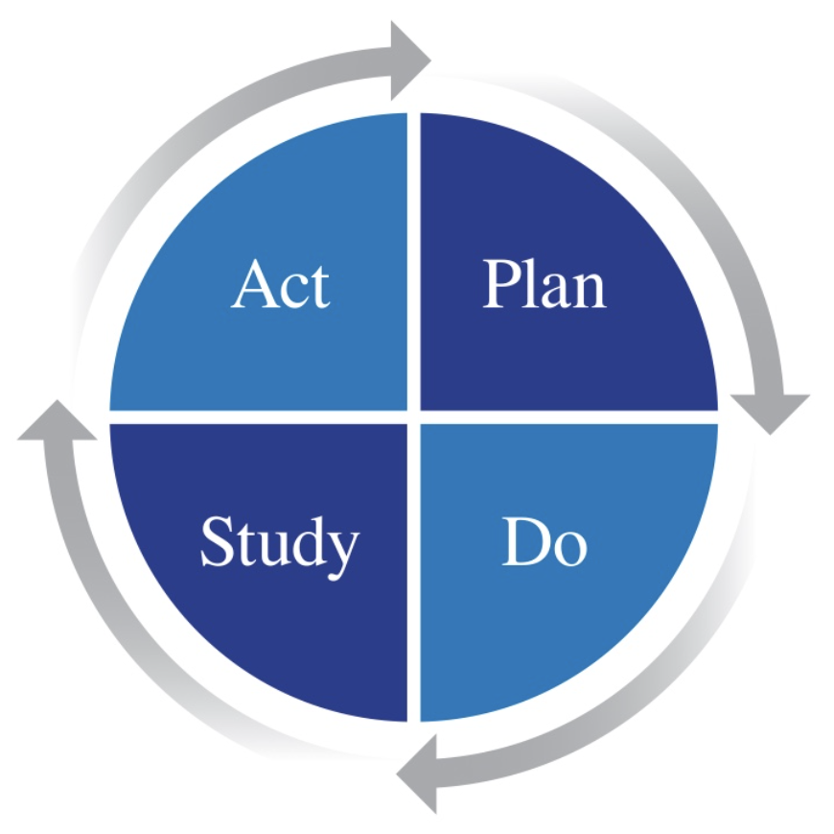
PDSA Cycles Small Tests of Change
PDSA Cycle # | Change Idea
1 | Label and number each PDSA cycle. Provide a short descriptive “headline” for each.
2 a- d | Huddles: tested different times of day, day of week, duration and interdisciplinary team member attendance.
3
4
5
Notes:
SLIDE SCRIPT:
INSTRUCTOR NOTES: The goal here is to demonstrate small tests of change, you will spend more time on your annotated run chart (on the next slide) to discuss specific PDSAs more thoroughly. You could even “bundle” similar tests of change, for instance line 1 could be PDSA number 1A-D (bundling the change ideas related to a specific process of interest. This slide, at a glance outlines the iterative “tests” of change for your work. Your next slide, the run chart or SPCC will be annotated with PDSA cycles – so do not go into great detail here. Overview – then details.
Timing: 30 seconds

Slide 9
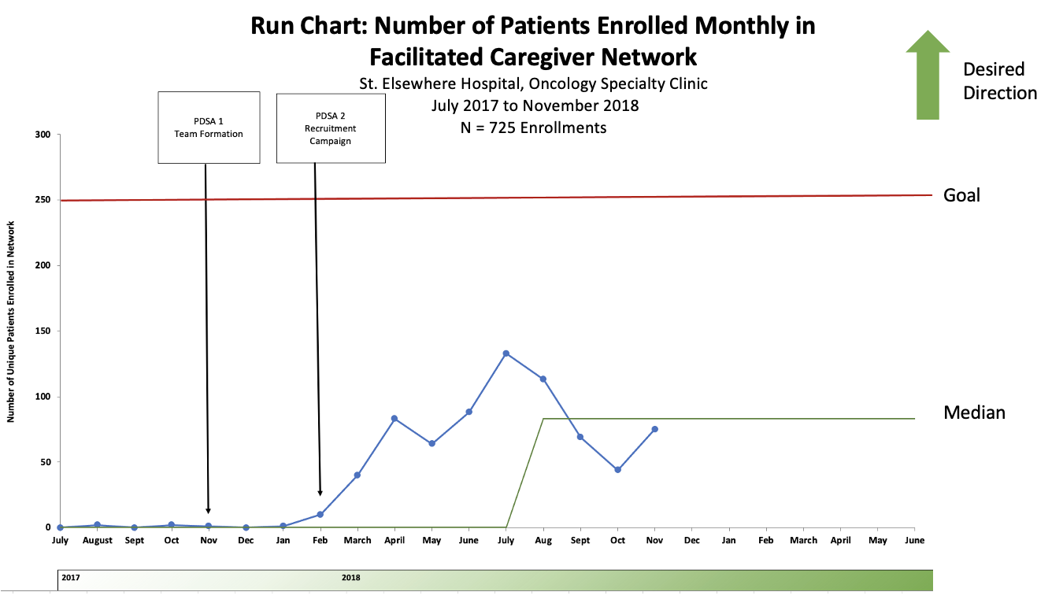
Notes:
SLIDE SCRIPT:
INSTRUCTOR NOTES:
You will spend most of your time on THIS SINGLE slide. Your Annotated Run Chart or Statistical Process Control Chart provides your audience an immense amount of information about the work you conducted overtime. If you only have a few minutes to pitch or inform others about your work –it would be THIS slide—as it tells your entire improvement story in ONE view.
You will insert your run chart or SPCC for the main outcome measure you have the best data for here
Be sure it is annotated with your PDSA cycles.
The chart should be interpretable at-a-glance but we encourage you to take your time to explain the chart to orient your audience. For example:
This is a run chart tracking X conducted in Y from Date to Date.
The desired direction of our AIM is up or down.
You will note that the Y axis is your main outcome measure and
The X axis demonstrates the data plotted [weekly/monthly] over time
Call out your aim or goal line and median line
Spend time talking about specific PDSAs that drove your data in the desired direction and also where your tests of change did NOT go in the predicted direction.
TIMING: 2 minutes

Slide 10
Key Lessons Learned
Insert lessons learned to date here which other teams may benefit from learning from
Bold certain words to draw attention to
……….
………
Notes:
SLIDE SCRIPT:
INSTRUCTOR NOTES:
Insert lessons learned to date here which other teams may benefit from learning from
You may want to bold certain words to draw attention to key actions or lessons
Lessons may include barriers that you overcame or wins that came easier than anticipated or some surprises or delights along the way that may help others
Remember as part of a learning collaborative we are here to all teach and all learn together.
Timing: 30 seconds

Slide 11




Next Steps: [insert a phrase here to build momentum of your work!]
Take creative liberties to highlight next steps to achieve your aim statement on this slide.
Use images, icons, etc.
To change icons, left click then right click the icons to see selection of options
Notes:
SLIDE SCRIPT:
INSTRUCTOR NOTES: This slide continues the momentum of the work to date and the work that lies ahead to achieve your Aim. If you have achieved your aim it may be time to revisit your aim and develop a new aim statement to continue your improvement journey or work on plans to systematically spread and scale the work. Have a little fun and get creative with this slide!
Timing: 30 seconds

Slide 12
Grateful for the Support of Many
Insert list of team members engaged in your learning journey on achieving your aim
Include a statement recognizing the patients and families at your practice
Insert a team photo here
Include Senior leaders within your organization
Notes:
SLIDE SCRIPT:
INSTRUCTOR NOTES: This final slide allows you to recognize your team for which this work would not be possible. You could also include patients and families to recognize their contributions here as well. This recognition is important and always well received.
Timing: 30 seconds

