Slide 1
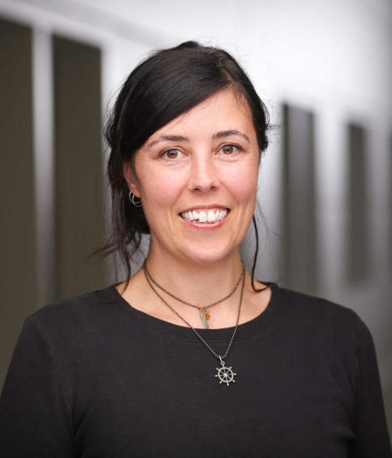


Data Driven Improvement Story
Alice Kennedy, MPH
Research Project Director
The Dartmouth Institute
Last modified 12/5/2023
Notes:
SLIDE SCRIPT:
Hello, my name is Alice Kennedy, I’m a Research Project Director with The Dartmouth Institute for Health Policy and Clinical Practice at Giesel School of Medicine at Dartmouth. I’m here to share an installment of the IBD Qorus Quality Improvement Curriculum, brought to you through a partnership of The Crohn’s & Colitis Foundation and The Dartmouth Institute. The purpose of this lesson is to introduce you to the steps to develop a structured, data-driven improvement story — because quality improvement work is not complete until it is shared!
TIME: 30 seconds

Slide 2
Learning Objectives
Identify
Identify the key elements of a structured data-driven improvement story.
Develop
Develop a compelling QI story by using a 12-step template.
Recognize
Recognize the multiple ways your improvement story can be used.
Notes:
SLIDE SCRIPT:
By the end of this session, you will be able to:
Identify the key elements of a structured data-driven improvement story;
Be able to easily develop a compelling QI story by using a 12-step template; and
Recognize the multiple ways your improvement story can be used.
TIME: 30 seconds

Slide 3
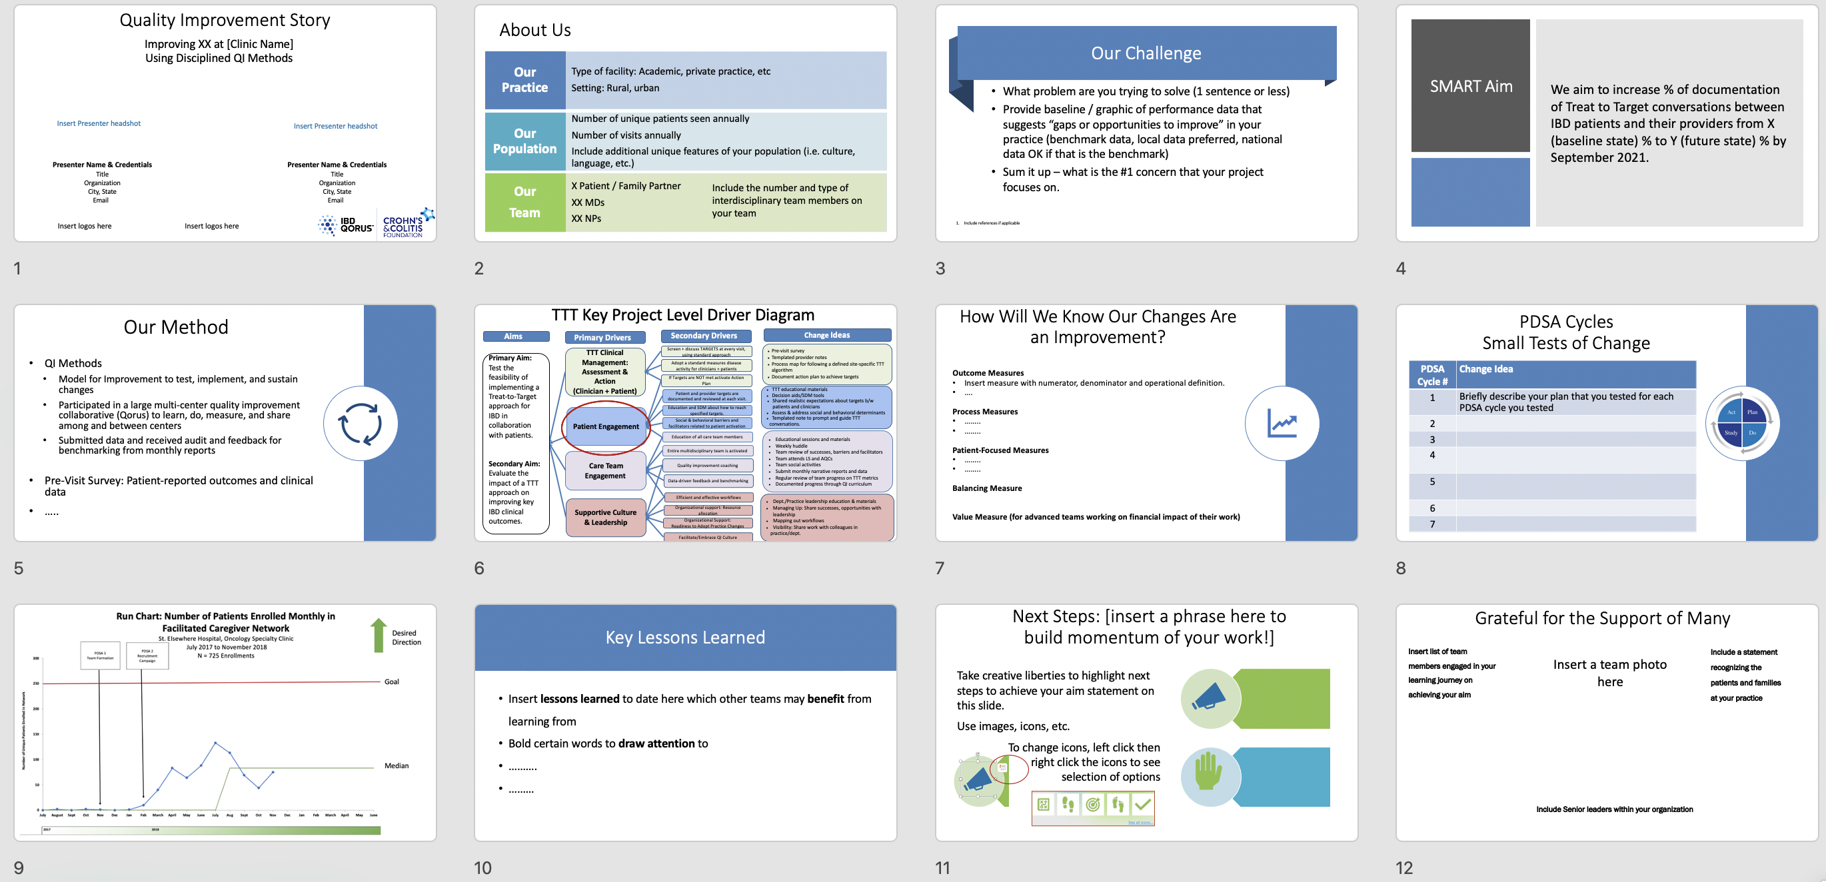
12-Slide Quality Improvement Story
Notes:
SLIDE SCRIPT:
This is a snapshot of the layout of an improvement story--12 slides in 10 minutes--it is possible! As I walk you through the key elements ---I want you to think about the improvement work you have already completed and see how you could easily start to populate this standard template with your own improvement story.
TIME: 25 seconds

Slide 4
Improving XX at [Clinic Name]
Using Disciplined QI Methods
Quality Improvement Story
Insert Presenter headshot
Insert Presenter headshot
Presenter Name & Credentials
Title
Organization
City, State
Email
Presenter Name & Credentials
Title
Organization
City, State
Email
Insert logos here
Insert logos here
Notes:
SLIDE SCRIPT:
We will provide a standard template for you and your team to populate with your local details.
There are suggested presentation times on each slide.
This slide introduces your improvement work, your team and your organization.
Be sure to recognize the larger interdisciplinary team that is behind all of the good work you are presenting.
TIME: 25 seconds

Slide 5
About Us
Our Practice
Number of unique patients seen annually
Number of visits annually
Our
Team
X Patient / Family Partner
Include additional unique features of your population (i.e. culture, language, etc.)
Our Population
Type of facility: Academic, private practice, etc
Setting: Rural, urban
XX MDs
XX NPs
Include the number and type of interdisciplinary team members on your team
Notes:
SLIDE SCRIPT:
This next slide helps set the context for your audience. This gives you an opportunity to describe your practice, the population you serve and the population you are focusing on for the purpose of this quality improvement project. You also can highlight your interdisciplinary team including patient and family partners as members of your improvement team.
TIME: 20 seconds

Slide 6
Our Challenge
Problem statement
OR
Data display that illustrates the opportunity to improve in your practice
Notes:
SLIDE SCRIPT:
This slide represents a brief and impactful statement to get at the what and why of the challenge you are working on. This could include a statement or a visual representation of the challenge. It might include data.
In 30 seconds or less you should be able to easily summarize the challenge you are working on. Think of this as your elevator pitch.
TIME: 25 seconds

Slide 7
SMART Aim
We aim to increase % of documentation of Treat to Target conversations from X (baseline state) % to Y (future state) % by September 2024.
Notes:
SLIDE SCRIPT:
Your SMART Aim Statement, connected to a driver from the Treat to Target Key Driver Diagram, informs your audience of what your local team is specifically working towards. Be sure to define operational definitions as needed here as well for your audience.
TIME: 15 seconds

Slide 8

Our Methods
QI Methods
Data Collection Methods
Notes:
SLIDE SCRIPT:
For your methods you will describe (at a high level) what were the methodologies you used to address the challenge and achieve your aim.
You may include QI methodologies such as
The Model for Improvement
PDSAs
Run charts
Participation in a learning collaborative
You can also describe your data collection methods such as
Pre-visit surveys
Tick and tally tracking
TimE: 25 seconds

Slide 9
TTT Key Project Level Driver Diagram
Aims
Primary Drivers
Secondary Drivers
Change Ideas
TTT Clinical Management: Assessment & Action
(Clinician + Patient)
Screen + discuss TARGETS at every visit, using standard approach
Pre-visit survey
Templated provider notes
Process map for following a defined site-specific TTT algorithm
Document action plan to achieve targets
Primary Aim:
Test the feasibility of implementing a Treat-to-Target approach for IBD in collaboration with patients.
Secondary Aim:
Evaluate the impact of a TTT approach on improving key IBD clinical outcomes.
Adopt a standard measures disease activity for clinicians + patients
If Targets are NOT met activate Action Plan
Patient and provider targets are documented and reviewed at each visit.
TTT educational materials
Decision aids/SDM tools
Shared realistic expectations about targets b/w patients and clinicians
Assess & address social and behavioral determinants
Templated note to prompt and guide TTT conversations.
Patient Engagement
Education and SDM about how to reach specified targets.
Social & behavioral barriers and facilitators related to patient activation
Education of all care team members
Educational sessions and materials
Weekly huddle
Team review of successes, barriers and facilitators
Team attends LS and AQCs
Team social activities
Submit monthly narrative reports and data
Regular review of team progress on TTT metrics
Documented progress through QI curriculum
Entire multidisciplinary team is activated
Care Team Engagement
Quality improvement coaching
Data-driven feedback and benchmarking
Efficient and effective workflows
Dept./Practice leadership education & materials
Managing Up: Share successes, opportunities with leadership
Mapping out workflows
Visibility: Share work with colleagues in practice/dept.
Supportive Culture
& Leadership
Organizational support: Resource allocation
Organizational Support:
Readiness to Adopt Practice Changes
Facilitate/Embrace QI Culture
Notes:
SLIDE SCRIPT:
You will also include the Key Driver Diagram for your project to illustrate the drivers you and your team are working on by dragging the circle to highlight which portion(s) of the KDD you are focused on. For instance, this example indicates that this team is primarily focused on clinical management– particularly, screening and discussing targets at every visit using a standard approach – the pre-visit survey.
NOTE: Your team should call out the key drivers that your SMART AIM focuses on.
TIME: 20 seconds

Slide 10

How Will We Know Our Changes Are an Improvement?
Outcome Measures
Insert measure with numerator, denominator and operational definition.
….
Process Measures
……..
……..
Balancing Measures
……..
……..
Notes:
SLIDE SCRIPT:
This slide is your measurement strategy at a glance.
Use a table of measures or bullets to outline your key measures from your monthly reports as well as any local measures you may be collecting. At a high level you will tell your audience what you measure, how you defined it, how you are reporting the measure (ie proportion, percentage, etc.) and frequency of data collection.
TIME: 30 seconds.

Slide 11
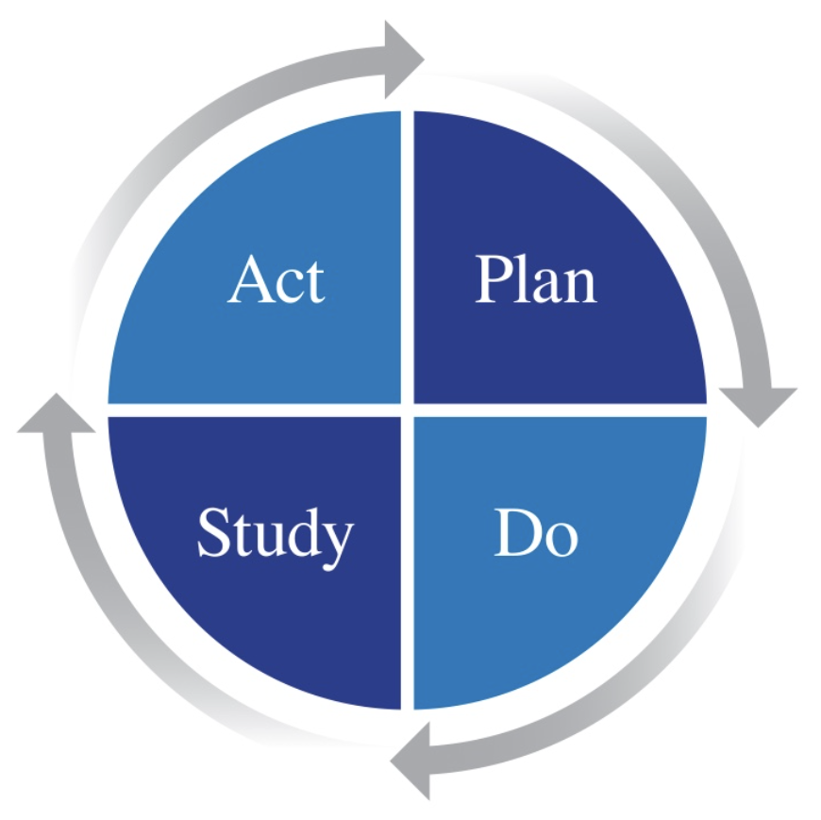
PDSA Cycles
Small Tests of Change
PDSA Cycle # | Change Idea
1 | Improvement team formed
2 a-d | Huddles: tested different times of day, day of week, duration and interdisciplinary team member attendance.
3
4
5
Notes:
SLIDE SCRIPT:
The goal of this slide is to show the multiple change ideas you’ve been testing. You won’t spend a lot of time on this slide. On the next slide, you’ll be showing how the PDSAs impacted your outcome of interest.
Over time you and your team will have run multiple PDSAs and you may run out of room on one slide to demonstrate all of your work. When you get to that point, you can bundle similar tests of change.
For instance, if you ran multiple PDSAs on team huddles, rather than documenting 4 separate PDSAs, you could bundle them into one line to indicate you spent PDSA 2 on multiple iterations of huddle testing.
TIME: 30 seconds

Slide 12
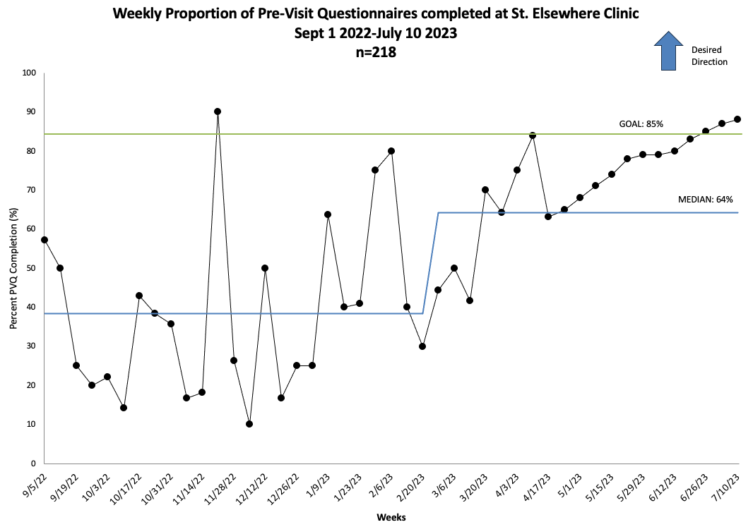
Run Chart
PDSA 1
PDSA 2
Notes:
SLIDE SCRIPT: Here is your run chart, annotated with PDSAs from the previous slide.
When presenting, you will spend most of your time on this single slide. Your Annotated Run Chart or Statistical Process Control Chart provides your audience an immense amount of information about the work you conducted overtime. If you only have a few minutes to pitch or inform others about your work –it would be THIS slide—as it tells your entire improvement story in ONE view.
You will insert your run chart or SPCC for the main outcome measure you have the best data for here
Be sure it is annotated with your PDSA cycles.
The chart should be interpretable at-a-glance but we encourage you to take your time to explain the chart to orient your audience. For example:
This is a run chart tracking X conducted in Y from Date to Date.
The desired direction of our AIM is up or down.
You will note that the Y axis is your main outcome measure and
The X axis demonstrates the data plotted [weekly/monthly] over time
Call out your aim or goal line and median line
Spend time talking about specific PDSAs that drove your data in the desired direction and also where your tests of change did NOT go in the predicted direction.
TIMING: 2 minutes

Slide 13
Key Lessons Learned
Insert lessons learned to date here which other teams may benefit from learning from
Bold certain words to draw attention to
……….
………
Notes:
SLIDE SCRIPT:
As we wrap up the improvement story, you will share your lessons learned to date.
You may want to bold certain words to draw attention to key actions or lessons
Remember that as part of a learning collaborative we are here to all teach and all learn together.
TIME: 30 seconds

Slide 14




Next Steps: [insert a phrase here to build momentum of your work!]
Take creative liberties to highlight next steps to achieve your aim statement on this slide.
Use images, icons, etc.
To change icons, left click then right click the icons to see selection of options
Notes:
SLIDE SCRIPT:
This slide continues the momentum of the work to date and the work that lies ahead to achieve your Aim. If you have achieved your aim it may be time to revisit and develop a new aim statement to continue your improvement journey or work on plans to systematically spread and scale the work. Have a little fun and get creative with this slide!
TIME: 20 seconds

Slide 15
Grateful for the Support of Many
Insert list of team members engaged in your learning journey on achieving your aim
Include a statement recognizing the patients and families at your practice
Insert a team photo here
You may want to include senior leaders within your organization
Notes:
SLIDE SCRIPT:
This final slide allows you to recognize your team including patients and families to recognize their contributions to the work.
INSTRUCTOR NOTES: Pause for questions
TIME: 15 seconds

Slide 16
Using One Story Many Times & Many Ways!
ACADEMIC
MOC Credits Engagement Score All Teach-All Share
Early Pilot Data
Abstracts for Conferences
Manuscripts
Expand Participation Secure Support Third-Party Payers
LOCAL
QORUS COLLABORATIVE
Notes:
SLIDE SCRIPT:
Your 12-slide improvement story can be used in many ways including:
QORUS USE
Receiving annual MOC credits
To assess engagement in the QI collaborative. AND
Allows you to learn, do, measure, and share with other Qorus sites.
At the LOCAL level. You can
Share your story with your team and those within your practice to get others curious and engaged in the work. For instance, posting your run chart in the break room or incorporating it into your huddles or team meetings—are ways to keep others informed of your work and keep an eye on your primary measures and aim.
You could also use the improvement story to report up to senior leaders in your organization demonstrating the value of your QI efforts to garner support and resources
Finally, you could share your results with third-party payers to demonstrate your investment in cost-effective and quality care.
For those that are interested, you could also
Use your run chart data as pilot data to pursue funding opportunities
You could submit your improvement story as an abstract for professional conferences and
Elevate your results to a publishable manuscript.
I hope you see the value of building and telling your story – and how easy it can be using this template.
TIME: 80 seconds

Slide 17
Summary
There are 12 components to a data-driven improvement story that align with the QI curriculum and the standard work related to your participation in IBD Qorus.
The improvement story is a tool that teams can use to develop a compelling story.
The improvement story can be used for multiple purposes including earning Maintenance of Certification credits, garnering local engagement and support, and for academic pursuits.
Notes:
SLIDE SCRIPT:
In summary the most important take home message ...read slide
TIME: 30 seconds

Slide 18

References
Ogrinc G, Davies L, Goodman D, et al SQUIRE 2.0 (Standards for QUality Improvement Reporting Excellence): revised publication guidelines from a detailed consensus process BMJ Quality & Safety 2016;25:986-992.
Stevens DP, Marshall BC Healthcare improvement is incomplete until it is published: the cystic fibrosis initiative to support scholarly publication BMJ Quality & Safety 2014;23:i104-i107.
Notes:
SLIDE SCRIPT:
Here are some resources for you to explore, that may be found in the supplemental lesson materials.
INSTRUCTOR NOTES:
If you will be coaching others you will find reviewing at least these brief resources will enrich your learning and help you meet your team’s needs more completely.
Also, it is often important to share these resources with eager or more advanced learners on your QI team may help you to meet their learning needs.
TIME: 30 seconds

Slide 19
Next Steps
ACTIVITY | MATERIALS
Review Steps to Develop a Data Driven Improvement Story lesson and share with key members of your team | Microlesson powerpoint
Spread the word about MOC credits across your practice as a benefit of engaging in your improvement work | Microlesson powerpoint: MOC Made Simple slides
Start building your Data Driven Improvement Story | Data Driven Improvement Story Template
Review MOC Attestation Form to be completed and submitted in the Fall along with your current Data Driven Improvement Story | Attestation Form
TEAM FORMATION
Notes:
SUGGESTED SLIDE SCRIPT:
If the Collaborative is currently in an Action Period of an Improvement Initiative, you may be asked to take some next steps at this time, such as [Read Slide]
Check with IBD Qorus Leadership to see what next steps are right for you!
INSTRUCTOR NOTES:
TIME: 30 seconds

