Slide 1
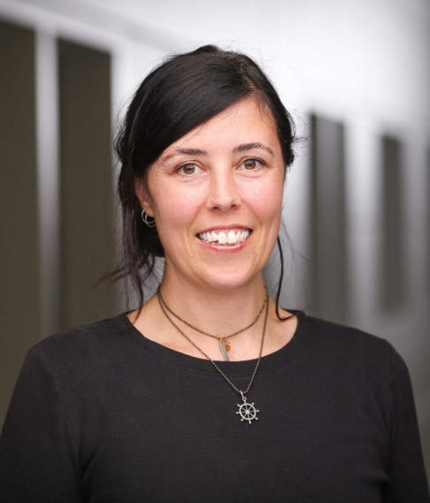


Foundations for High Performing Teams, Pt. 1
Alice Kennedy, MPH
Research Project Director
The Dartmouth Institute
Last modified 12/5/2023
Notes:
SLIDE SCRIPT:
Hello, my name is Alice Kennedy, I’m a Research Project Director with The Dartmouth Institute for Health Policy and Clinical Practice at Giesel School of Medicine at Dartmouth. I’m here to provide you with an installment of the IBD Qorus Quality Improvement Curriculum, brought to you through a partnership of The Crohn’s & Colitis Foundation and The Dartmouth Institute. This lesson is called Foundations for High Performing Teams Part 1 and the purpose of this lesson is to integrate principles from team science to improve the performance of multidisciplinary teams, like yours, engaged in improving quality.
TIME: 30 seconds

Slide 2
Learning Objectives
Compare and Contrast
Compare and contrast a team versus a work group.
Review
Review the evidence for the impact of teamwork on healthcare outcomes.
Recognize
Recognize the 4 classic stages of team development.
Identify
Identify some best practices that can help a team become high performing.
Notes:
SLIDE SCRIPT:
We have 4 learning objectives for today that include:
Presenter simply reads the learning objectives.
TIME: 1 Minute

Slide 3

Is this group appropriately classified as a team?
A. Yes
B. No
C. I’m not quite sure . . . .
Notes:
OPTIONAL SLIDE:
Slide Script:
Please take a moment to reflect on this group (the one assembled here) or the group you work with most frequently. And answer this question with them in mind (read poll question from slide).
Instructor Notes: This poll serves as a tool for engagement. It is also a bit of a “pre-test”. Poll should be built into Zoom, or Poll Everywhere. Let the results come in, thank the participants, make no judgements, and invite them to move through the lesson to probe this thinking further. If polling is unavailable, you could use the chat feature or raise of hands as well.
TIME: 45 seconds MAX. Don’t linger here – move on quickly.

Slide 4
Work Groups vs. Teams
Katzenbach JR, Smith DK. The Discipline of Teams. Harvard Business Review. March-April 1993.
Work Groups
Teams
Strong, clearly focused leader
Individual accountability
Individual work-products
Runs efficient meetings
Measures its effectiveness indirectly (e.g., financial performance of the business)
Discusses, decides, and delegates
Shared leadership roles
Individual and mutual accountability
Collective work products
Encourages open-ended discussion and active problem solving meetings
Measures performance directly by assessing collective work-products
Discusses, decides, and does work together
Notes:
Script:
Not all work groups are teams, in fact the word team is woefully over-utilized. Let’s compare and contrast key behaviors of a work group vs a team.
Instructor Notes: Presenter reads work group characteristics and behaviors and pauses . . . . Allow the content to resonate. Then move on to the key behaviors and characteristics of a team, again with pause for reflection.
Script Summary Statement: A team is characterized by shared leadership roles; different situations may require different individuals to lead. Team members need to practice both “leadership” skills and “follow-ship” skills. These concepts transcend roles and apply to front-line clinical providers, to administrators, and to researchers
TIME: 3 Minutes

Slide 5

Definition of a Team
“a small number of people
with complementary skills
who are committed to a common purpose,
a common set of performance goals, and a common approach
for which they hold themselves mutually accountable.”
Katzenbach JR, Smith DK. The Discipline of Teams. Harvard Business Review. March-April 1993.
Notes:
SLIDE SCRIPT:
Let’s begin by establishing a common definition of a team. Read quote, with emphasis.
INSTRUCTOR NOTES: This classic definition comes from an oft-quoted paper in the Harvard Business Review by seminal team guru Katzenbach. A “must read” for coaches.
TIME: 1 minute

Slide 6
Is this group appropriately classified as a team?
A. Yes
B. No
C. I’m not quite sure . . . .
Notes:
OPTIONAL SLIDE:
SLIDE SCRIPT: Reflecting on our learning is this group appropriately classified as a team?
INSTRUCTOR NOTES: If you can note verbally how the distribution shifted.
TIME: 45 seconds

Slide 7

Improving Quality
Requires the Work of Teams www.nytimes.com/2016/02/28/magazine/what-google-learned-from-its-quest-to-build-the-perfect-team.html
Notes:
SLIDE SCRIPT: Improving quality will never happen from the top down. It always requires the work of teams. WHY? One of the foundations of improvement is appreciating the distributed knowledge that it takes to make the system work and improve upon it. Teams develop a collective “wisdom” and a collective I.Q. (A. Wooley, Carnegie Mellon’s work).
Ideally, every team member should be practicing at the TOP of their license and/or role capabilities. Not doing so creates waste in the system, by underutilizing knowledge, skills, and capabilities. It also creates disengagement and decreases satisfaction.
Unfortunately, particularly in healthcare, traditional hierarchies, and local culture sometimes inhibits that vision! As you are called to join and/or lead a new team, you have an exciting opportunity to influence the culture, behaviors and performance of the team, and to influence the outcomes of patients and families we serve. It is critical to invest the time and energy “up front” to get your team off to the right start. The Team Lesson toolkit, has numerous resources to help you launch and learn how best to work together.
TIME: 1.5 minutes

Slide 8
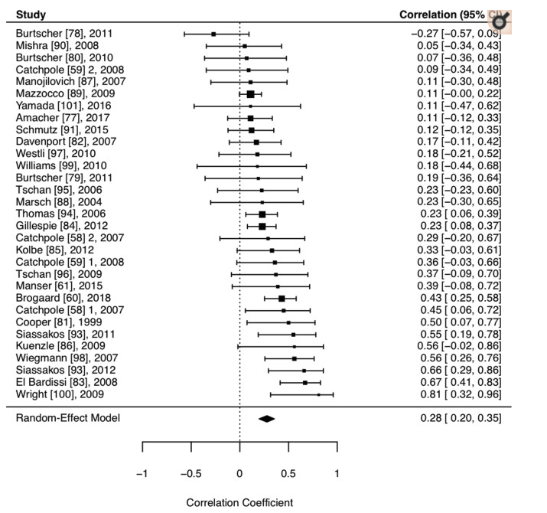
Forest Plot
Meta-Analysis of Teamwork and Performance
Schmutz JB, Meier LL, Manser T. How effective is teamwork really? The relationship between teamwork and performance in healthcare teams: a systematic review and meta-analysis. BMJ Open. 2019; (9): Sep 12.
Outcomes Worsen Outcomes Improve
Analysis of 31 studies and 1390 teams
Improved patient outcomes
Decreased costs
Improved coordination
Notes:
SLIDE SCRIPT:
There is strong evidence that teamwork plays a role in improving both the quality of care, experience of care, costs of care, as well as improving joy in work. This paper published in BMJ in 2019 is a systematic review and meta-analysis of teamwork in healthcare. They analyzed:
31 healthcare studies across a wide variety of settings and conditions
The 31 studies included a total of 1390 healthcare teams.
This Forest plot examines the correlation between clinical outcomes (did they get worse? or improve?) and teamwork. The evidence presented on this slide suggests that across a wide variety of settings and conditions teamwork had a measurable impact (animate slide to SHOW the improved outcomes) on improving patient outcomes (quality), decreased cost likely because of better quality decisions (the wisdom of the team), and better coordination of complex tasks.
TIME:1 minute if no deeper explanation needed for audience of MDs, APPs, or researchers. 2-3 minutes could be required for audience that wants / needs to have a deeper understanding of what this data means.
INSTRUCTOR NOTES: Many will “get it” at first glance. For those without prior exposure to meta-analysis, you may want to take a moment to explain the Forest Plot, BUT avoid the pitfall of going too deep here.
Forest Plot Background – a Deeper Dive for Coaches / Presenters:
When looking at a Forest Plot remember that it combines outcomes from numerous studies (listed under study). It places a “dot” on the outcome. The size of the dot is larger in studies with larger sample sizes. The “dot” is surrounded by two lines (or arms) extending to the left or the right. These are the confidence intervals of the data (listed under the correlation column) which essentially is a visual representation of our level of confidence that the results represent a “real” correlation between teamwork and improved outcomes.
Wide confidence intervals, suggest wider variation in the data, and therefore make you a bit less confident in the study (often related to small sample sizes, or simply random effects). Narrow confidence intervals, are seen here in the 4 studies with the larger dot. This suggests that larger sample sizes, provided increased confidence in the results that improved teamwork improved outcomes. It also provides some clue into the sample size that might be needed to study an intervention in the future.
You can also note the that preponderance of the evidence, (the dots) are in the improved outcomes category (all but 1), providing further evidence that teamwork matters. The final finding on a Forest plot is the DIAMOND. When all the effects are added together, the Forest plot represents this summative data on a line called the Random Effects Model with a diamond, and in this case, it suggests that when analyzed together the studies support that teamwork improves outcomes.

Slide 9
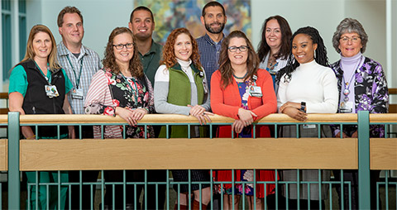
Potential Members for Your Quality Improvement Team
Physicians | Fellows
Nurses | Nurse Navigators
PAs | ARNPs
Medical Assistants | Schedulers Front Office Staff
Clinic Leader s Office Managers | Patient & Family Partners
PharmD | Social Workers
Dieticians | EMR Epic Data Support
Senior Leaders Project Sponsor | Others?
Who Should Be on Your Improvement Team?
NOTE: Choose only the key roles that relate to your project focus.
Notes:
SLIDE SCRIPT: An interdisciplinary team engaged in action is one of the most powerful forces to drive innovation and/or improvement. There are 4 'steps' in thinking about this team.
Step 1. The first and most important step of any successful QI or innovation project is the assembling and “drafting” the team. The composition of the teams should be customized to the task / improvement effort at hand. The Team Foundations lesson toolbox, has a team roster to trigger your thinking and help you organize your team. We provide examples here to prompt you to consider the potential members that will support your QI project.
Step 2. Consider the system that will be affected by / or could influence the long-term success of this work. Assure that the QI “team” includes interdisciplinary members who are familiar with all parts of that process; this may include leveraging system leadership, data and technical expertise, and day-to-day leadership.
Step 3. Assure the team has a combination of “front-line” workers in addition to physicians, nurses, NPs, social workers and unit leaders / administrators. Don’t forget support role team members who have unique insight to the process and/or can help improve it. Effective teams are typically 5-8 people; some stakeholders may contribute to the project on an intermittent or ad hoc or advisory basis.
Step 4. Every team benefits from a patient and/or family perspective. Strive to include patients and families, making sure they are imbedded in the team and treated as “full-fledged” members of the team. They may benefit from extra support in the team launch stages.
Instructor Notes: In a workshop setting, or session where more time is allowed, you could build in a 10-minute activity, focused on filling out the team roster, with time for sharing, learning and coaching. In the micro-lesson setting, you will assign the group to complete the team roster exercise off-line and to share the team roster with their QI Coaching team.
TIME: 3 Minutes

Slide 10
4 Classic Stages of Team Development
PERFORMING
NORMING
FORMING
EFFECTIVENESS OF TEAM
STORMING
TIME
Adapted from: BW Tuckman (1965), Developmental Sequence in Small Groups, Psychological Bulletin 63.
Notes:
Slide Script: Teams often proceed through 4 classic stages of development and evolution, these stages are forming, storming, norming and performing. This visual demonstrates how team effectiveness changes over time through these developmental stages. It is important to note that although this is displayed as a line, teams can move in both directions over time. Today we will focus on the first 2 stages: forming & storming.
In a subsequent lesson we will discuss norming and performing.
TIME: 30 seconds

Slide 11
Team Stages: The Path to a High Performing Team
Forming
Storming
Norming
Performing
1. Develop a clear and compelling aim
2. Pay attention to psychological safety
3. Develop a charter and use this as a living document to guide your work
1. Team co-develops rules of engagement
2. Ongoing open dialogue on working together effectively
3. Conduct small tests of change (PDSAs)
Team moves from cooperation to true collaboration
1. Progress toward aim
2. Engagement & joy in work
3. No longer dependent on the “leader” all teach, all learn together
Notes:
Slide Script: The first step - forming – as we know that getting off to a good start is critical to the success of a team. At this early stage, team members are positive and polite and perhaps a bit anxious or worried about the work that lies ahead. The goals at this phase include: READ SLIDE
During the Forming stage, the team should consider:
the key roles are invited and respected; and members understand their role and value to the team.
Include patient & family partners early on; team leader should position patient partners as full members of the team
The team kick-off meeting and agenda setting is critical and teams should answer the “so what and so why” questions of the work ahead
Insert Story / Example / Case Study Here: In Google’s quest to build the perfect team, called the Aristotle Project they studied 100s of teams and analyzed consistent evidence for team success. They found that the “launch” or formative phase of a team actually sets the course for the team’s success. Two teams with very similar starting conditions can end up with completely different levels of functioning and outcomes due to very slight differences in how they begin. One of the key lessons here is creating psychological safety for each member of the team.
Step 2 is “Storming” which is the stage where team members are moving from being from polite to conflict. Different work styles and approaches to problems may arise and there may be confusion on the aims. The goals at this phase include: READ SLIDE
During the norming stage, teams may consider:
Icebreakers to build trust and understanding.
Discover and acknowledge different work styles amongst team members
Acknowledge that confusion on project aims is normal and continue to use or refine your SMART aim and charter to provide focus and clarity
In summary, conflict is normal and healthy but should be managed.
Take a quick peek at how the team will evolve, over time, to generate success. (open animations for norming and performing). Norming (read slide) and Performing (read slide).
ONLY If this comes up in your session:
Tips for NORMING:
Growing appreciation for differences and shared mental models
New ways of working (Timekeeping, standard agendas, meeting expectations adopted, and routine data feedback loop);
Increased participation across multiple roles in the group; more comfortable with controversy; infusing some fun!
Tips for Performing:
Team measures their collective performance; commitment and pride growing.
Team discusses, decides and does real work together
Team holds themselves and each other accountable
Celebrates small wins and infuses some FUN!
Let’s take a look at some strategies that high performing teams use.
Instructor Notes: If time allows, you could connect back to Project Aristotle. They demonstrated that how teams “start up” and how they organize and set group norms, expectations and traditions in the early phases, are a big predictor of their success. Technology roll-out projects are particularly sensitive to this. Tools are designed, developed and rolled out (a first round win) and then subject to failure for lack of use, or failure to learn from the data they generate.
TIME: 2 MINUTES

Slide 12
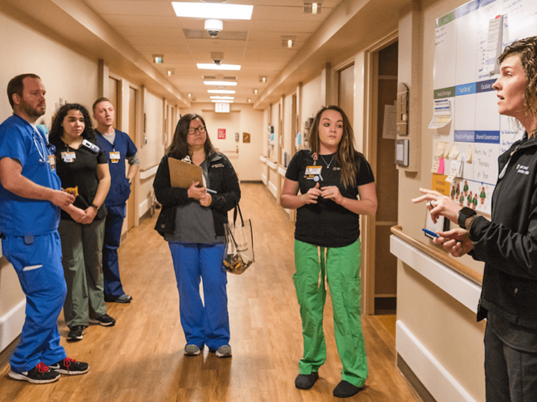
Never Underestimate the Power of
Team Huddles
Notes:
Slide Script:
Many teams find that regularly scheduled rapid fire quick team huddles are effective in promoting teamwork and driving their goals. Please be sure to check out the huddle video which shows teams in action.
Remember that team huddles are short (10 minutes or less) and typically conducted “standing” on the shop floor. Huddles align team members, and typically focus on the task of the day (i.e. what PDSA are we testing today to enroll more patients). Huddles should include the whole team, whenever possible, to help to align and sync the work. Huddles are a great place to get quick answers, to share quick updates or reminders (for example: we are slipping on patient enrollment), and to give quick shout-outs. Bigger challenges are identified and “parked” for the longer team meeting agenda.
A best practice is for QI teams to have daily huddles and weekly QI team meetings and monthly “all staff” meetings with QI teams reporting in – see what works for your context.
TIME: 60 seconds

Slide 13
Effective Meeting Skills
Leader
Co-creates the agenda; leads icebreakers
Uses agenda to structure discussion and decision-making; brings in all voices
Debriefs with team: what went well, what can be improved?
Encourages shared leadership opportunities.
Expresses gratitude and shout-outs!
Recorder
Takes notes
Clarifies actions and key decisions
Reviews next steps at the end
Disseminates action items
Meeting Participants
Review agenda & come prepared.
Meet deliverables.
Ask curious questions, promote participation.
.
Timekeeper
Patient / Family Partner
Asks important clarifying questions
Shares patient and family perspectives
Provides an alternate “lens” and suggestions
Provides periodic time checks
May suggest parking lot items
Keeps team on time
Notes:
Slide Script: Speaking of that longer, less frequent, team meeting - that requires some skill building as well:
Effective meetings require a clear and focused agenda (with time allocations for each agenda item);
Some agenda items may come from the team huddle parking lot.
Send agenda before the meeting (whenever possible).
During the “forming” stage of development it is critical to agree on meeting ground rules and roles such as recorder, timekeeper, and leader.
At the outset of each meeting review roles and be sure that all understand their role and responsibilities (Read from slide).
The meeting notes / or record should focus on accountability and disseminate next steps in a who, what, where and by when format);
If you have enough team members, you can assign a facilitator to ensure all attendees have an opportunity to speak and that one person isn’t taking up all the time. The Leader can also play this role.
It is a good idea to rotate roles if possible, so that everyone gets an opportunity to practice each role.
Instructor Notes:
As you coach teams, you need to help them make a standard “time” as that is the critical space” to do real work. You can also help teams by modeling how to use the Model for Improvement in each meeting; frame your team meetings by revisiting the 4 key questions. Short, focused weekly meetings are ideal; however, for active improvement efforts meeting at least 2X month is necessary to gain momentum and imbed the discipline needed to achieve your SMART Aims.
TIME: 60 seconds

Slide 14
Visual Management Board
Share goals
PDSA cycles
Track measures overtime
Celebrate successes
Notes:
Slide Script:
One tool that many teams use to anchor their huddles AND meetings is a Visual Management Board. It allows the team to make their goals and work tangible, visible, and to share data and progress in real time. It is also a tool of engagement for other care team members not in the core of the improvement work but will be critical for uptake across a practice when you are ready to spread. It’s a powerful tool to build a culture of quality in your organization.
The VMB pictured here evolved over months and years and is a bit complicated. We suggest you start by sharing or posting your SMART aim and your run chart showing your data over time. You can also track your PDSA cycles right on your run chart so that anyone walking by would know what you are working on.
Instructor Notes: Point teams to the lesson materials with examples of VMBs, and link to video of use of a VMB.
TIME: 60 seconds

Slide 15
Summary
Not all working groups are teams, and it’s important to know the difference.
Forming
Storming
Norming
Performing
Highly effective teams meet regularly, have rhythm and discipline, and use huddles and meeting skills which may drive engagement and true joy in work!
Evidence supports improved team performance can positively impact
outcomes, cost, and care coordination.
High performing teams evolve over time, and we can anticipate 4 developmental stages.
Notes:
Slide Script:
In summary the most important take home messages focus on getting your team off to a good start and/or pragmatic tips to reset a team on a more productive and joyful course.
To reiterate: A team is a small number of people, with complementary skills who are committed to a common purpose, a shared set of performance goals, (think SMART AIM) and approach (think small tests of change or PDSA cycles, and data review) for which they hold themselves and each other accountable.
Read remainder of slide…
INSTRUCTOR NOTES: Infusing more joy into work is an important goal. Moving forward we will be measuring the wellbeing index and using an improvement readiness measure to measure some aspects of “teamness” over time.
TIME: 1 minute

Slide 16

Resources
BW Tuckman (1965), Developmental Sequence in Small Groups, Psychological Bulletin 63.
Katzenbach JR, Smith DK. The Discipline of Teams. Harvard Business Review. March-April 1993.
Schmutz JB, Meier LL, Manser T. How effective is teamwork really? The relationship between teamwork and performance in healthcare teams: A systematic review and meta-analysis. BMJ Open. 2019; (9): Sep 12.
TED Talk - Amy Edmondson – Why High Performing Teams are Critical (11:26) https://www.youtube.com/watch?v=7xpQmKRWN9k
Team Meetings – AMA Steps Forward Practice Toolkit (1:26) https://edhub.ama-assn.org/steps-forward/module/2702508#resource
DHMC Team Huddle (7:00)
https://www.youtube.com/watch?v=ykYUGZJP9Wo
Notes:
SLIDE SCRIPT:
Here are some resources for you to explore, that may be found in the supplemental lesson materials.
INSTRUCTOR NOTES:
If you will be coaching others, you will find reviewing at least these brief resources will enrich your learning and help you meet your team’s needs more completely. Also, it is often important to share these resources with eager or more advanced learners on your QI team may help you to meet their learning needs.
TIME: 30 seconds

Slide 17
Next Steps
ACTIVITY | MATERIALS
Review Foundations For High Performing Teams, Part One lesson and share with key members of your team | Teams Part One microlesson powerpoint
Develop team roster with the knowledge, skills and diversity to make the project successful | Team Roster template IHI’s QI team member matrix worksheet
Engage Patient & Family Partners | Lesson: Engaging Patient & Family Partners as Members of Your Quality Improvement Team; Sample Letters of Invitation
Invite team members to join the QI project and schedule a kick-off meeting | Team invitation examples Model for improvement handout SMART Aim and Charter Kick-off agenda
Set-up and conduct regular team meetings | Meeting agenda template and samples Meeting minutes template Example of Ground Rules
TEAM FORMATION
Notes:
If the Collaborative is currently in an Action Period of an Improvement Initiative, you may be asked to take some next steps at this time, such as [Read Slide]
Check with IBD Qorus Leadership to see what next steps are right for you!
TIME: 60 seconds

