Slide 1



Measurement Strategy
Interpreting the IBD Qorus QI Reports
Alice Kennedy, MPH
Research Project Director
The Dartmouth Institute
Last modified 12/5/2023
Notes:
SLIDE SCRIPT:
Hello, my name is Alice Kennedy, I’m a Research Project Director with The Dartmouth Institute for Health Policy and Clinical Practice at Giesel School of Medicine at Dartmouth. I’m here to share an installment of the IBD Qorus Quality Improvement Curriculum, brought to you through a partnership of The Crohn’s & Colitis Foundation and The Dartmouth Institute. This lesson marks the beginning of your journey into improvement measurement with the Qorus collaborative – during this session we will start to understand and interpret the reports you receive every month so you can turn your improvement measurement into action. In Quality Improvement, measurement is only helpful if it informs action.
TIME: 30 seconds

Slide 2
Today’s Session
Improvement Measurement
What are we measuring?
Qorus QI Reports
Basic SPC Interpretation
Notes:
SLIDE SCRIPT: There are four major segments to today's session: first we'll talk a little bit about what improvement measurement is and what it's not; then, we'll talk about what we measure in IBD Qorus and how we collect that data; then we'll talk about how we turn that data into information and get that information back to you in the IBD Qorus monthly QI reports and finally, an introduction to interpreting these reports to inform intelligent action whether that's for strategic planning, making the case that quality improvement is worth some funding support, or engaging your frontline teams in real time improvement.
INSTRUCTOR NOTES: CONSOLIDATE WITH SLIDE 2?
TIME: 60s

Slide 3
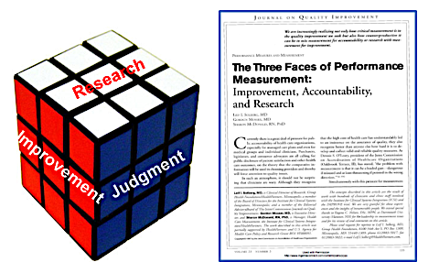
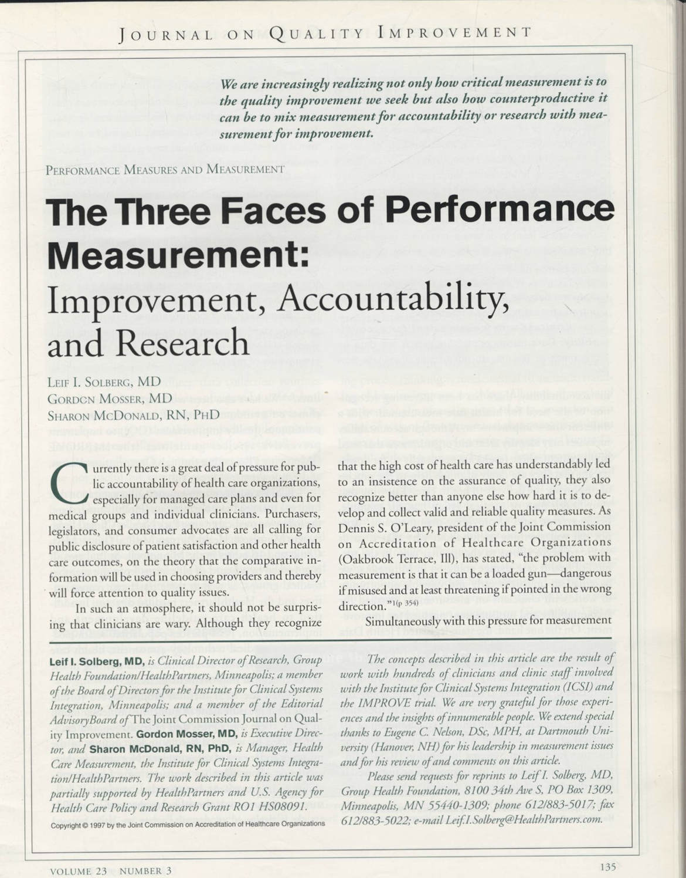
Three Faces of Measurement
Solberg LI, Mosser G, McDonald S. The three faces of performance measurement: improvement, accountability, and research. Jt Comm J Qual Improv. 1997 Mar;23(3):135-47. doi: 10.1016/s1070-3241(16)30305-4. PMID: 9103968.
Notes:
SLIDE SCRIPT: Let’s talk about how improvement measurement is different; improvement measurement is one of three major domains of measurement that can be employed in an empirical approach.
[ANIMATE]Many of you may be aware of the research approach, where we gather data to generate new generalizable knowledge and do inference testing to find out how things are associated. There is also measurement for judgment: are you meeting your performance goals for funding or are there any “never” events occurring in your organization. But the measurement on the left side [ANIMATE] of the Rubik's Cube is where we're going to be living - in this segment and also in our work – measurement for improvement. While measurement for improvement is separate from the other two types, the Rubik's Cube picture helps illustrate that it doesn't exist entirely separate from the other two types of measurement - just like in a Rubik's Cube all of the faces are connected in some way. For the sake of today’s discussion we're going to focus on improvement measurement which is unique in many ways from research and judgment-based measurement approaches in that its sole purpose is to study variation in real time and inform improvement quickly.
INSTRUCTOR NOTES: MAYBE ADAPT TO MEASUREMENT 101 RUBIK’S CUBE
TIME:

Slide 4
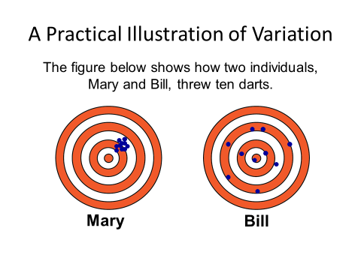
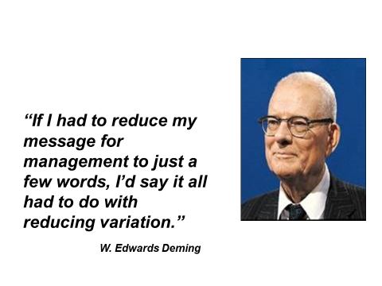
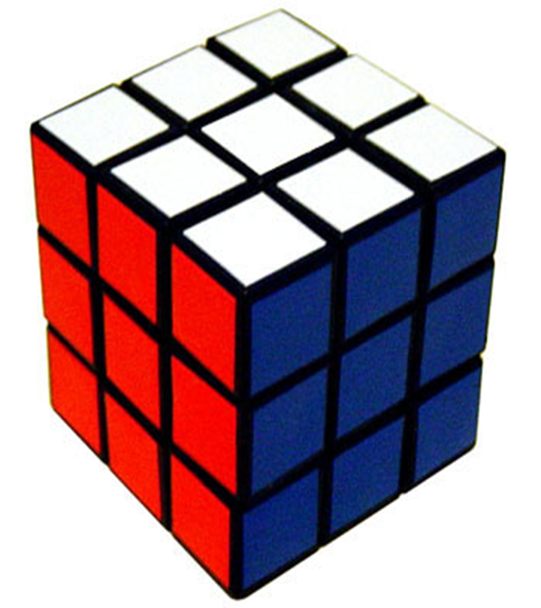
Improvement Measurement: Informing Intelligent Action
Improvement
Notes:
SLIDE SCRIPT: We refer to W. Edwards Deming frequently because he is one of the foundational theorists in healthcare quality improvement and along with colleagues such as Shewart and others brought to the fore the real time study of variation in systems to inform intelligent action. Deming went so far as to say that if he had to reduce his message for management to just a few words, it all has to do with reducing variation.
[ANIMATE] On the left, we introduce this concept of variation briefly as Mary and Bill both are throwing darts at a target. Mary's darts are all clustered and close to the bullseye while Bill is all over the place but one of his dots hit the bullseye. In this particular case Bill’s degree of variation is much wider than Mary. Even though he hit the bullseye once, his degree of variation is all over the place. This is two concepts we call precision and range of variation. That concept can be applied to the performance of systems when you ask questions like ‘what's the variation in ED utilization’.
INSTRUCTOR NOTES: GET RID OF DUPLICATIONS IN SCRIPT
TIME:

Slide 5
IBD Qorus Data Collection Tool: The IBD Qorus Previsit Survey (PVS)
Improvement
Improvement
Notes:
SLIDE SCRIPT: Let’s take a closer look at our data collection tool – the goal of this survey is to combine both the patient and provider perspective. In the first part of the survey, patients self report their number one concern or goal and other standard patient reported outcomes. There is a second part of the survey that captures the provider’s perspective on the patient’s current status. This information is gathered and reported back to teams monthly using the power BI system from the Crohn’s & Colitis Foundation.
INSTRUCTOR NOTES:
TIME:

Slide 6
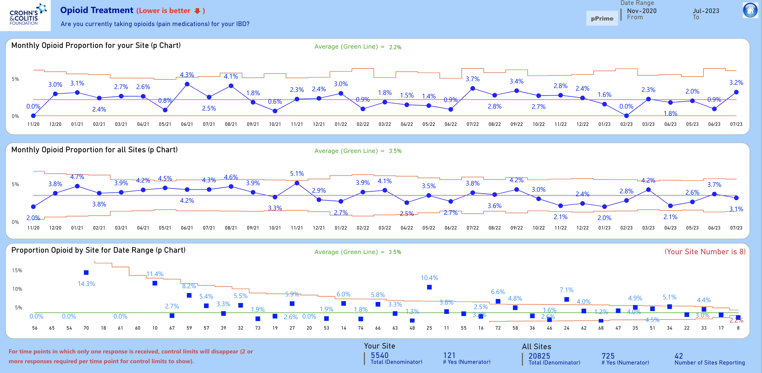
IBD Qorus QI Reports
Your site over time
Collaborative over time
Collaborative by site
Notes:
SLIDE SCRIPT: Once you start collecting data, you'll receive a monthly report that displays the variables captured in the PVS. The example here shows opioid treatment.
[ANIMATE] The top display shows your site's patient reported opioid use over time.
[ANIMATE] The middle display shows collaborative wide use over time [ANIMATE] and the bottom display shows a cross sectional and deidentified view of each participating site. In this one snapshot you'll be able to see how your site is doing over time, how the collaborative is doing over time, and then how your site is doing compared to the other sites in the collaborative.
INSTRUCTOR NOTES:
TIME:

Slide 7
IBD Qorus QI Reports
Date range
Which way is better?
Average
Average
Notes:
SLIDE SCRIPT: There is guidance on each of these displays to orient you to what you’re looking at. For example, [ANIMATE] often times you might think that higher is better but in this example, for opioid treatment, lower is actually better, so we tell you in red at the top what the desired direction is for each outcome.
[ANIMATE] We also tell you the date range that we're looking at.
[ANIMATE] We tell you what the average performance level is on top of each chart and it's also represented by the green line.
You can also locate your site number which will be on the front page of your report. For example, if you are site 8, [ANIMATE] you can see how you fare compared to everybody else in the collaborative, and compared to the overall average. For this site, their data is based on [ANIMATE] 5,540 responses to the question [ANIMATE] ‘Are you currently taking opiods (pain medications) for your IBD?’ of which 121 were yes.
INSTRUCTOR NOTES:
TIME:

Slide 8
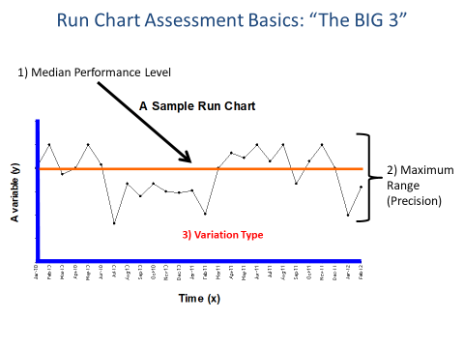
Interpretation
Notes:
SLIDE SCRIPT: In addition to the reports that you receive from us you are also encouraged to supplement what you get at the macro level from the organization with local measures using a Run Chart, which you can learn more about in the QI Curriculum. Run charts also illustrate data over time and have three major components. In the middle is a median which is a measure of central tendency - this turns a line graph into a run chart The difference between the maximum point and minimum point is called the range and illustrates precision. The third component is variation type. There are two types of variation - common cause or random variation, and special cause or non random variation. We’ll teach you more how about how to create these and interpret them. On the bottom is an example of a run chart display from one of the QI reports.
INSTRUCTOR NOTES:
TIME:

Slide 9
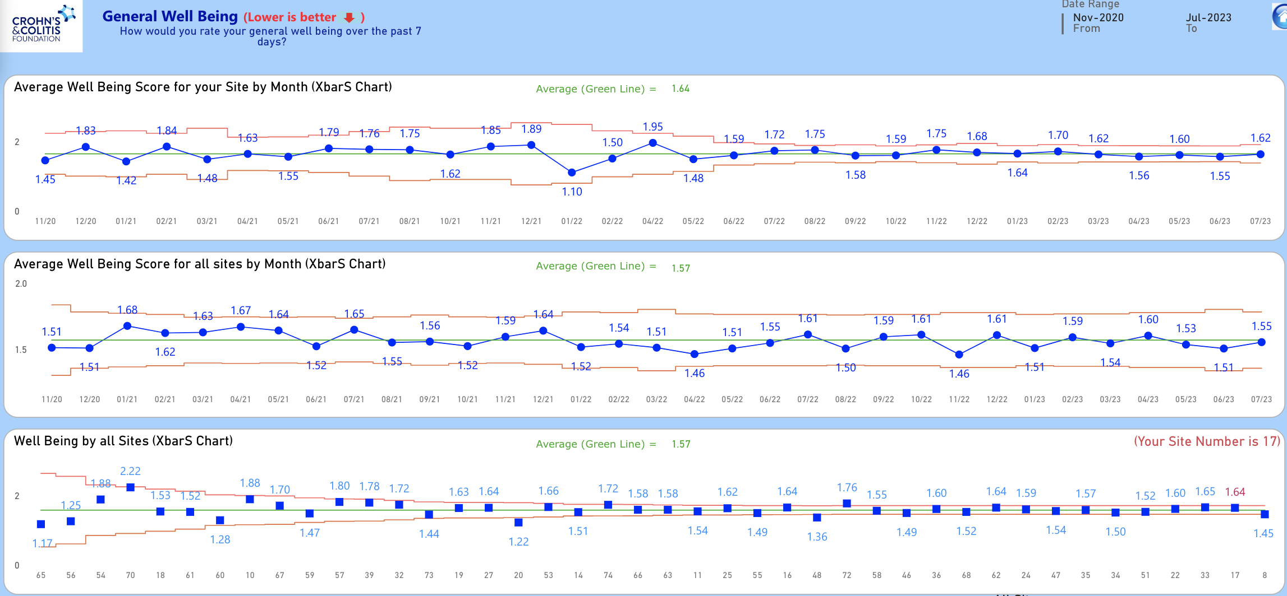
Statistical Process Control (SPC)
Green Line= Average
Blue= Observed Values
Data over time…
Red=
Control Limits
NOT significantly higher than the average
Cross-sectional
Significantly
lower than the average…
Notes:
SLIDE SCRIPT: While some data in your reports is displayed in different ways like a bar chart or a run chart, the most commonly used display you’ll find is a Statistical Process Control or SPC Chart, so let’s take a look at how these SPC charts are developed and how to interpret the variation in the data you see. There are two types of variation - common cause, or random variation, and special cause, or non-random, variation.
[ANIMATE] In the reports you’ll see two different kinds of SPC Charts - one that shows data variation over time called longitudinal and [ANIMATE] one that shows the cumulative average for the date range shown in the top corner called cross-sectional.
[ANIMATE] The blue dots are the observed values each month and [ANIMATE] the red lines are control limits which are about 3 standard deviations away from the average represented by the green line [ANIMATE] . Any points that fall outside of those control limits are indications of special cause variation.
Let’s interpret the bottom graph together. [ANIMATE] Looking at site 20, that blue box is outside the control limit indicating a special cause variation - this site’s general wellbeing scores are significantly lower that the average and the team may want to take a closer look to see what is driving the lower wellbeing scores.
[ANIMATE] Looking over at site 54, it looks like it's higher than the green line but statistically that's just random variation - it is within the red control limit so that site is not significantly higher than the average.
INSTRUCTOR NOTES:
TIME:

Slide 10
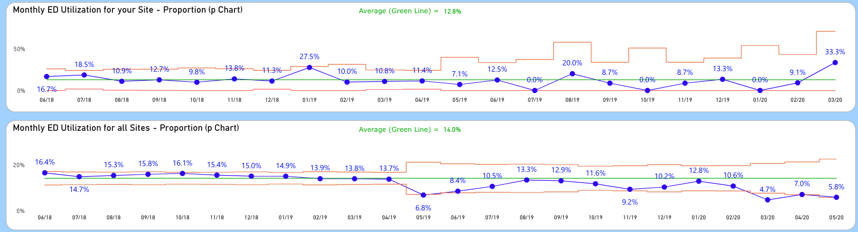
Three Basic Detection Rules (IHI Criteria)
SHIFT = 8 or more consecutive points above or below the average
Points outside the control limits: One or more points outside of the upper or lower control limits
TREND = 6 or more consecutively increasing or decreasing points
Notes:
SLIDE SCRIPT: There are 3 basic detection rules that you can use to determine whether there is any special cause variation happening in your displays. In this display for ED Utilization, we're going to focus on the bottom graph, illustrating the proportion of patients reporting an IBD-related trip to the ED in the past 3 months across the Collaborative.
[ANIMATE] Rule number one asks you to look for something called a shift – a shift is eight or more consecutive points above or below the average. [ANIMATE] Here is a shift right here and it’s a big one – a cluster of points below the center line that indicates non-random variation.
[ANIMATE] Next is the three Sigma signal also simply called ‘points outside the control limits’ - one or more points outside the upper or lower control limits. [ANIMATE] Here is an example of a point outside the lower control limit illustrating non-random variation.
[ANIMATE] Our third rule looks for a trend - six or more consecutively increasing or decreasing points. Here is a decreasing trend circled in purple from January to July 2019. You do not need a statistician to effectively interpret these charts - these are probability-based rules. Each of these is significant with a p value less than .05 which indicates very powerful signals.
INSTRUCTOR NOTES:
TIME:

Slide 11
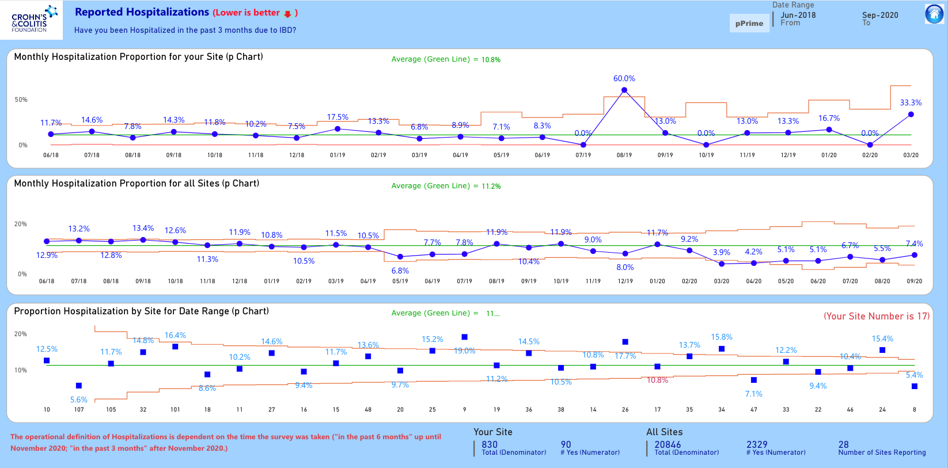
Three Basic Detection Rules (IHI Criteria)
SHIFT = 8 or more consecutive points above or below the average
Points outside the control limits: One or more points outside of the upper or lower control limits
TREND = 6 or more consecutively increasing or decreasing points
Notes:
SLIDE SCRIPT: Now it’s your turn! The rules are on the right of this slide for your reference.
In this Hospitalization graph, can you find a shift in the ‘monthly proportion for all sites’ chart? You can use the chat or just shout it out! (PAUSE)
Here on the bottom ‘Proportion for All Sites’ chart, we do see a shift [ANIMATE] from February 2020 to September 2020! A shift is defined as eight or more consecutive points above or below the average. This example is a very strong shift, suggesting that the overall rate of ED utilization in that cluster has significantly decreased.
Let's go to the next rule and look for any points outside the control limits in the ‘All Sites’ chart. Feel free to chat it in or shout it out! [PAUSE]
[ANIMATE] In September of 2018, we have a point that looks REALLY CLOSE. In a case like this we may want to go back to look at the raw data to determine if this data was outside the control limit or not. Today we will circle it to indicate that we want to take a closer look at that month. Second, [ANIMATE] we have a point clearly outside the control limit in March of 2020 which indicates that something unusual was happening in our system that warrants further investigation.
Last question, are there any trends in this display? Remember, trends are defined as six or more consecutively increasing or decreasing points. [Pause] If you said no, you are correct; there are no trends in this data.
You only need one of these signals in order to have what's called a special cause variation pattern meaning that something non-random is going on. We use these rules to answer the question in the model for improvement ‘How will we know that a change is an improvement’? In the graph we just analyzed, we want to see a decrease in ED Utilization – so when we see special cause signals that it is decreasing, it's suggesting that this change is indeed an improvement.
INSTRUCTOR NOTES:
TIME:

Slide 12
Summary
Improvement Measurement
What are we measuring?
Qorus QI Reports
Basic SPC Interpretation
Improvement
Notes:
SLIDE SCRIPT: In summary, we've covered four items in this session:
[ANIMATE] First, how is improvement measurement different from other types of measurement? It is not for judgment or accountability, rather, it is to inform intelligent action by your improvement team.
[ANIMATE] Second, what are we measuring – we are looking at the outcomes in the IBD Qorus Pre-visit survey.
[ANIMATE] Next, how are we getting that data back? The patient and provider reported feedback will be contained in the monthly reports you receive.
[ANIMATE] Finally, we interpret the monthly reports to understand it if the changes we’re seeing are real change or if it's just random variation.
INSTRUCTOR NOTES:
TIME:

Slide 13
Next Steps
ACTIVITY | MATERIALS
Review this lesson and share with key members of your team | Microlesson powerpoint or recording
Collect data for your QI reports
Review your data with your team and look for areas of improvement! | Data Driven Improvement Story Template
Notes:
SUGGESTED SLIDE SCRIPT:
In a continuous quality improvement collaborative like IBD Qorus, you don’t have to be in an Action Period of an Improvement Initiative to be collecting and learning from your data. So please feel free to share this lesson with key members of your team; start or continue to collect data for your QI reports; and when you receive your monthly report, set aside time to review the report with your team looking for areas in which you can start to improve!
INSTRUCTOR NOTES:
TIME: 30 seconds

