Slide 1



Key Driver Diagram
Illustrating Your Theory of Change
Alice Kennedy, MPH
Research Project Director
The Dartmouth Institute
Last modified 12/5/2023
Notes:
SLIDE SCRIPT:
Hello, my name is Alice Kennedy, I’m a Research Project Director with The Dartmouth Institute for Health Policy and Clinical Practice at Giesel School of Medicine at Dartmouth. I’m here to provide you with an installment of the IBD Qorus Quality Improvement Curriculum, brought to you through a partnership of The Crohn’s & Colitis Foundation and The Dartmouth Institute. This lesson is called about the Key Driver Diagram, and the purpose of this lesson is to help you and your team gain a better understanding and appreciation of this important quality improvement tool which represents the team’s theory for improvement. This lesson will cover important tips for who, what, when and how to use a KDD to drive your SMART Aim.
TIME: 30 seconds

Slide 2
Learning Objectives
Describe
Describe a key driver diagram (KDD) and show how teams use it to drive improvement.
Review
Review the anatomy of a KDD.
Notes:
SUGGESTED SLIDE SCRIPT:
Our learning objectives for today are to: (read slide).
INSTRUCTOR NOTES:
Note the active verbs in the learning objectives (define, review, analyze) move from simple to more complex applied learning. Explicitly verbally stating your learning objectives at both the beginning of the lesson, and summarizing what was learned at the end of the lesson, is important. It helps learners prepare for what you will teach them. Data suggests that learners listen more carefully, and, are more likely to retain key teaching points.
Timing: 30 seconds

Slide 3
What is a Key Driver Diagram (KDD)?
Improvement Tool
Visual Representation of Your Theory of Improvement
What Drives Desired Outcomes?
What Gets in the Way of Desired Outcomes?
Notes:
SUGGESTED SLIDE SCRIPT:
So, what is a Key Driver Diagram?
It is an evidence-based improvement science tool used by quality improvement teams to “drive” outcomes.
The tool visually represents (at a glance) a shared theory of how things might be better, building upon knowledge gleaned from research, observation and experience. A KDD is created both with and for the team based upon the collective wisdom of subject matter and improvement experts. Think of the KDD as the project teams’ theory for improvement. The “diagram” format makes the theory visible.
Simply put, when using a KDD, team members can simply ask ‘What factors drive or contribute to the desired outcome?’
Or, sometimes it is helpful to ask the opposite ‘What are the barriers that often get in the way of us achieving our desired outcomes?’
INSTRUCTORS NOTES: Local teams may choose to adopt a project level KDD provided to them by their collaborative organizers. They may also opt to either create their own KDD, and/or most frequently will modify or enrich the primary / secondary drivers and change ideas based upon what will drive improvement in their local context.
Timing: 30 seconds

Slide 4
The Cornerstone of Our Methodology:
The IHI Model for Improvement
AIM
What are we trying to accomplish?
MEASURE
How will we know that a change is an improvement?
CHANGES
What change can we make that will result in improvement?
Act
Plan
Study
Do
Notes:
SUGGESTED SLIDE SCRIPT:
As always, the work we do cascades from the important questions in the Model for Improvement. A key driver diagram helps your team focus on what they are trying to accomplish (our aim) and identify key things that facilitate the goal or barriers to it (see ’changes’ box). The drivers then pave the way to brainstorming change ideas that could be prioritized and tested.
TIME: 30 seconds.

Slide 5

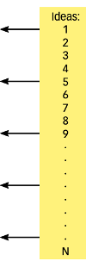
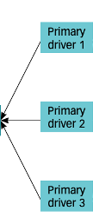
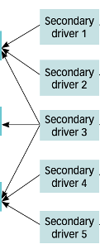
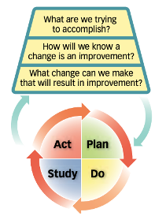

Anatomy of a Key Driver Diagram
Bennet B, Provost L. Organizational Improvement. July 2015.
Driver diagram informs testing, testing refines theory
Primary drivers
Secondary drivers
Specific change ideas
Model for improvement
Notes:
SUGGESTED SLIDE SCRIPT: (Note there are multiple animations that builds out this image!)
A Key Driver Diagram will help your team understand what drives your current state and, most important, how to drive improved practice.
The first step is to understand the anatomy of a KDD and how to read it.
(ANIMATE) Let’s start to the far left: The KDD begins with an aim that your team is trying to achieve. You may have already learned about the importance of a SMART Aim in a separate lesson.
(ANIMATE) The next column represents the primary drivers. These are high level factors that may be invisible but clearly contribute to success and/or failure to achieve the AIM. Primary drivers of the aim may relate to culture, knowledge, attitudes and skills; however, others relate to organizational and/or structural elements that are, or will be essential, to create conditions for success.
(ANIMATE) Next are secondary drivers. These are additional factors that also contribute to achieving the aim. They are important, but less important, than primary drivers. See how the secondary drivers link to the powerful primary drivers that drive the aim in this diagram. Primary and secondary drivers are the leverage points in the system.
(ANIMATE) In the yellow column of this KDD are specific change ideas, that are linked to the secondary drivers. Often teams want to jump in and change things; your KDD will help you sequence, prioritize, organize and link potential changes to your theory of improvement.
Notice that as you move from left to right that the change ideas are often things that are WITHIN YOUR CONTROL. And you and your team have the responsibility to test changes before widespread adoption. Using the KDD will help your team refine your theory of improvement and to test, retest and adjust it along the way.
(ANIMATE) And finally, see how the KDD links to the model for improvement. Each of these changes ideas are only “potentially better practices” until they are tested and refined within your system, to see how they influence the measures or metrics related to your AIM.
INSTRUCTOR NOTES: This animated slide is the MEAT of your presentation. Take the time to walk the learners through each step, helping them master both the anatomy of the KDD, the language of improvement, and the power of linking theory to action. Typically coaches / facilitators spend 3-4 minutes on this slide alone.
Timing: ~3 minutes

Slide 6
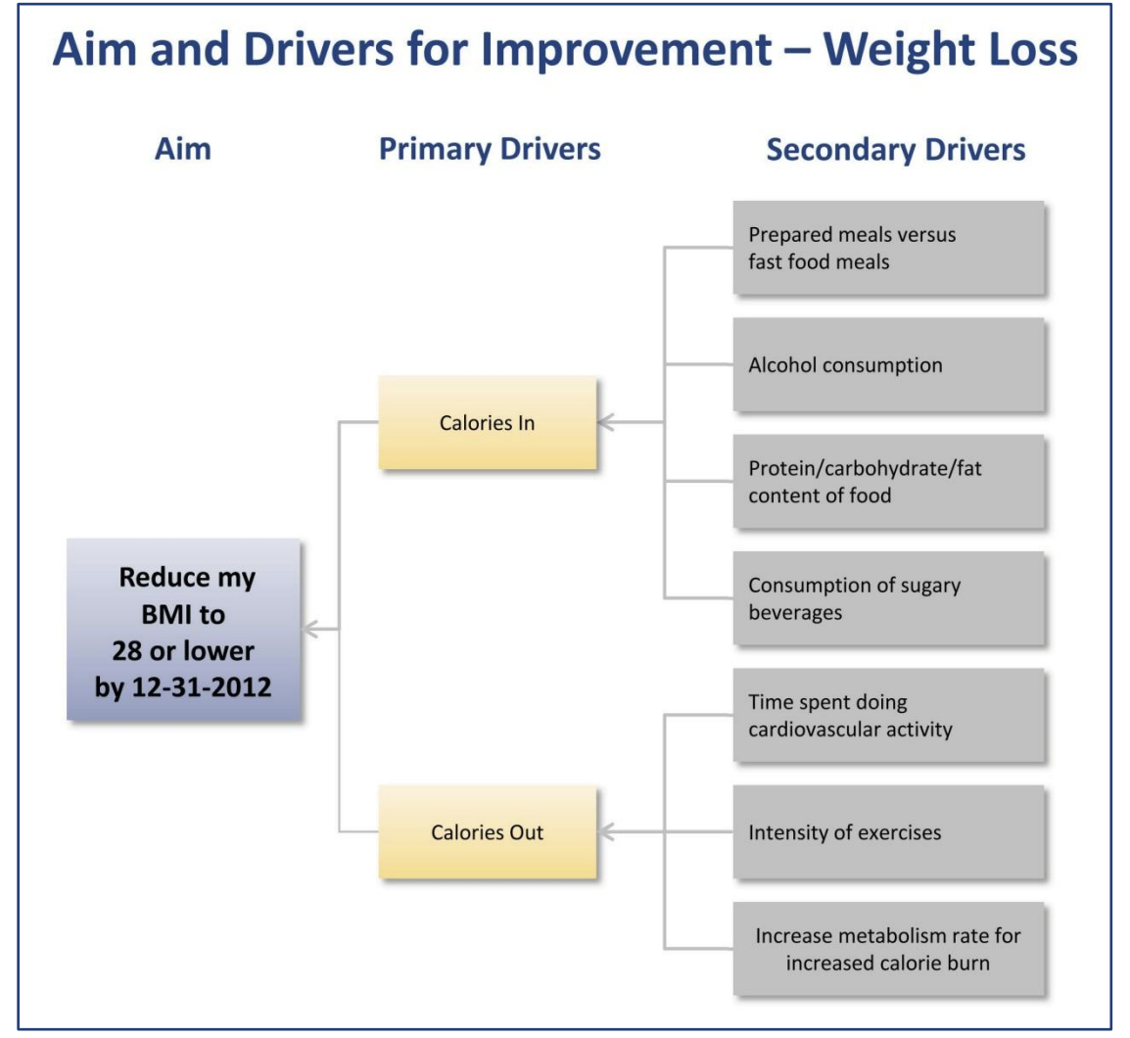
Example of a Very Simple KDD
U.S. Department of Health and Human Services Centers for Medicare & Medicaid Services Center for Medicare and Medicaid Innovation Learning and Diffusion Group. Available at: https://innovation.cms.gov/files/x/hciatwoaimsdrvrs.pdf
Notes:
SUGGESTED SLIDE SCRIPT:
The following is an example of a very simple Key Driver Diagram for weight loss. Note how it builds from left to right. This SMART Aim (specific, measurable, attainable, realistic and timebound) is focused on reducing an individual’s Body mass Index (BMI) to 28 or lower by New Year’s Eve.
Weight loss has 2 primary drivers Calories In and Calories Out. Recognizing this helps you focus on secondary drivers and begin to build out your change ideas and link them to your Aim.
See the secondary drivers here that would help drive calories in. What change ideas can you think of that you could link to some of these secondary drivers?
How about change ideas to drive calories Out?
And, we all know that although weight loss is “simple” at first glance, testing the ideas will be important to see which change ideas drive the overall aim.
Next let’s see a health care improvement project KDD which includes a more complex intervention.
INSTRUCTOR NOTES: The more complex the intervention, the more important creating and using a KDD both at project launch, and throughout the project, becomes.
Timing: 60 seconds

Slide 7
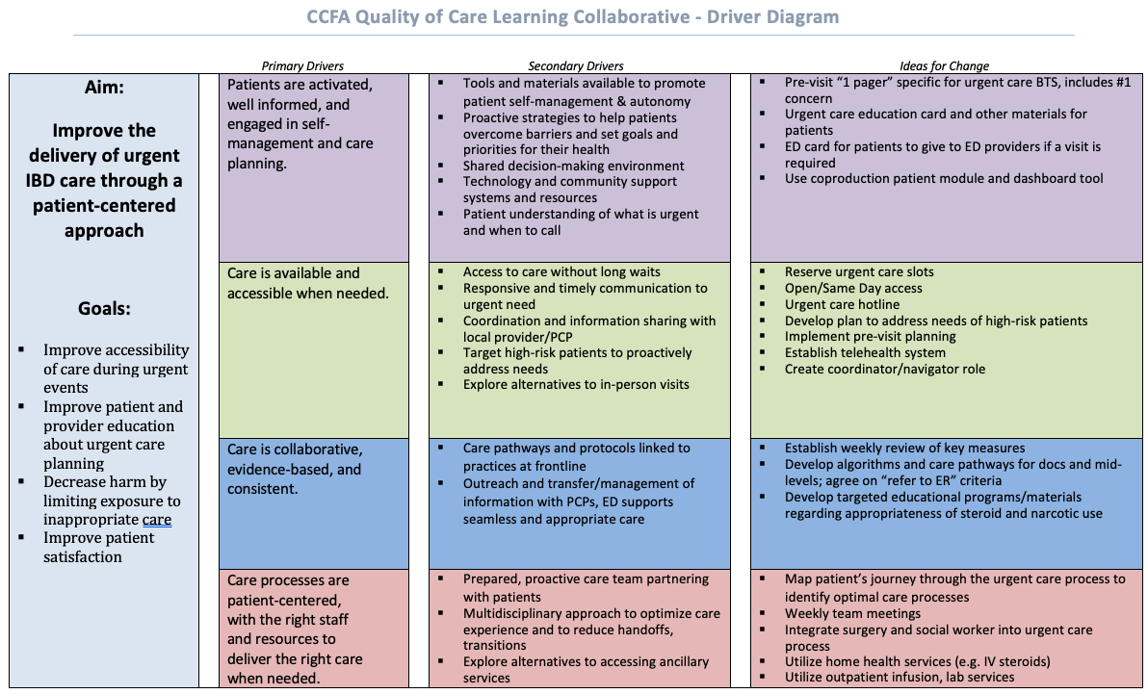
Notes:
Optional: Here is an example of a more complex Key Driver Diagram, the IBD Qorus Urgent Care Key Driver Diagram. This illustrates how the global aim to improve the delivery of urgent IBD care through a patient-centered approach, has 4 primary drivers, each driver is impacted by several secondary drivers, and many testable change ideas to help bring these improvements about. It’s important to note that this Key Driver Diagram was created through a collaborative approach, harnessing the expertise and experience of all members of IBD Qorus.

Slide 8
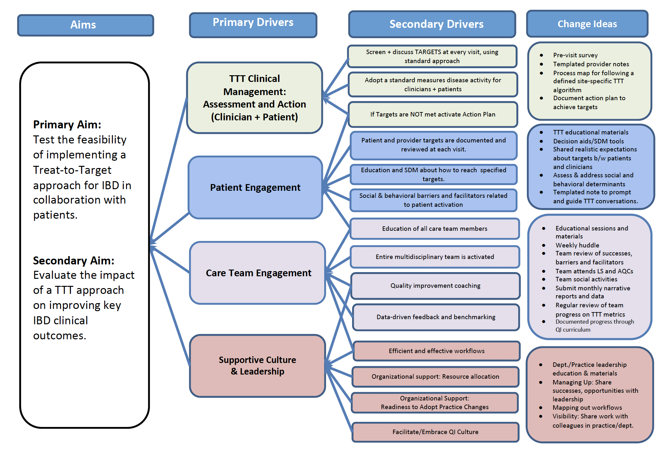
Notes:
Optional: Here is another example of a detailed Key Driver Diagram, this one from the IBD Qorus Treat to Target feasibility initiative. Similar to urgent care, the primary aim has 4 primary drivers, each driver is impacted by several secondary drivers, and there are many testable change ideas to help bring these improvements about. The collaborative approach taken to create this Key Driver Diagram was foundational to the success of the project.

Slide 9
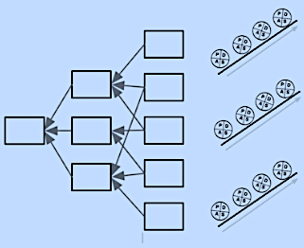
How Will You and Your Team Use the KDD?
Organize and Link Change Ideas
Develop and Test PDSAs
Notes:
SUGGESTED SLIDE SCRIPT:
How will you and your team use the KDD? Read slide
Time: 20 seconds

Slide 10
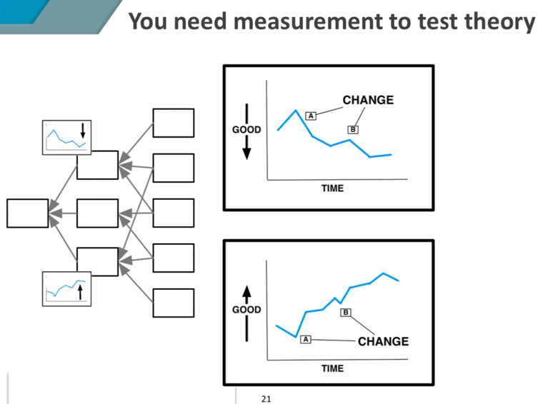
Link Your Measures to Your Theory of Change
PDSAs
PDSAs
Notes:
SUGGESTED SLIDE SCRIPT:
Your team can also use your KDD to help define and refine your MEASURES – so that measurable improvement can be achieved. Use the primary and secondary drivers to identify appropriate measures – for example, how would we measure calories in and calories out?
These measures can tell us when we need to course correct. Your team should REVISIT the KDD to better understand if your changes are making an improvement. The KDD is a dynamic document and should be revisited regularly throughout the project as you learn more along the way.
Timing: 30 seconds

Slide 11
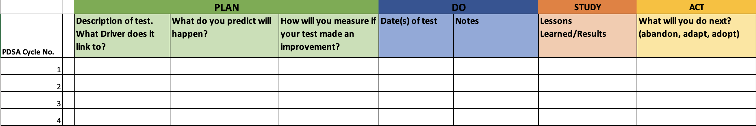
Importance of Tracking Lessons Learned
PDSA Tracking Tool
Notes:
SUGGESTED SLIDE SCRIPT:
As your team conducts PDSA tests of your different change ideas, it is important to STUDY and document what you learned. Change ideas that were abandoned or adapted in the ACT phase of the PDSA cycle should be documented in your PDSA Tracking Tool. It is important to continue to modify your change ideas in your KDD based on lessons learned.
Failures are important to document for those that intend to replicate your theory of change, to avoid pitfalls or waste in time and resources on change ideas that did not result in the predicted outcome. This also will be helpful when writing your results down the road.
Timing: 30 seconds

Slide 12
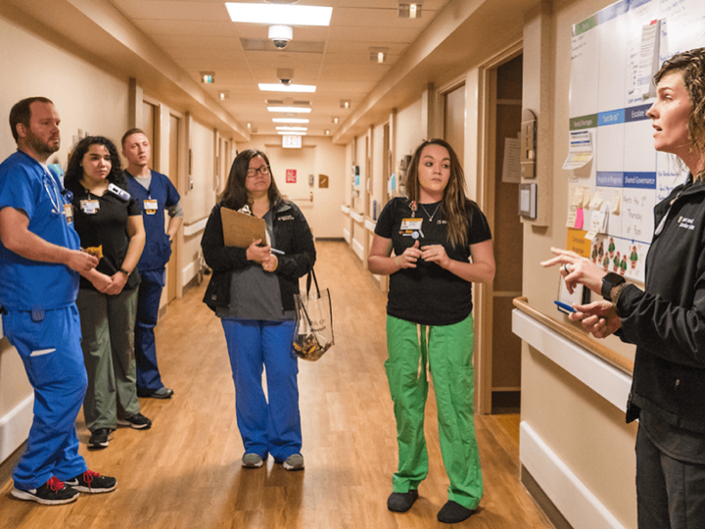
Use a KDD To Anchor Your Team Huddles & Meetings
Notes:
SUGGESTED SLIDE SCRIPT:
As we begin to summarize – the KDD is a visual representation of the theory of improvement illustrating causal pathways and linkages. It can be used in virtually every team meeting as the frame” for the project. It also serves the following functions:
Makes the team’s theory of change logical and visible
Helps each team member to see their role and work as a critical link in the cycle of improvement
Helps the team acknowledge the complexity while prioritizing their focus / work a single driver.
INSTRUCTOR NOTES: Every team member needs to be able to envision themselves doing this work. If time allows share a tangible example from a successful team that may inspire / motivate / and inform.
Timing: 60 seconds

Slide 13
Summary
KDD = Your Theory of Improvement
SMART Aim
Primary Drivers
Secondary Drivers
Change Ideas
Allows you to test your theory with PDSAs
Informs what to measure
Keeps you organized
Notes:
SUGGESTED SLIDE SCRIPT:
In summary . . .
A KDD or your theory of improvement has 4 major components. It links your SMART Aim to primary drivers, secondary drivers, and change ideas.
It provides a road map to guide and encourage your team to TEST your theory of improvement with PDSAs.
A KDD informs WHAT to measure
And finally, a KDD keeps you focused, organized and supports you and your team to move into action!
INSTRUCTOR NOTES: Pace the presentation to get to this slide at ~ 6.5 minute mark. You should be able to wrap up this lesson in about 7 minutes.
The most important thing is to get the teams into ACTION!
This may be an opportunity to revisit the project KDD, looking at where to start, what seems feasible, etc.
Timing: 60 seconds

Slide 14

Resources
Bennett B, Provost L. Quality Progress. July 2015.
Picarillo A. Introduction to quality improvement tools. J Perinatol. 2018;38:929-935.
Examples of KDDs
https://www.med.unc.edu/ihqi/programs/medical-student-scholarly-concentration/session-3-charters-a3s-driver-diagrams/
Intro to Driver Diagrams by Bob Lloyd (6:18)
http://www.ihi.org/education/IHIOpenSchool/resources/Pages/AudioandVideo/Whiteboard9.aspx
How Do You Use a Driver Diagram with Don Goldmann (6:37) http://www.ihi.org/education/IHIOpenSchool/resources/Pages/Activities/GoldmannDriver.aspx
Notes:
SUGGESTED SLIDE SCRIPT:
Here are some resources for you to explore, that may be found in the supplemental lesson materials.
INSTRUCTOR NOTES:
If you will be coaching others you will find reviewing at least these brief resources will enrich your learning and help you meet your team’s needs more completely.
Also, it is often important to share these resources with eager or more advanced learners on your QI team may help you to meet their learning needs.
TIME: 30 seconds

Slide 15
Next Steps
ACTIVITY | MATERIALS
If using an already developed KDD … Review project level KDD as a TEAM Identify local drivers that are missing and adapt the project KDD to your local context. | Project Level KDD (if applicable) Review How To Develop a KDD micro lesson
Prioritize which change ideas are likely highest impact AND low hanging fruit (easy to improve) | Review Prioritizing Change Ideas & PDSAs Using the Pareto Principle micro-lesson (optional) IHI Video (optional)
Share your project KDD with your QI team and other members of your care team. | Post it, get feedback, incorporate good ideas.
TEAM FORMATION
Notes:
SUGGESTED SLIDE SCRIPT:
If the Collaborative is currently in an Action Period of an Improvement Initiative, you may be asked to take some next steps at this time, such as [Read Slide]
Check with IBD Qorus Leadership to see what next steps are right for you!
INSTRUCTOR NOTES:
TIME: 60 seconds

