Slide 1

Maintenance of Certification Made Simple
Last modified 04.09.2021
Notes:
SLIDE SCRIPT:
You and your team members are able to earn Maintenance of Certification credits (also known as MOC) for the improvement work you are already doing as part of the IBD Qorus Learning Collaborative.
TIME: 20 seconds

Slide 2

Maintenance of Certification
American Board of Internal Medicine (ABIM) requirement for board certification for physicians and physician assistants
~100 credits are required every 5 years
Disciplined quality improvement activities related to IBD Qorus Learning Collaborative and our QI Curriculum can fulfill these requirements.
Notes:
SLIDE SCRIPT:
MOC is a requirement for board certification for physicians and PAs. They must accrue 100 credits every five years, and the QI activities you are engaged in as part of Qorus can fulfill this requirement. MOC is not YET a requirement for Nurse Practitioners.
INSTRUCTOR NOTES: Some physicians are double-boarded and therefore need credits for both certifications. 100 credits would be the “typical” # for single boarded physicians.
TIME: 15 seconds

Slide 3

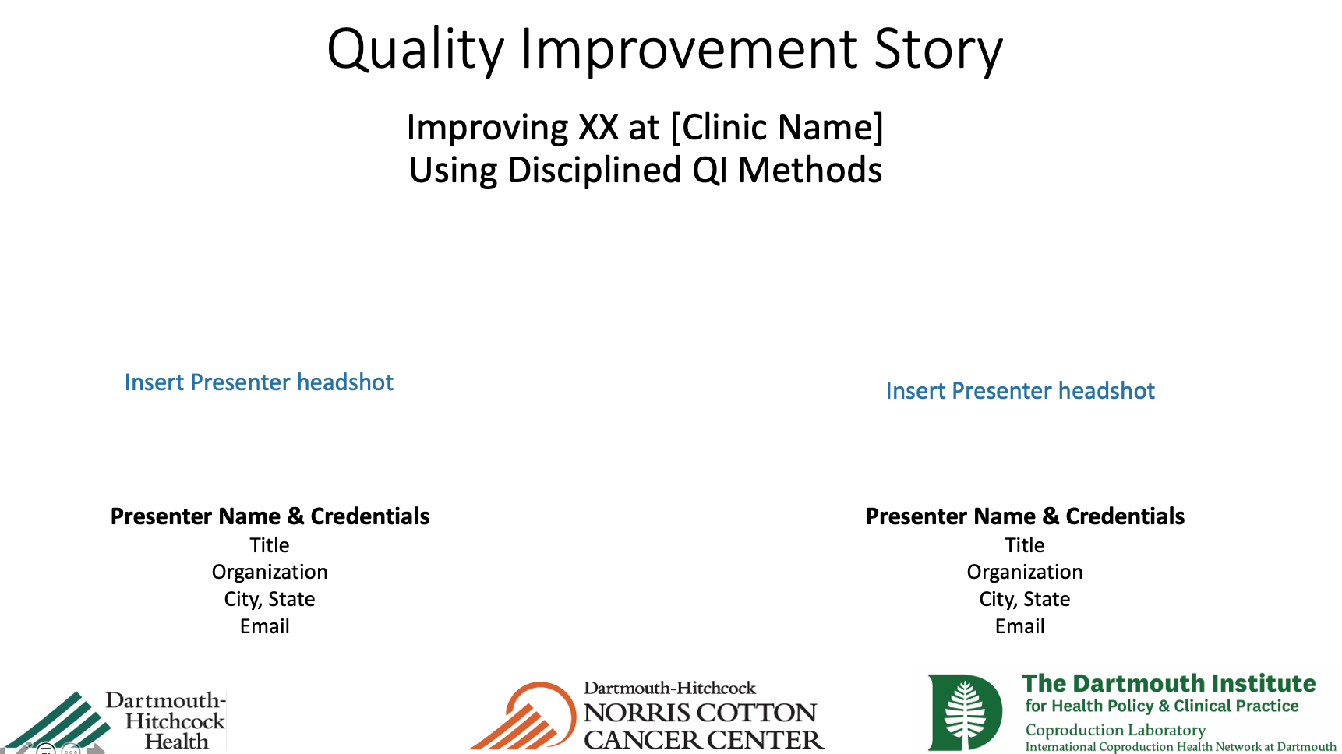

3 Simple Steps To Achieve MOC Credits
1
2
3
Contribute to Routine Monthly Run Chart / SPCC Data & Review
Contribute to Team’s Data-Driven Improvement Story as a
Co-Author
Sign a Personal Attestation
Form
20 MOC Credits Annually
Notes:
Slide SCRIPT:
TDI has collaborated with the Dartmouth-Hitchcock’s Center for Learning & Professional Development, who is an established MOC Portfolio Provider.
Each year, TDI will submit an application to register and gain project level pre-approval for the discrete QI initiatives being conducted in IBD Qorus.
Each physician or PA seeking MOC credits must demonstrate “meaningful participation” in the QI initiative. Therefore, they must join the QI team and contribute to the work along the way. This includes:
Each team will be developing a data-driven improvement story in advance of each learning session which will serve as their team-level MOC evidence of improvement. You must be listed as an author to the improvement story to receive MOC credits.
Your improvement story coupled with your attestation form will need to be submitted directly to the TDI team each September; and I will work with our Portfolio Provider to file your project and assure that you are awarded the 20 MOC credits annually by December.
Multiple physicians / providers from your organization are eligible to receive MOC credits for a single project, as long as they meet the standard of meaningful participation.
Therefore, the only extra “lift” you will need to do is complete the attestation form and send it to me to be processed every September!
This process will occur annually as long as Qorus has an active QI project in action and available for credits.
Questions?
TIME: 3 minutes

Slide 4
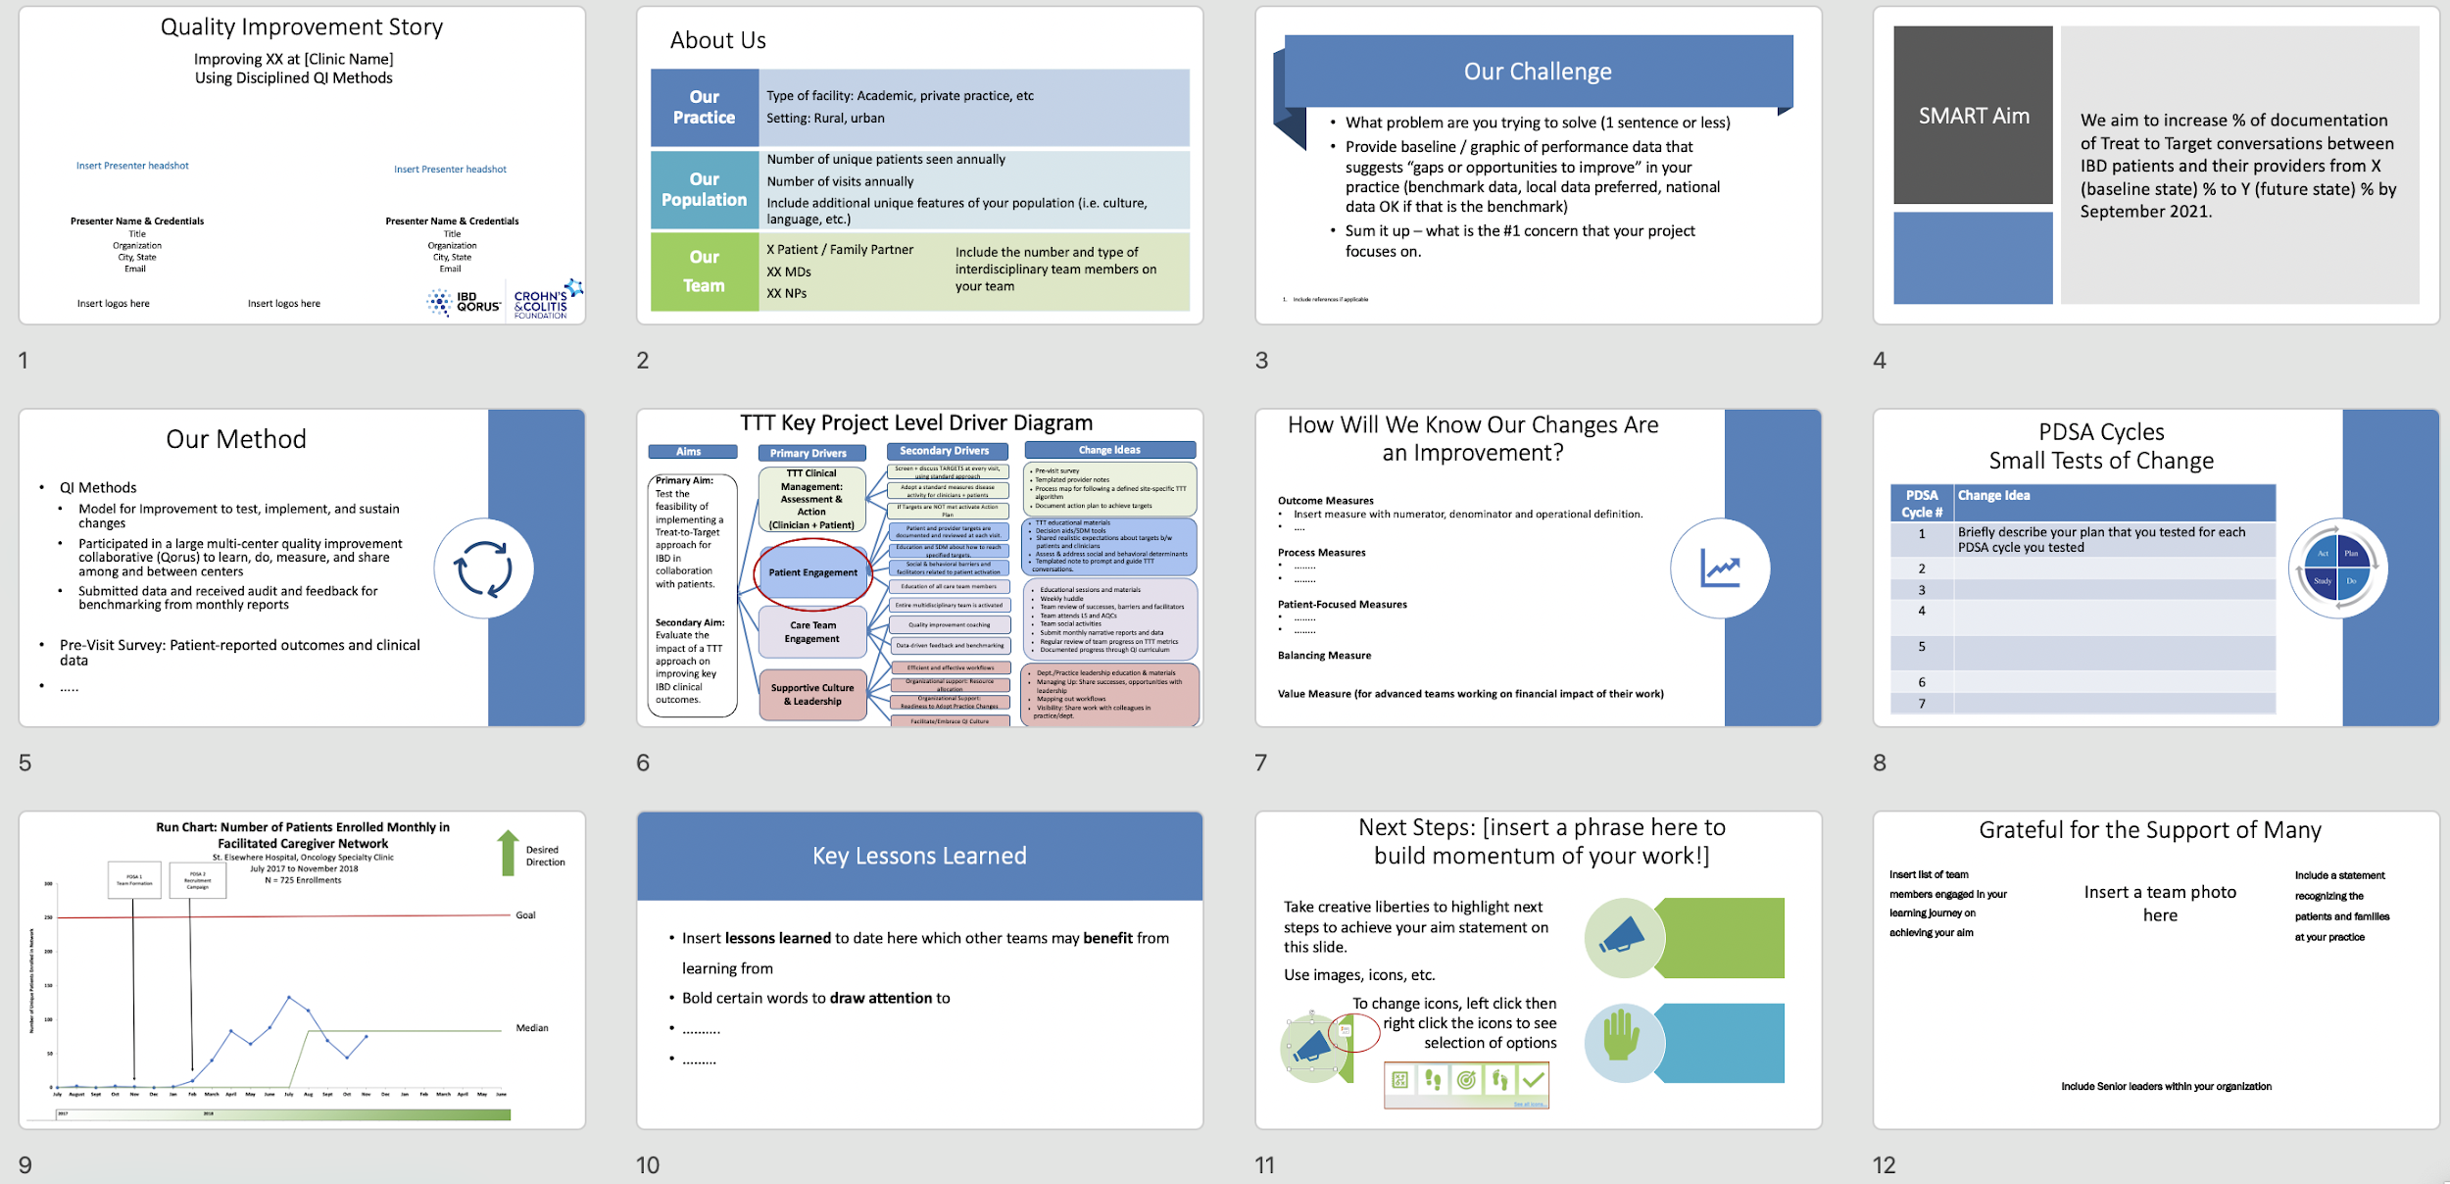
12-Slide Quality Improvement Story
Notes:
SLIDE SCRIPT:
This is a snapshot of the layout of an improvement story--12 slides in 10 minutes--it is possible! As I walk you through the key elements ---I want you to think about the improvement work you have already completed and see how you could easily start to populate this standard template with your own improvement story.
TIME: 90 seconds

Slide 5

What is Meaningful Participation?
Annual attestation forms acknowledging “meaningful engagement” required by ABIM
Active in your improvement/innovation team
  Attend team meetings/huddles
  Participate in PDSA cycles
  Collect data
Contribute to and listed as a co-author on your team’s Data Driven Improvement Story
Notes:
Slide SCRIPT:
I hope you can easily see that this is not “new work”. The standard work of participating in this Collaborative is already meeting the “rules of engagement”.
The only new piece required to receive MOC credits is completing an attestation form annually acknowledging your meaningful participation in the work. This includes completion of the form, including your ABIM number and signature so that credits can be awarded and tracked.
Being a contributor to this work includes being an active member of your local improvement team, such as participating in team meetings and huddles, conducting small tests of change, collecting and reviewing the data in partnership with your team all in an effort towards achieving your shared SMART Aim. You will also be contributing to your team’s improvement story and must be listed as a co-author.
TIME: 45 seconds

Slide 6
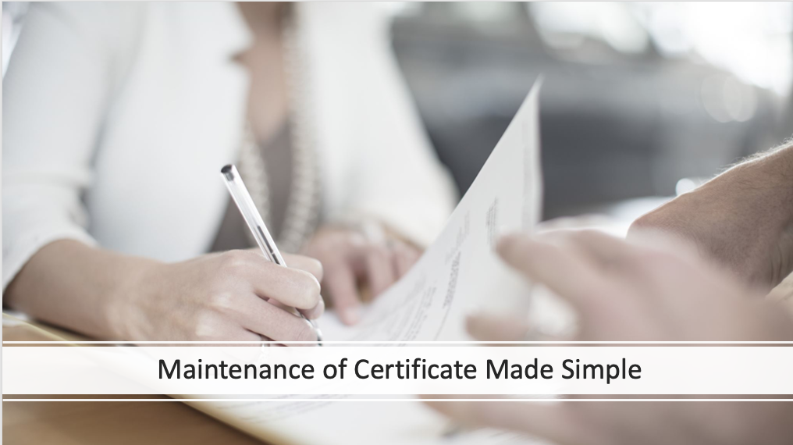


Expand Team Engagement in Quality Improvement Activities
Notes:
SLIDE SCRIPT:
MOC credits, as an added benefit of participating in IBD Qorus, may be a way to gain the attention of your colleagues to lean in, learn more and start participating in QI activities. It may also bring along “resistors” --to start getting involved --allowing you to expand your local improvement team. Imagine your ability to achieve your SMART Aim with more team members working WITH you towards a shared goal.
Multiple physicians and PAs at your practice can receive MOC credits working on the same QI activity. So, I encourage you to spread the news of this added benefit at your next team meeting and let us know how we can best support bringing new team members along in this QI learning journey.
INSTRUCTOR NOTES: Pause for questions here
TIME: 45 seconds

