Slide 1



Introduction to
Measurement for
Quality Improvement
Alice Kennedy, MPH
Research Project Director
The Dartmouth Institute
Last modified 12/5/2023
Notes:
SLIDE SCRIPT:
Hello, my name is Alice Kennedy, I’m a Research Project Director with The Dartmouth Institute for Health Policy and Clinical Practice at Giesel School of Medicine at Dartmouth. I’m here to share an installment of the IBD Qorus Quality Improvement Curriculum, brought to you through a partnership of The Crohn’s & Colitis Foundation and The Dartmouth Institute. The purpose of this lesson is to introduce you to a unique approach to measurement for quality improvement with an emphasis on understanding variation, the role of measurement, and the critical linkages between measurement and key QI tools like a SMART Aim, Key Driver Diagram, and PDSA Cycles.
TIME: 30 seconds

Slide 2
Learning Objectives
Describe
Identify
Understand
Understand the difference between warranted and unwarranted variation.
Describe the rationale and importance of measurement as a fundamental component of the Model for Improvement.
Identify 3 types of measures used to measure improvement.
Notes:
SUGGESTED SLIDE SCRIPT:
Our learning objectives for today are to: (read slide).
TIME: 30 seconds

Slide 3
“If I had to reduce my message for management to just a few words, I’d say it all had to do with reducing variation.”
-W. Edwards Deming
Notes:
SUGGESTED SLIDE SCRIPT:
Once you begin to measure something and compare it, you will often reveal variation.
The Dartmouth Atlas data map, seen here, is an example of measured variation telling a story. For more than 20 years, the Dartmouth Atlas has measured variations in how medical resources, clinical outcomes, and healthcare utilization vary across geographic regions of the United States often using large Medicare data sets.
Sometimes variation is expected, or warranted because each patient is unique and different.
However, there is variation that can’t be explained by differences in patients and populations. This is unwarranted variation which is patient care that differs in ways that are not a response to evidence or to the healthcare choices of patients. This is the type of variation we do not want. For example, in a 2013 paper by Gil Melmed and Corey Siegel, unwarranted variation in inflammatory bowel disease care was identified with regard to cancer surveillance, drug dosing and monitoring, and the management of severe disease These were, by definition, areas identified for care improvement. (Melmed GY, Siegel CA. Quality improvement in inflammatory bowel disease. Gastroenterol Hepatol (N Y). 2013;9(5):286-292).
Unwarranted variation in the system provides us opportunities to make improvements.
We do not need to rely on the macro level data illustrated in this map, to understand that unwarranted variation in care exists, we see it in practice every day. We can start small by measuring and looking for variation in our own day-to-day clinical systems.
Time: 90 seconds

Slide 4
MEASUREMENT Three Different Approaches
RESEARCH
ACCOUNTABILITY
IMPROVEMENT
Notes:
SUGGESTED SLIDE SCRIPT:
So why do we measure? There are 3 main reasons:
1. You may measure for research. Most of us are familiar with measurement for the purposes of research. For example, you may measure to compare different treatments or interventions in a randomized clinical trial.
2. You also may measure for accountability or judgment. Examples of this might be mandatory measures for Joint Commission accreditation, or the Centers for Medicare and Medicaid Services. This data tends to be aggregate data, and in some cases is publicly available. It may drive consumers to or away from a health system or provider.
3. Finally, we often measure because we want to drive improvement. There are measurement strategies specifically designed for Quality Improvement, which allows you and your team to monitor variation of your outcomes over time, within your clinical micro-system (the place and space where you do your work).
TIME: 90 seconds

Slide 5
The Cornerstone of Our Methodology: The IHI Model for Improvement
AIM
What are we trying to accomplish?
MEASURE
How will we know that a change is an improvement?
CHANGES
What change can we make that will result in improvement?
Act
Plan
Study
Do
Notes:
SUGGESTED SLIDE SCRIPT:
The work we do is guided by the questions in the adapted Model for Improvement. Measurement is related to the second question, how will we know that a change is an improvement? We need to determine what measures we should consider to understand if our theory of improvement is on target. But before I introduce you to the different types of improvement measures, let’s look at the logical connections between SMART Aim, Drivers, PDSA cycles and Measures.
TIME: 1 minute

Slide 6
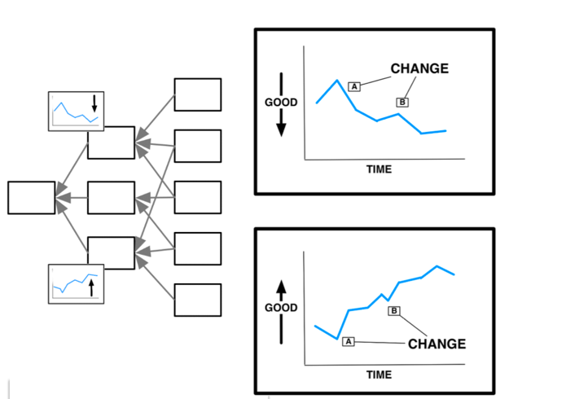
Use Your Key Driver Diagram to Develop Measures
PDSAs
AIM
PDSAs
Notes:
SUGGESTED SLIDE SCRIPT:
Remember that your team has already had a jumpstart on developing your measurement strategy when you developed your key driver diagram. Your SMART Aim focused on statements that are specific, measurable, achievable, relevant, and time-bound. Then you identified the primary and secondary drivers and change ideas that you would like to test. Studying our SMART Aim and Key Driver Diagram will help your team identify the concepts we want to measure. This measurement will generate the data required to tell us if and how our PDSA cycles influenced the system.
Timing: 30 seconds

Slide 7
What Data Do We Need To Measure Improvement?
What is our baseline state?
How much does practice vary?
Are things getting better, worse, or the same over time?
Are the changes we are making an improvement?
Reference: Provost LP, Murray S. The Health Care Data Guide: Learning from Data for Improvement. Jossey-Bass; 2011.
Notes:
SUGGESTED SLIDE SCRIPT:
The data we need for improvement is quite simple and specific; we need to know what is our baseline state. Do we have an accurate measure about where are we now?
We need to understand if and how much variation there is in our practice day to day, week to week and month to month. To do this we use data over time, often in the form of a run chart or statistical process control chart.
Once we have mapped our data over time, we can examine the variation. Is our outcome getting better, worse, or essentially unchanged over time. This way of measuring helps us understand the care we are giving, whether or not we are getting better or worse, and will tell us if the changes we are testing result in improvement.
Choosing from the universe of possible measures can be a daunting task. Often teams want to measure everything – as it all seems important. The key to developing a measurement strategy is to keep it as simple as possible. Your team has very limited time. You want to reserve most of that time for improving (not just measuring).
In measurement for improvement, we often use what we call a family of measures. This acknowledges that no ONE type of measure will tell the whole quality story – we need outcome, process, and balancing measures. Let’s take a closer look at each measurement type.
TIMING: 60 seconds

Slide 8
Choosing Your Measures: It’s a Family Affair!
Provost LP, Murray S. The Health Care Data Guide: Learning from Data for Improvement. Jossey-Bass; 2011.
Outcome
Are we achieving our SMART Aim?
Process
What are upstream steps that must occur in the process to achieve the SMART Aim?
Balancing
What could go wrong if we made this change? What are the unintended consequences?
Notes:
SUGGESTED SLIDE SCRIPT:
There are 3 types of measures you should consider when developing a family of measures to guide your improvement work.
Outcome measures are tightly coupled with your SMART Aim. Did you achieve what you set out to do? They tells us how the system is performing using data over time. Outcome measures are often challenging to move and may move slowly. They may take months or years to fully achieve. Given this, outcome measures are often referred to as “lagging” measures.
Due to the natural “lag” in outcome measures they are almost always coupled with process measures which provide earlier signals of system improvement.
Process measures are logically linked to your key drivers. They are often processes or steps that are precursors to achieving the outcomes. Ask your team what are the upstream actions or steps that must occur before we can achieve X (our SMART Aim)? Then build process measures that matter and focus on those that will help you monitor whether critical steps in the process are occurring as planned. Process measures are “leading indicators” that your process is moving in the desired direction. They are necessary, but alone are not sufficient, to demonstrate meaningful improvement. Process measures should always be coupled with outcome measures.
Balancing measures are critical to monitor the system for potential harm. What could go wrong if key changes were made to the system? What could be the unintended consequences of your well-intended change ideas? By trying to make an improvement in one area of the system, you may be causing harm or less desirable outcomes in another area of the system. Therefore, we suggest your team brainstorms, look at the system and stakeholders with a 360-degree perspective. Listen carefully to worries about testing a particular change. Understanding these concerns can identify potential causes for harm. Then your team can identify a measure to monitor for harm; this may be critical to your success and is a “safety monitoring” feature of QI.
INSTRUCTOR NOTE: Pause for questions, you will be going into an example after this so some questions may be deferred and best supported by reviewing an example.
TIME: ~4 minutes

Slide 9
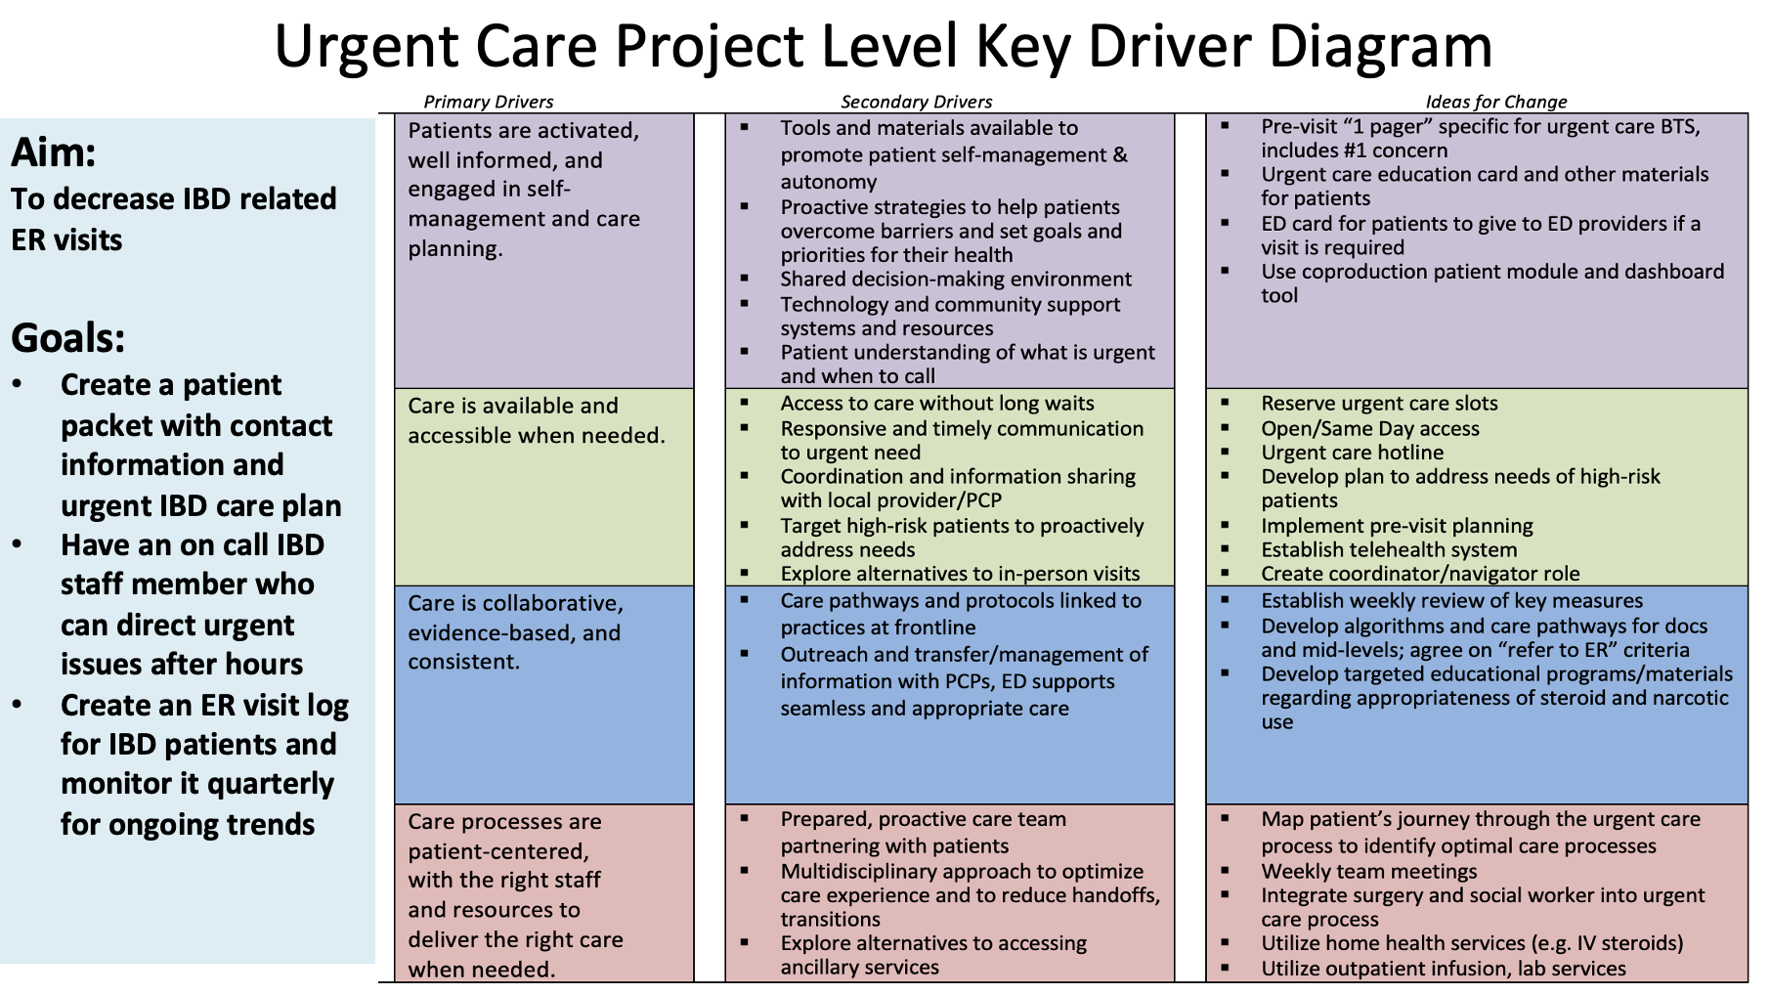
Outcome
Decrease IBD related ER visits.
Process
Care processes are patient centered, with the right staff and resources to deliver the right care when needed.
Balancing
Care is available and accessible when needed.
Notes:
SUGGESTED SCRIPT: ANIMATED
Let’s look at an example and visit the Serious Illness Conversation Key driver Diagram and their Aim Statement. [Read Aim Statement].
Their primary drivers are developing the right process, developing engaged care teams and engaged patients, and garnering system level supports.
Let’s start by choosing an outcome measure for the aim statement. (Animate in OM header) An outcome measure is your endpoint - the result of your smart aim - and you want to know how the system is performing relative to that endpoint. The purpose of the outcome measure is to monitor and understand if the changes you made resulted in the improvement you predicted. What would be a potential outcome this improvement team would want to measure to know if they are, in fact, improving the frequency, quality and documentation of SIC conversations? This brings us to the conceptual definition of our measure – conceptually, the team wants to know the number of conversations conducted. (Animate in Outcome measure example.)
Upstream from the outcome measure is our process measure. (Animate in process measure box) It's important to look upstream from the SMART Aim because the outcome measure of interest that we’re trying to improve can require months or sometimes a year of work to actually ‘move the dot’. We call this a lagging measure and given that outcome measures are often lagging measures we partner outcome measures with process measures, which are often leading measures.
For our first process measure let’s dig into the Primary driver of Developing the Right Process:
(Animate) We will want to measure first is the screening process – do we know ‘which patients and by when?’.
Next let’s look at an example of a balancing measure. (animate in title box)
Balancing measures are critical to monitor the system and protect it from potential harm. Do no harm, do not create undue stress on our patients and/or our team members
When you're thinking about what you want to measure as a balancing measure ask your team to brainstorm potential unintended consequences (Animate) that could result from our very well-intentioned changes. When you make an improvement in one area of the system it's possible to cause harm or less desirable outcomes in another area of the system; therefore we suggest your teams brainstorm to monitor for harm.
(Animate title box) Next, let’s identify a patient and family measure for the serious illness conversation implementation project. What should we measure to understand the impact on pts and families? (Animate) Measuring the patient experience of the quality of the conversation could be a possibility. There are many reliable pt/family experience measures teams can choose from in this domain of measurement.
(Animate title box) Lastly, let’s consider a value metric for this work. (Animate). By measuring revenue or RVUs for conducting & documenting conversations, we can potentially start to measure the economic impact of implementing serious illness conversations into standard oncology practice.
In our next lesson we will take a deeper dive into this example to “operationalize” these measures. Here we have identified the types of measures and the concepts we should be measuring. We will then need to develop a table of measures so that anyone could understand and replicate our measurement strategy.
Time: 5 minutes

Slide 10

Tap into the Collective Wisdom of Your Team & Patient Partners
Notes:
SLIDE SCRIPT:
Encourage your team to think about measures that matter (to patients) – engage care team members and patient partners side by side – meet and brainstorm each measurement type to develop a balanced family of measures for your improvement project.
In your lesson toolkit is a tool called the Table of Measures that might help you and your team develop a more detailed measurement strategy that includes both conceptual and operational definitions of your measures.
TIME: 30 seconds

Slide 11
Summary
Understanding variation in your micro-system (the place you do your work) is critical to improving it.
Build your measure set with your team using a family of measures framework.
To understand if your changes are an improvement, you must measure, linking your measures to your Key Driver Diagram and SMART Aim.
Notes:
SLIDE SCRIPT:
In summary, understanding variation in your micro-system (the place you do your work) is critical to improving it!
Disciplined quality improvement requires careful planning of your measurement strategy to help you understand if the changes you are making are really an improvement. Therefore, To understand if your changes are an improvement, you must measure, linking your measures to your Key Driver Diagram and SMART Aim.
Deploying a balanced “family of measures” typically requires a process measure, an outcome measure, and a balancing measure. Work with your team to build a robust measurement strategy so that you can confidently assess if the changes you are applying to the system are making an improvement.
INSTRUCTOR NOTES:
TIME: 30 seconds

Slide 12

Resources
Chapter 5: Measurement Part 1: Data Analysis for Decision Making in Health Care Objectives. In: Gregory S. Ogrinc, MD, MS; Linda A. Headrick, MD, MS, FACP; Amy J. Barton, PhD, RN, FAAN, ANEF; Mary A. Dolansky, PhD, RN, FAAN; Wendy S. Madigosky, MD, MSPH; Rebecca S. (Suzie) Miltner, PhD, RN, CNL, NEA-BC. Fundamentals of Health Care Improvement: A Guide to Improving Your Patients' Care. 3rd ed. Joint Commission Resources. 2018:67-85
Provost LP, Murray S. The Health Care Data Guide: Learning from Data for Improvement. Jossey-Bass; 2011.
Scanlon DP, Darby C, Rolph E, Doty HE. The role of performance measures for improving quality in managed care organizations. Health Serv Res. 2001;36(3):619-641.
Notes:
SUGGESTED SLIDE SCRIPT:
Here are some resources for you to explore, that may be found in the supplemental lesson materials.
INSTRUCTOR NOTES:
If you will be coaching others you will find reviewing at least these brief resources will enrich your learning and help you meet your team’s needs more completely.
Also, it is often important to share these resources with eager or more advanced learners on your QI team may help you to meet their learning needs.
TIME: 30 seconds

Slide 13
Next Steps
ACTIVITY | MATERIALS
Review this lesson and share with key members of your team. | Measurement Part 1 micro-lesson powerpoint
Meet with your team and start brainstorming measures starting with your aim statement and primary drivers | Your SMART Aim Your Key Driver Diagram
Notes:
SUGGESTED SLIDE SCRIPT:
If the Collaborative is currently in an Action Period of an Improvement Initiative, you may be asked to take some next steps at this time, such as [Read Slide]
Check with IBD Qorus Leadership to see what next steps are right for you!
INSTRUCTOR NOTES:
TIME: 30 seconds

