Slide 1



The Model For Improvement:
Three Simple Questions to Guide Your
Improvement Journey
Alice Kennedy, MPH
Research Project Director
The Dartmouth Institute
Last modified 12/5/2023
Notes:
SLIDE SCRIPT:
Hello, my name is Alice Kennedy, I’m a Research Project Director with The Dartmouth Institute for Health Policy and Clinical Practice at Giesel School of Medicine at Dartmouth. I’m here to provide you with an installment of the IBD Qorus Quality Improvement Curriculum, brought to you through a partnership of The Crohn’s & Colitis Foundation and The Dartmouth Institute. The foundation of our improvement work is a deceptively simple method, designed specifically for health care improvement, called the Model for Improvement.
In this lesson we will discuss the 3 simple questions that improvement teams revisit throughout their project to guide their improvement journey.
TIME: 30 seconds

Slide 2
Learning Objectives
Define
Define quality improvement.
Ask
Ask the 3 simple questions embedded in the Model for Improvement to guide your QI project.
Apply
Apply the steps in the Model for Improvement, illustrated in the data-driven improvement story, to structure your work.
Notes:
SLIDE SCRIPT:
We have 3 learning objectives for today that include:
Presenter simply reads the learning objectives.
TIME: 60 seconds

Slide 3

What is Quality Improvement?
Batalden, P. Qual Saf Health Care. 2007;16:2-3.
“The combined and unceasing
efforts of everyone—
healthcare professionals, patients and their families, researchers, payers, planners and educators—
to make the changes
that will lead to better patient outcomes (health),
better system performance (care) and better professional development (learning).”
Notes:
SLIDE SCRIPT:
Let’s being by developing a shared vision of “quality” improvement.
Although quality is in the eye of the beholder, a simple and universal definition has been proposed by one of the visionary leaders in quality improvement here at Dartmouth, Dr. Paul Batalden.
His definition has motivated and inspired teams for 1.5 decades.
INSTRUCTOR NOTES: Read this slowly, letting the powerful ideas resonate . . . . Encourage them to read this seminal paper (located in the files).
IF time allows, you might give students the opportunity to reflect (is this real? Or is it a lofty idea)? Have they ever been part of a successful quality improvement team?
TIME: 30 seconds

Slide 4
Quality Improvement Requires the Convergence of 4 Powerful Drivers
Best
Evidence
Clinical
Expertise
Patient Values
&
Preferences
QI +
Implementation
Science
Methods
Notes:
SLIDE SCRIPT:
An effective improvement team will bring together team members with deep clinical knowledge and expertise, an understanding of the best evidence to guide practice, patient and family partners who represent the values and preferences and lived experience of the clinical condition / encounters, and team members with expertise in quality improvement methods and implement science to help frame the work.
INSTRUCTOR NOTES:
Teams often begin with patients / families simply present. Remember that this may be a new idea, and require new knowledge, skills and competencies which we will cover in future lessons.
However, at the highest level of functioning patients and families are imbedded in teams, are full-fledged team members, can take on shared leadership functions, and are helping to co-produce care over time.
Est. Time: 1 minute

Slide 5
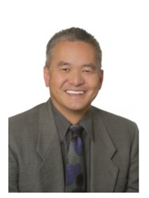

Learning From A Real-World Improvement Story
Listen to a Data-Driven Improvement Story
Focus on Improvement Content
What did they do?
What results did they achieve?
More importantly . . . .
How?
What methods did the team in in this example use that you can apply to your work?
Notes:
SLIDE SCRIPT:
Today we are going to begin with a real-world improvement story.
Why use a story? Every quality improvement team will need to be able to tell their story, using a standard approach, language and methods. They may tell their story to recruit other team members, to advocate for time or money or resources to support or grow the work. They may want to disseminate their work at a local Quality Fair, professional conference, and/or ultimately in a peer-reviewed journal.
So today – we begin with the end in mind. Each step in the QI journey is intentional, and we begin crafting the journey in a series of small “tasks” or “assignments.
PLEASE listen very carefully to this data-driven improvement story.
Although the clinical details may or may not be of interest (depending on your role) today you are listening carefully to the improvement content and methods.
What did they do?
What results did they achieve?
And most importantly HOW did they achieve this?
As you listen jot down any “methods” that might apply to your work. How might you apply a QI lens to make improvements in the work you do?
TIME: 90 seconds

Slide 6
Quality Improvement Data Driven Story Decreasing the Need for Emergency Room Visits at The Oregon Clinic by Using Qorus Data and Applying QI Methods
Donald Lum MD, FACG
The Oregon Clinic, Gastroenterology East
Portland, Oregon
The Oregon Clinic Improvement Story
Click Here
Deputy Director
Site Engagement & Experience
IBD Qorus
dlum@orclinic.com
Notes:
Instructor Notes:
To play the video, the slides must be in presentation mode.
Ideally this story is told, by playing the video tape of the engaged team.
Their telling of the story is genuine, real, conveys passion and speaks to your learners – so that they can begin to see how their team could do this work.
IF time – does not allow, then the instructor can tell the story, in brief.
The key in telling the story is to focus on the METHODS (leaving the precise clinical details for the students to read on their own).
TIME: 13.33 minutes

Slide 7

Questions? Comments? Reflections?
Notes:
SLIDE SCRIPT:
Let’s take a few minutes to reflect on this team’s improvement story?
What did you learn?
Were you able to discern the “method” that the team used (The Model for Improvement)?
Potential answers . . . . (teamwork, standard work, high-risk identification, patient engagement, patient education, careful measurement, benchmarking and tracking data over time)?
How might these skills apply to a project that you are working on or are envisioning?
Let’s refocus on this teams improvement methods via a quick QI theory bolus.
This will help YOU as you coach teams moving forward.
Time: 2 minutes for brief presentation; up to 5 minutes could be beneficial for longer presentation

Slide 8
The Cornerstone of Our Methodology: The IHI Model for Improvement
AIM
What are we trying to accomplish?
MEASURE
How will we know that a change is an improvement?
CHANGES
What change can we make that will result in improvement?
Act
Plan
Study
Do
Notes:
SLIDE SCRIPT:
Let’s circle back to dissect the simple improvement method used by this team.
As a QI participant or coach, you will constantly revisit these 3 questions to drive your improvement effort.
Estimated Time: 90 seconds

Slide 9
Quality Improvement Data Driven Story Decreasing the Need for Emergency Room Visits at The Oregon Clinic by Using Qorus Data and Applying QI Methods
Donald Lum MD, FACG
The Oregon Clinic, Gastroenterology East
Portland, Oregon
Deputy Director
Site Engagement & Experience
IBD Qorus
dlum@orclinic.com
Notes:
Slide Script:
As we revisit this QI story – let’s see if this team used a common QI method (The Model For Improvement).
Instructor Notes:
If teams are seeking Maintenance of Certification Credit through Dartmouth or other avenues, it is imperative that their team members who can use MOC Credits (PA and MD) be listed as co-authors of the improvement story either here on slide 1 – or – if the list is too long on the final gratitude slide. These names should also be listed on future abstracts and publications.
Time: 30 seconds

Slide 10


Question 1: What Are We Trying To Accomplish?
Notes:
Slide Script:
Question #1 in the Model for Improvement is:
What are we trying to accomplish?
Was the team clear on what they were trying to accomplish?
Did they have a SMART Aim?
Time: 30 seconds

Slide 11
Our SMART Aim
We aimed to improve ED utilization for our IBD patients by decreasing ED use from 30% per month to 15% per month by April 30, 2019.
NOTE: Motivated by the end of the Qorus IBD Breakthrough Series.
Notes:
Instructor Notes:
Flash up the SMART AIM . . . And ask – is this a strong SMART AIM?
Time: 30 seconds

Slide 12
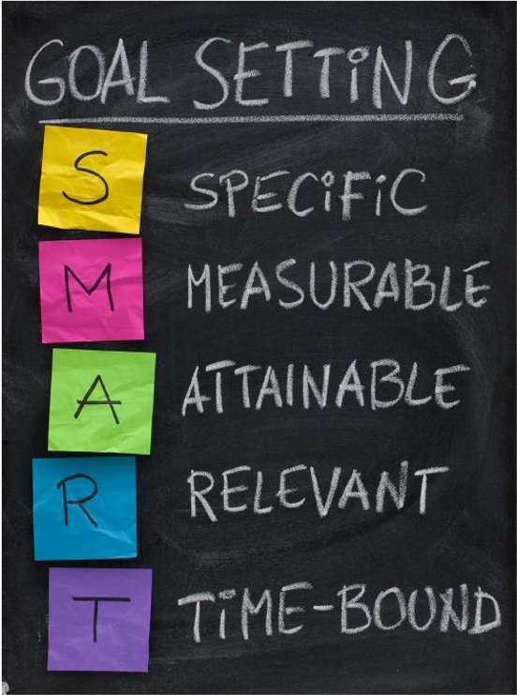
Every Project Needs a SMART Aim
Notes:
SLIDE SCRIPT:
Every project needs a SMART Aim. This is established early in the project cycle, typically after identifying a practice gap or service need (preferably with some baseline data).
Although deceptively simple, SMART Aims are challenging to write. Stay tuned for the SMART Aim lesson and SMART Aim tools to guide you and your team.
Time: 60 seconds

Slide 13
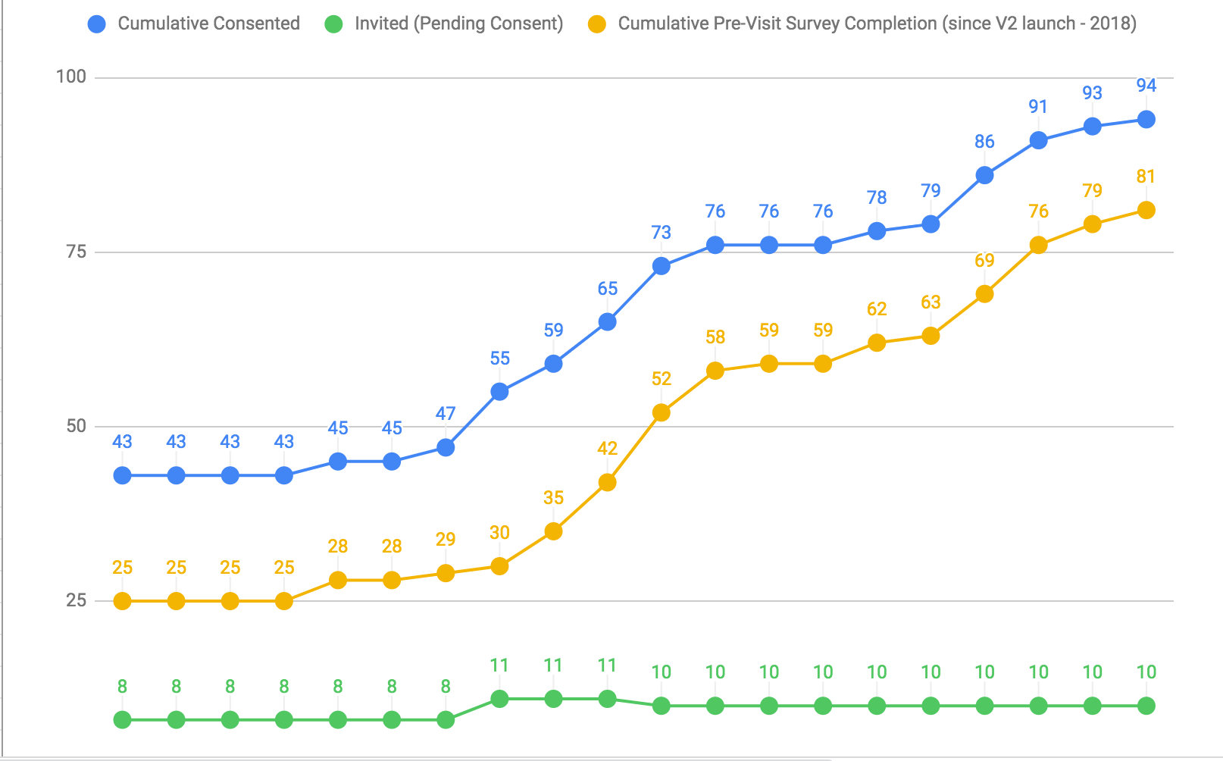
Question 2: How Will We Know a Change is an Improvement ?
Notes:
Slide Script:
Question #2 in the Model for Improvement is:
How will we know that a change is an improvement?
Other than feeling “good” about the project that is progressing, how did this team know that their changes were an improvement?
Time: 30 seconds for slide and optimally 1 minute for response time from audience

Slide 14
Key Measures
Data
Percent of IBD patients who sought care at any local ED during the past 6 months.
Data Source
Patient-reported data
Collected on the Qorus Pre-Clinic Survey Question*
*Have you been to an Emergency Department (ED) in the past 6 months due to your IBD?”
Notes:
Slide Script:
Prior to launching into the improvement cycles this team established a clear metric (review from slide) and a method (insert data capture strategy, ie patient reported outcomes via pre-visit surveys) to get at this data.
This is a CRITICAL step to deploying the Model for Improvement. Because clinicians are not necessarily measurement experts or QI experts, this is an area that some focused early coaching can pay BIG dividends.
Time: 30 seconds

Slide 15
Question 3: What Changes Can We Make That Will Result in Improvement?
Notes:
Slide Script:
The third question in the model for improvement is:
What small tests of change can we test?
It is important to start SMALL . . . Remember, the idea is not to implement change, but to TEST it?
You will learn more about how to structure tests of change, and measure their impact in future lessons on PDSA cycles.
Est Time: 30 seconds.

Slide 16
Plan-Do-Study-Act Cycles
PDSA 1 Test Creation of a High-Risk List
1A How Many Questions
1B, 1C, 1D What Questions to Ask (3 revisions)
1 E Standardize Frequency to See High-Risk Patients
PDSA 2 Refine “Work-in Appointments
2A Frequency
2B Number of “Slots” to Hold
2C When to Release the Slots
PDSA 3 Test Weekly Huddles
3A Best Day
3B, 3C Best Time, Method
Notes:
Slide Script:
Did this team conduct multiple, iterative, small tests of change?
Do the PDSA cycles logically build upon learning from each PDSA cycle over time?
Time: 60 seconds

Slide 17
Statistical Process Control Chart (p-Chart)
Monthly ER Use in Qorus IBD Patients February 2018 to December 2018 (n= 750 Patients Evaluated)
Desired
Direction
Emergency Room Use
0% 20%
Mean or Average
Green Line = 11%
Notes:
SLIDE SCRIPT:
SHORT VERSION:
So let’s focus here on the project results presented using a standard QI format, demonstrating data over time.
Although you may not yet be an expert in reading run charts or statistical process control charts, you can see, at a glance that ER use began at ~20% and decreased to 7-12% in the last 3 data points.
This was temporally associated with the PDSA cycles that the team tested.
Time: 60 seconds
Instructor Notes:
More Detailed explanation (reserve for more experienced teams) . . . .
Systematically present the run chart from top to bottom explaining first the structure of the chart, and then walking through the data over time
LONGER VERSION OF OF SCRIPT:
This is a statistical process control chart (p-chart) highlighting monthly emergency department use from February 2018 to December 2018.
The chart includes a robust sample (750 patients in 10 months).
The Y Axis is the percent of IBD patients who were seen in the ER.
The X Axis is time (denoted monthly).
The GREEN line is the measure of central tendency (Mean). Red lines are the upper and lower control limits for the chart.
Each blue dot represents all of the patient-reported data from pre-visit surveys aggregated monthly and is the % who were seen in the ER.
The arrows indicate the timing of the various PDSA cycles.
Although you may not yet be an expert in reading run charts or statistical process control charts, you can see, at a glance that ER use began at ~20% and decreased to 7-12% in the last 3 data points.
This was temporally associated with the PDSA cycles that the team tested.

Slide 18
Connecting the Dots – What Lessons Did You Learn?
What Methods Might You Adopt?
Listen to Data-Driven Improvement Story
Focus on Improvement Content
What did they do?
How?
What methods did the team in this example use could you apply to your work?
What results did they achieve?
Notes:
SLIDE SCRIPT: Read the slide / focus on how.
INSTRUCTOR NOTES: Try to get teams working on divergent projects . . . (i.e. dashboard uptake, or Patient Wisdom, or creating a patient support network) to see how the use of a SMART AIM, and small tests of change, and using the data to improve practice, might inform their work. Solicit 1 or 2 brief examples to spur the thinking of others.
Time: 90 sec (micro-lesson form; longer if in a workshop).

Slide 19

In the future, when striving to make improvements in my work or with teams I am coaching, I might use key concepts from this lesson to focus on:
Being more intentional in setting a SMART Aim early in the project.
Investing time in creating measures that matter.
Focusing on feeding real-time data back to my team to motivate change.
Engage my end users and/or patient and family partners earlier.
More intentional structured improvement cycles using the Plan-Do-Study-Act method
Other
Notes:
SLIDE SCRIPT:
Keep in mind that there is no “right” answer.
Your response should reflect a place in the Model for Improvement where you believe you have ”room to grow.”
INSTRUCTOR NOTES:
Please use the following modality to respond to this poll (use Zoom polling, provide Poll Everywhere instructions, or simply have participants us the chat). If time allows, give up to 5 minutes for discussion modeling good listening and the “all learn, all teach” culture of QI.
Time: Response 90 seconds

Slide 20
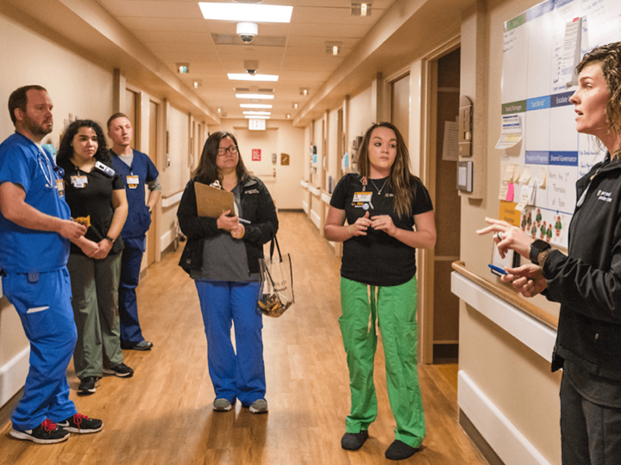
Use your team huddles and meetings to plan and debrief
small scale tests of change.
Notes:
Slide Script:
As written on slide.
Instructor Notes:
As you coach teams, you need to help them make a standard “time” and “space” and expectation to use the Model for Improvement and revisit these 3 questions in their team huddles.
Meeting weekly is ideal, but at least 2X month is required to imbed the discipline and gain momentum.
Est Time: 30 seconds.

Slide 21
Summary
3 Key Questions in the Model for Improvement
What
How
Changes
Answer each question with a SMART Aim
Key Measures
Changes Tested via PDSA Cycles
Adopting a common model, disciplined approach and methods leads to improved results!
Notes:
Slide Script:
In summary remember the 3 key questions in the Model for Improvement – and imbed these in your QI and coaching practice:
What are we trying to accomplish (defining the problem is key!)
How will we know our changes are an improvement (measurable improvement required).
What changes can we test? (evidence-based potentially better practices).
You will find that each time you embark on a project, and in each phase of the project, these 3 questions will prompt deeper thinking and understanding for YOU and your colleagues.
Est Time: 1 minute.

Slide 22

Resources
Batalden PB, Davidoff F. What is “quality improvement” and how can it transform healthcare?. BMJ Quality & Safety. 2007 Feb 1;16(1):2-3.
Chen Y, VanderLaan PA, Heher YK. Using the Model for Improvement and Plan-Do-Study-Act to effect SMART change and advance quality. Cancer Cytopathol. 2020 Aug 4.
Courtlandt CD, Noonan L, Feld LG. Model for improvement - Part 1: A framework for health care quality. Pediatr Clin North Am. 2009;56(4):757-778.
Pratap JN, Varughese AM, Adler E. Getting started with the model for improvement: the model in practice. Br J Hosp Med (Lond). 2013;74(1):42-6.
Randolph G, Esporas M, Provost L. Model for Improvement – Part Two: Measurement and feedback for quality improvement efforts. Pediatr Clin North Am. 2009;56(4):779-98.
Model for Improvement Part 1. IHI Whiteboard Video
2:54 minutes
Basic Overview
http://www.ihi.org/education/IHIOpenSchool/resources/Pages/AudioandVideo/Whiteboard3.aspx
Model for Improvement- Improvement Foundation Video
6:54 minutes
Animated, fun and with an easy example. Explains why tests of change, before implementation are important.
https://www.youtube.com/watch?v=lZAx-69Vn_Y
Notes:
SLIDE SCRIPT:
Here are some resources for you to explore, that may be found in the supplemental lesson materials.
INSTRUCTOR NOTES:
If you will be coaching others you will find reviewing at least these brief resources will enrich your learning and help you meet your team’s needs more completely.
Also, it is often important to share these resources with eager or more advanced learners on your QI team may help you to meet their learning needs.
Timing: 30 seconds

