Slide 1



Plan-Do-Study-Act
Iterating Your Way to Improvement
Alice Kennedy, MPH
Research Project Director
The Dartmouth Institute
Last modified 12/5/2023
Notes:
SLIDE SCRIPT:
Hello, my name is Alice Kennedy, I’m a Research Project Director with The Dartmouth Institute for Health Policy and Clinical Practice at Giesel School of Medicine at Dartmouth. I’m here to provide you with an installment of the IBD Qorus Quality Improvement Curriculum, brought to you through a partnership of The Crohn’s & Colitis Foundation and The Dartmouth Institute. This lesson is called Crafting a SMART Aim, and the purpose of this lesson is for teams to gain a better understanding of where the plan-do-study-act cycle fits into the Model for Improvement. By the end of this lesson, you and your team will be prepared to plan your first PDSA cycle to set out on achieving your SMART Aim.
TIME: 30 seconds

Slide 2
Learning Objectives
Describe
Describe a PDSA cycle and link it to the questions in the Model for Improvement.
Review
Review the components and ramping of the PDSA cycle.
Apply
Apply your new knowledge and develop a plan for your first PDSA cycle with your team to test by next Tuesday.
Notes:
SUGGESTED SCRIPT:
Our learning objectives for today are to (read slide).
INSTRUCTOR NOTES:
Note the active verbs in the learning objectives (define, review, analyze) move from simple to more complex applied learning.
Explicitly verbally stating your learning objectives at both the beginning of the lesson and summarizing what was learned at the end of the lesson, is important. It helps learners prepare for what you will teach them. Data suggests that learners listen more carefully, and, are more likely to retain key teaching points.
Timing: 30 seconds

Slide 3
The Cornerstone of Our Methodology: The IHI Model for Improvement
AIM
What are we trying to accomplish?
MEASURE
How will we know that a change is an improvement?
CHANGES
What change can we make that will result in improvement?
Act
Plan
Study
Do
Notes:
SUGGESTED SCRIPT: The Plan-Do-Study-Act (PDSA) cycle is derived from the scientific method and is a commonly used to move the bottom box of the model for improvement into action! The PDSA method is a simple scientific approach to conduct repeated small-scale experiments, or tests of change, aimed at facilitating improvement.
INSTRUCTOR NOTE: Emphasize the scientific nature of the PDSA and that it is iterative and small scale, and most often employed in multiple cycles of shorter duration.
Timing: 45 seconds

Slide 4
The PDSA Cycle
Define next steps
Adapt
Adopt
Abandon
Who, what, where, when, how
ACT
PLAN
STUDY
DO
Analyze data
Summarize what was learned
Carry out the plan
Record results
Notes:
SUGGESTED SCRIPT: The Plan-Do-Study-Act cycle is a scientific method for testing a change by planning it, trying it, observing the results, and acting on what is learned.
We recommend that you start with the planning phase. This includes
Clearly stating the objective of the test
Make predictions about what will happen, and
Develop a plan to test the change. (Who? What? When? Where? How? What data need to be collected?)
Next you run a small scale “test” the Do Phase
a. Carry out the plan
b. Record your results and document problems or unexpected observations
Study the results; set aside time to analyze the data
a. Complete the analysis of the data
b. Compare the data to your predictions
c. Summarize and reflect on what was learned
Act based on what was learned from the test – Adapt, Adopt, or Abandon?
a. Determine what modifications should be made
b. Prepare a plan for the next test
INSTRUCTOR NOTES: IT WOULD BE HELPFUL TO PROVIDE A SIMPLE EXAMPLE OF A “N OF 1” PDSA CYCLE EITHER A HEALTHCARE EXAMPLE OR A PERSONAL EXAMPLE
Timing: 90 seconds

Slide 5
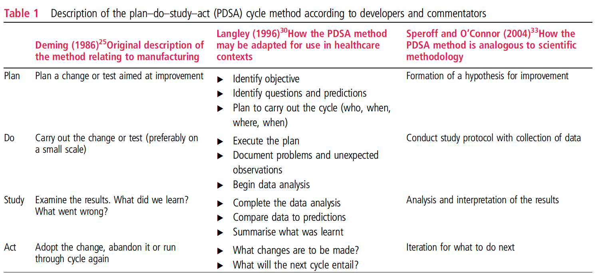
How the PDSA Method is Analogous to the Scientific Method Taylor MJ, et al. Systematic review of the application of the plan-do-study-act method to improve quality in healthcare. BMJ Qual Saf 2014;23:290–298.
Key Features of the PDSA Method | Key Principles of the PDSA Method
1. | Iterative cycles
2. | Prediction-based test of change
3. | Small-scale testing
4. | Use of data over time
5. | Documentation
Notes:
SUGGESTED SCRIPT:
Evidence suggests that there is wide variation in the use of the PDSA method. It is important to apply each step of the method in your approach to assure the outcomes you are seeking.
Here we can crosswalk the stages of the PDSA Method to the Scientific Method.
The plan phase is analogous to developing your hypothesis for improvement.
Do is similar to conducting your study protocol and collecting data.
Study is the analysis and interpretation of your results.
Followed by the Act phase and researcher’s plans for what to do next based on their hypothesis and final results.
To realize the full benefits of the methodology (ANIMATE) it is important to apply the five key features of the PDSA method:
To achieve an iterative approach, multiple PDSA cycles must occur. Lessons learned from one cycle link and inform cycles that follow. Ineffective cycles can be abandoned early on, in the do stage therefore eliminating the need to go through all the remaining stages. Ineffective changes will result in learning, which is a fundamental principle behind a PDSA cycle. However minor an abandoned trial may be, it can still be usefully described as a PDSA cycle.
A prediction of the outcome of a change is developed in the ‘plan’ stage of a cycle. This change is then tested and examined by comparison of results with the prediction. Do not skip this step!
PDSAs start small in scale and build in scale as confidence grows. This allows the change to be adapted according to feedback, minimizes risk and facilitates rapid change and learning.
The use of data over time increases understanding regarding the variation inherent in a complex healthcare system and is necessary to understand the impact of a change on the process or outcome of interest. You will learn more about data over time in Run Chart lessons at a later time.
Documentation is crucial to support local learning and transferability of learning to other settings.
TIME: 3 minutes
Timing: 60 seconds

Slide 6
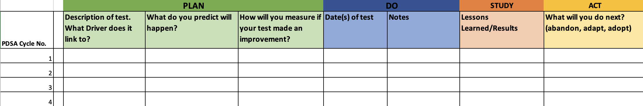
Importance of Tracking Lessons Learned
PDSA Tracking Tool
Notes:
SUGGESTED SCRIPT:
As your team conducts PDSA tests of your different change ideas, it is important to track and document what you learned. Those change ideas that did not turn out as predicted and were abandoned or adapted in the ACT phase of the PDSA cycle should be captured continuously in your PDSA Tracking Tool.
The lessons you learn including the “failures” are important to document for those that intend to replicate your theory of change, to avoid pitfalls or waste in time and resources on change ideas that did not result in the predicted outcome. This also will be helpful when annotating your run chart and writing your results down the road.
Timing: 30 seconds

Slide 7


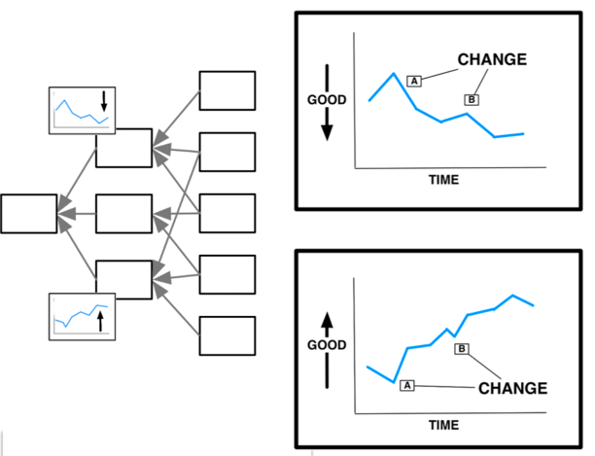
PDSAs Are Change Ideas in Action
PDSAs
Change
Ideas
Measures
Drivers
Aim
Notes:
SUGGESTED SCRIPT:
Here you can see how PDSAs link to your Key Driver Diagram.
You can think of PDSA as a method to test changes that will affect key drivers linked to your aims.
Timing: 30 seconds

Slide 8
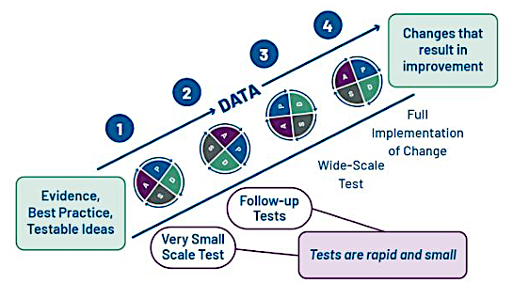
Ramping Up Your PDSAs
Agency for Healthcare Research and Quality (AHRQ). Job Aid: Model for Improvement and PDSA Cycles.
Notes:
SUGGESTED SCRIPT:
A PDSA Ramp is a series of sequential small tests of change that relate to a similar goal.
The first PDSA begins with a theory or a hunch that if we try ”X” an outcome of interest “Y” will improve. The team begins with a very small test of change, as they have nothing more than a hunch that it will work.
PDSA cycles start out very small. Then, as the degree of belief that the change will be successful increases, the scale of the test can be increased, and wider tests can be conducted with multiple team members and ultimately across multiple contexts.
In later stages, as your confidence in the intervention increases, and you are considering full-scale implementation of a change, PDSA cycles are often used to optimize and sustain the change (i.e., implementation) or to address problems with the implementation (when the implementation does not proceed as planned).

Slide 9
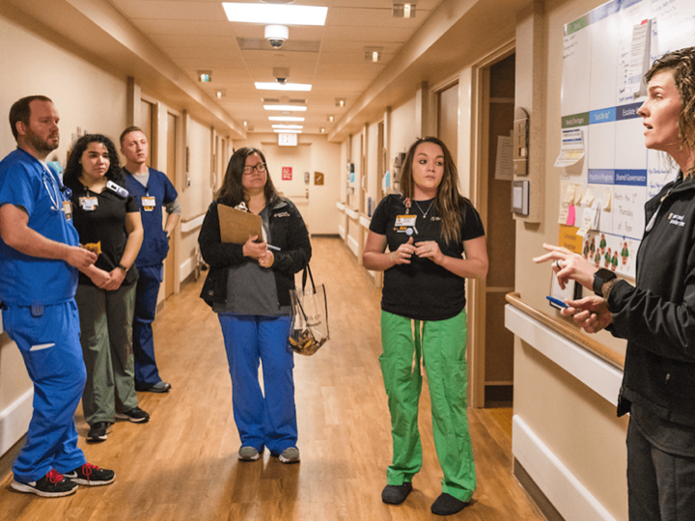
Huddle Time – Discussing Your PDSA Cycles
Notes:
SUGGESTED SCRIPT:
I strongly urge you to start small, something that’s an easy win. Team huddles are a great time to discuss PDSAs results – study how it went, and decide will you adapt, adopt, or abandon?
After testing a change on a small scale, learning from each test, and refining the change through several PDSA cycles, your team may implement the change
on a broader scale.
INSTRUCTOR NOTE: Discussion: What might your team test first?
Timing: 60 seconds

Slide 10
Summary
PDSA Cycles
Plan
Do
Study
Act
PDSA is a scientific approach used to perform tests of
change to drive improvement.
PDSAs are a simple and effective way to test change ideas linked to your aims and drivers.
Notes:
INSTRUCTOR NOTES: Read summary of lesson take aways
Timing: 30 seconds

Slide 11

Resources
Leis JA, Shojana KG (2016). A primer of PDSA: Executing Plan-Do-Study-Act cycles in practice, not just in name. BMJ Open; 26:572-577.
Reed JE, Card AJ (2015). The problem with PDSA cycles. BMJ Quality & Safety; 25:147-152.
Taylor MJ, McNicholas C, Nicolay C, et al. (2013). Systematic review of the application of the Plan-Do-Study-Act method to improve quality in health care. BMJ Quality & Safety; 23:290-298.
PDSA Part I: PDSAs in Everyday Life (4:45)
https://youtu.be/_-ceS9Ta820
PDSA Part II: PDSAs a Healthcare Example (3:48)
https://youtu.be/eYoJxjmv_QI
Notes:
SUGGESTED SCRIPT:
Here are some resources for you to explore, that may be found in the supplemental lesson materials.
INSTRUCTOR NOTES:
If you will be coaching others you will find reviewing at least these brief resources will enrich your learning and help you meet your team’s needs more completely.
Also, it is often important to share these resources with eager or more advanced learners on your QI team may help you to meet their learning needs.
TIME: 30 seconds

Slide 12
Next Steps
ACTIVITY | MATERIALS
Review PDSA Microlesson & Share With Your Team | PDSA: Iterating Your Way to Success microlesson
View instructional videos on PDSA cycles | PDSA Part I: PDSAs in Everyday Life PDSA Part II: PDSAs a Healthcare Example
Draft your team’s PDSA plan Run the test Study and document results Capture multiple PDSA cycles on the tracking worksheet—this can be used to inform your annotated run chart as well! | PDSA Worksheet PDSA Tracker
Share & Compare | Share the results of your PDSA with colleagues/other teams!
Notes:
SUGGESTED SCRIPT:
If the Collaborative is currently in an Action Period of an Improvement Initiative, you may be asked to take some next steps at this time, such as [Read Slide]
Check with IBD Qorus Leadership to see what next steps are right for you!
INSTRUCTOR NOTES:
TIME: 60 seconds

Slide 13

PDSA Simulation Exercise
Adapted From:
Williams, D.M. Coin Spin PDSA Exercise Facilitator Guide. Austin, TX: DMW Austin, LLC. 2019.
Available at www.davidmwilliamsphd.com
https://www.davidmwilliamsphd.com/coin-spin-pdsa/
Copyright © 2019 DMW Austin, LLC
Notes:
INSTRUCTOR NOTE: If time allows here is a PDSA exercise you can conduct with one small team or multiple teams, the following has been adapted to run in a virtual/online context. Adapt if in person.
Please refer to PDSA Coin Exercise Facilitator Prompts for additional guidance on how to lead this exercise in a group setting.
The Coin Spin PDSA Exercise may be used to teach participants the concepts and value of designing experiments for quality improvement.
Factors may include the coin, technique, and surface. Levels include variations on each factor such as type of coin used.
Participants may design an experiment, complete the PDSAs and data collection, and quickly learn the combination of factors that results in the longest spin.
Timing: 30 seconds

Slide 14
Exercise Learning Objectives
Test your theory of improvement
Identify key testable variables
Conduct rapid cycle small tests of change
Measure the results
Compare the results by benchmarking with others
Notes:
SUGGESTED SCRIPT:
Test your theory of improvement.
Identify key testable variables.
Conduct rapid cycle small tests of change.
Measure the results.
Compare the results by benchmarking with others.
Timing: 30 seconds

Slide 15
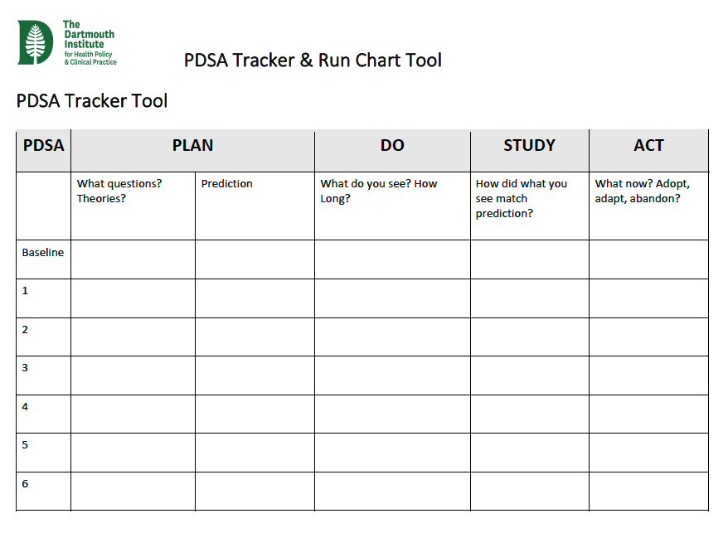
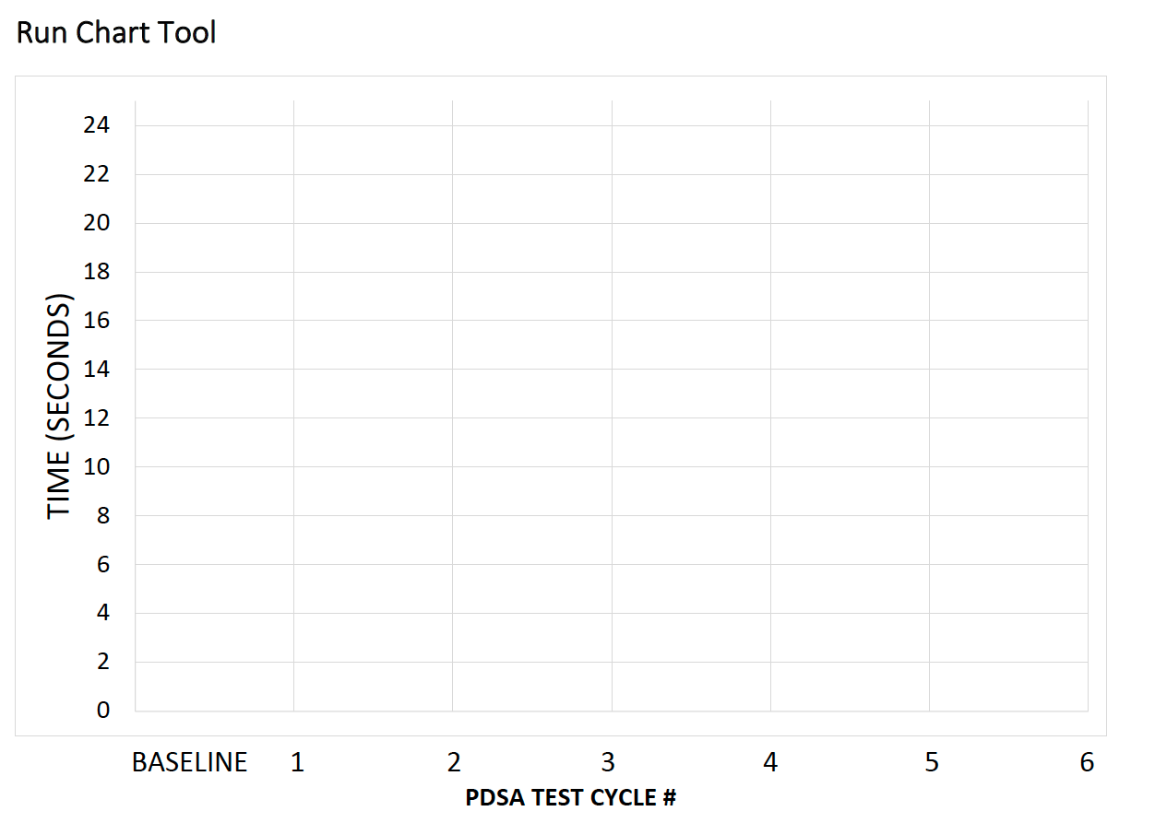

What You Will Need
1-2 Pennies
PDSA tracker & run chart tool
Cellphone or watch for a timer
Notes:
SUGGESTED SCRIPT:
What if someone is on their own? Lesson is –you need a team to be efficient and effective when testing new interventions
In virtual context what tools will they need—how can we make this easy
Timing: 30 seconds

Slide 16





PLAN
Use the PDSA tracker and run chart tool to draft your plan
Organize your coins
Identify team roles
Select the Testing Site
What do you PREDICT will happen?
“If I use both hands to spin the coin, it might produce a more stable spin that lasts longer.”
Coach
Observers
Timekeeper
Tester / “coin spinner”
Data collector
Where will you conduct the test (i.e. where will you spin?)
Is the test site “ready” to test
Clear?
Aware?
Participatory?
Write down your predictions
Notes:
INSTRUCTOR NOTE: Walk teams through the steps of the PDSA exercise.
Timing: 60 seconds

Slide 17





Standardized Measurement
How will we know a change is an improvement?
Are our results comparable?
Operational definitions
START: Timer starts when the tester starts to spin the coin.
STOP: Time stops when the coin stops spinning on the test surface.
Notes:
INSTRUCTOR NOTE: Walk teams through the measurement steps
Timing: 60 seconds

Slide 18


DO
Spin the coin
Note the time & record it
Notes:
INSTRUCTOR NOTE: Describe the activities / steps.
Timing: 30 seconds

Slide 19






STUDY
Study – what did you observe?
What do the data tell you?
Was your prediction accurate or not?
Text your time into the chat
What might you test next?
Prioritize & plan
EXAMPLE
Notes:
INSTRUCTOR NOTE: Review as a large group.
Timing: 60 seconds

Slide 20
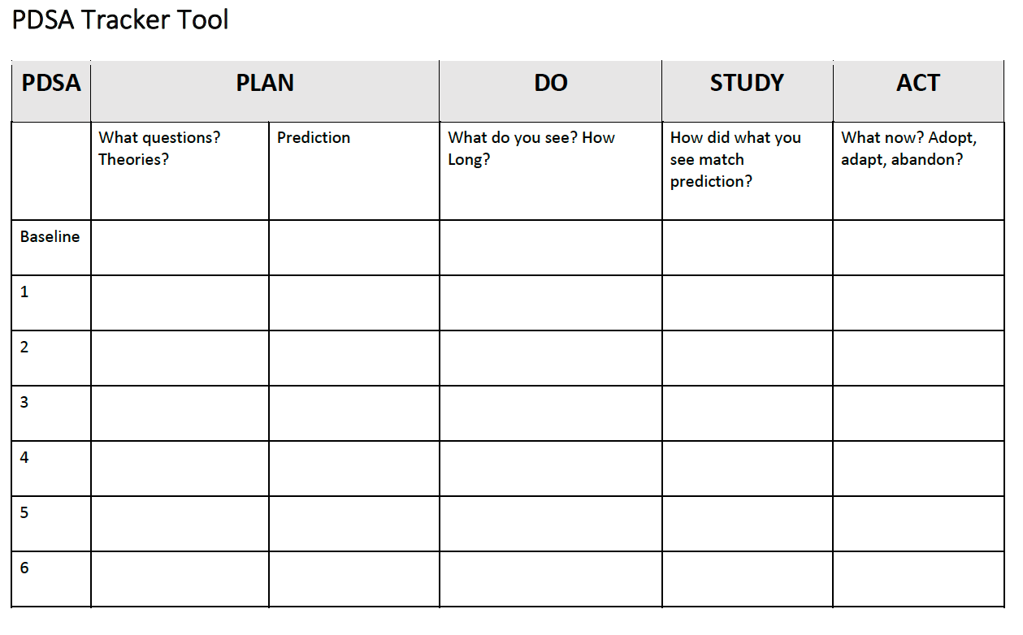
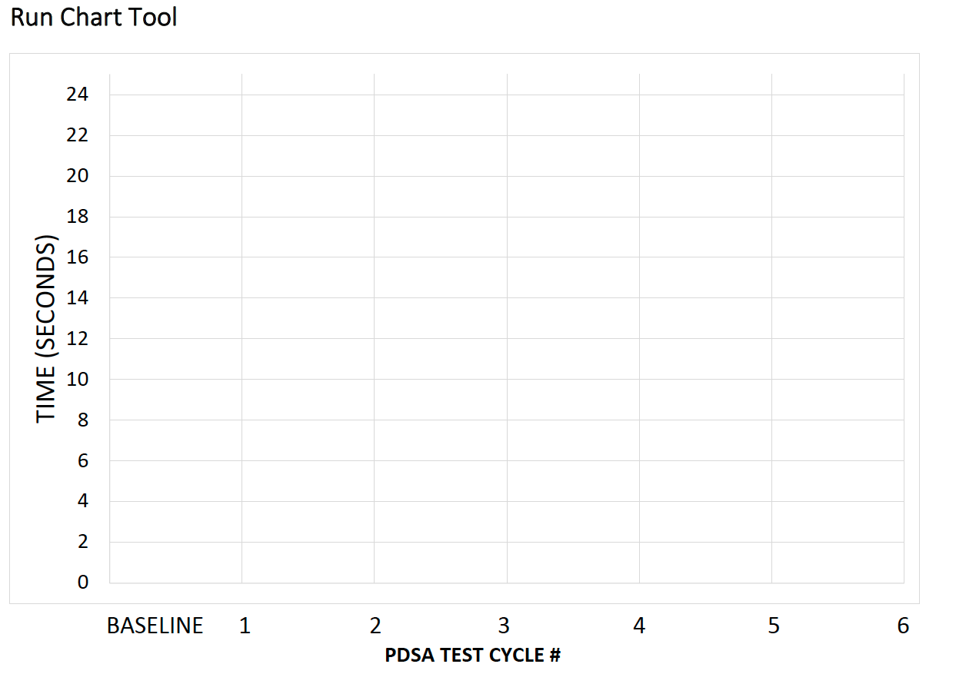
Simple PDSA Tracker & Run Chart Tool
Notes:
INSTRUCTOR NOTES:
“If you had to run a test and all you had was an index card and a pen you could still collect data”
What questions? Theories? Predictions? What do you see? How Long? How did what you see match prediction? What now? Adopt, adapt, abandon?
Timing: 60 seconds

Slide 21

ACT
This Photo by Unknown Author is licensed under CC BY-SA
Adopt
Adapt
Abandon
Notes:
INSTRUCTOR NOTE:
ACT Phase: This is where teams skip over too quickly and do not take the time to pause and learn from the test and the results. Encourage teams to pause to discuss what they learned and use the data to inform the next PDSA.
Timing: 30 – 60 seconds

Slide 22


Teams into Action
This Photo by Unknown Author is licensed under CC BY-SA
Notes:
INSTRUCTOR NOTE:
Describe how teams will break out, how much time they have and how we will return to compare team results. Also indicate that if they experience technical issues when moving to a virtual breakout room what should they do to get assistance.
Timing: 60 seconds

Slide 23

DEBRIEF
LESSONS LEARNED
Notes:
Instructor notes: Considerations for Debriefing
https://www.davidmwilliamsphd.com/coin-spin-pdsa/step-four-debrief/
Test vs. Talk – Teams frequently spend too much time planning and not enough time testing and learning. Testing leads to learning that facilitates future tests and improvement. Testing reveals considerations that cannot be predicted.
Parallel Testing – Discourage parallel testing of change ideas in the exercise. This can lead to multiple participants testing different ideas but not learning together.
Competition – While competition between teams is not introduced in the aim, teams frequently become competitive and challenge winning teams and times that are significantly better than others. Note the competition that emerges and inquire if it is helpful for improvement work.
Collaboration – It’s very common for teams to never think to visit another team to learn ideas and share knowledge. Ask why no one visited another team and highlight the missed opportunity.
Documentation – Ask how much time it took to complete the PDSA tracking form and run chart for each test. Note that documenting improvement does not need to be a burden. Some participants will fail to document their PDSAs and run chart data or abandon it; inquire why and discuss the missed learning.
Testing Considerations – Teams will often ask about several testing considerations including switching testers and changing test ideas versus iterative testing on a single idea. Each consideration offers a chance to discuss various considerations you might encounter when doing PDSA testing.
Collaborative or Networked Learning – If participants are participating in an IHI Breakthrough Series Collaborative or networked learning process, it can be helpful to show the group’s aggregate mean scores along with a small multiples for each table. Note the variation represented in the group and connect how this is similar to the variation noted in teams or sites participating in collaborative or networked improvement initiatives.
Timing: 5 or more minutes for reflection depending on the time allotted for the exercise

