Slide 1



Run Chart Basics: Pt 1
A Tool to Plot the Dot Over Time
Alice Kennedy, MPH
Research Project Director
The Dartmouth Institute
Last modified 12/5/2023
Notes:
SLIDE SCRIPT:
Hello, my name is Alice Kennedy, I’m a Research Project Director with The Dartmouth Institute for Health Policy and Clinical Practice at Giesel School of Medicine at Dartmouth. I’m here to share an installment of the IBD Qorus Quality Improvement Curriculum, brought to you through a partnership of The Crohn’s & Colitis Foundation and The Dartmouth Institute. The purpose of this lesson is to help you and your team gain a better understanding and appreciation of an important quality improvement tool, called the run chart. You will get some tips for who, what, when and how to use a run chart to drive your SMART Aim and answer the all important question – How will we know our change is an improvement?
TIME: 30 seconds

Slide 2
Learning Objectives
Describe
Describe a run chart and describe how the run chart links to and drives your SMART Aim.
Review
Review the anatomy of a run chart and key elements required to tell a useful data story.
Notes:
SLIDE SCRIPT:
We have 2 learning objectives for today that include: read slide.
INSTRUCTOR NOTES: This lesson will focus on the simplest of tools, a run chart. Statistical process control charts (SPCC) are a related but distinct type of tool that will be covered in a future lesson. Note the active verbs in the learning objectives (define, review) move from simple to more complex applied learning. Interpreting and analyzing run charts will be the focus of Part 2.
Explicitly verbally stating your learning objectives at both the beginning of the lesson and summarizing what was learned at the end of the lesson, is important. It helps learners prepare for what you will teach them. Data suggests that learners listen more carefully and are more likely to retain key teaching points.
TIME: 30 seconds

Slide 3
What is a Run Chart?
A Simple Improvement Tool
Allows You to “Plot the Dot” and Analyze Data Over Time
Examine Temporal Relationships Between Changes You Make and Results You Achieve
Notes:
SLIDE SCRIPT:
A run chart is a statistically-grounded improvement science tool used by quality improvement teams to measure and drive outcomes.
This improvement tool allows your team to “plot the dot” and analyze data over time.
By including both data and PDSA annotations, the run chart allows you to examine the temporal relationships between changes you are “testing” using PDSA cycle methods, and their impact on the results you achieve. Tracking data in this way helps you achieve the results you desire.
INSTRUCTOR NOTES:
Local teams may choose to adopt a project level run chart, provided to them by their collaborative organizers. They may also opt to either create their own run charts for unique local process or outcomes measures, and/or most frequently will modify or enrich existing data or materials by annotating either local run charts, or data reports with PDSA cycles.
Run charts and statistical process control charts without annotations are interesting; however, they only represent 50% of the data story. The other 50% of the story emerges from the annotations and the team’s understanding of their local context.
TIME: 1 Minute

Slide 4
The Cornerstone of Our Methodology: The IHI Model for Improvement
AIM
What are we trying to accomplish?
MEASURE
How will we know that a change is an improvement?
CHANGES
What change can we make that will result in improvement?
Act
Plan
Study
Do
Notes:
SLIDE SCRIPT:
It is helpful to once again anchor our work in the overarching framework of the Model for Improvement.
Run charts can help highlight variation in your system, measure the impact of your project overall, and understand how small tests of change influence your SMART Aim. It helps the team answer the second question in the Model for Improvement – how will we know that a change is an improvement.
TIME: 30 seconds

Slide 5
Potentially Better Practices Plsek PE. Quality Improvement Methods in Clinical Medicine. Pediatrics.1999;103:203-214.
S
A
A
D
P
S
P
A
P
PDSA 1
PDSA 2
PDSA 3
D
S
D
“We will not know if the changes we are imposing are truly better until we adapt them to our local context, implement them, and measure the results.”
Notes:
SLIDE SCRIPT:
Remember that your PDSA cycles are a way to objectively test and evaluate potentially better practices. You may think these practices are indeed better, but you won't know until you test them in your own context and until you measure the results.
TIME: 20 seconds

Slide 6


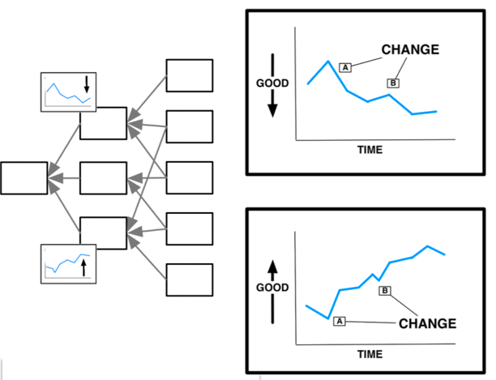
Key Linkages
PDSAs
Measures
Drivers
Aim
PDSA Cycles
PDSA Cycles
Notes:
SLIDE SCRIPT:
This slide demonstrates how the steps of your improvement work link to each other.
Your SMART Aim statement grounds your work, keeping your project priorities focused on things that will move the Aim. Notice the logic here . You can see how the aim links to your primary and secondary drivers which inform your PDSA cycles, or, what changes can we make to drive improvement, and your measures evaluate the impact of the PDSA cycles.
Now, using run chart methodology to plot your data, your team can begin to understand if the changes you are making are really an improvement.
INSTRUCTOR NOTE: Good to keep emphasizing aims, drivers and measures! They must align and fit together logically.
TIME: 60 seconds

Slide 7
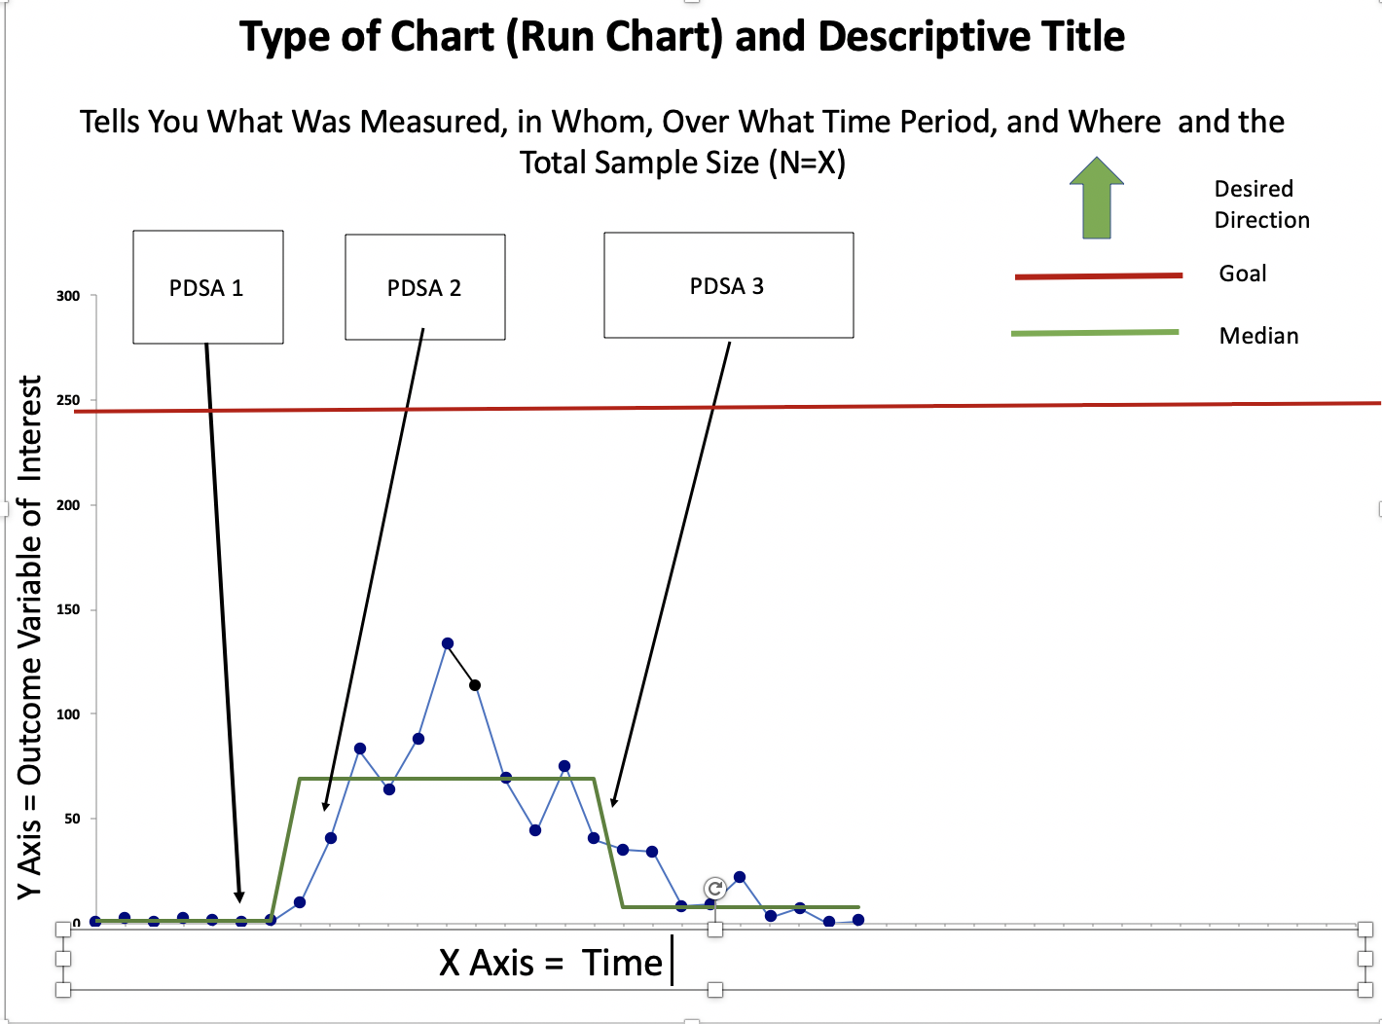
Key Elements of a Run Chart
Goal
Median
Perla RJ, Provost LP, Murray SK. The run chart: a simple analytical tool for learning from variation in healthcare processes. BMJ Qual Saf. 2011 Jan;20(1):46-51.
Notes:
SLIDE SCRIPT:
As a QI team member, you should understand your team’s run chart and be able to use it to clearly tell your team’s data driven improvement story. A project may have multiple measures; however, the main data-driven run chart links to the team’s overall outcome measure, identified in the SMART Aim. This is the heart of your improvement work.
Let’s begin by studying the anatomy of a simple run chart.
Instructors Notes: You should read the chart (and explain the chart to others during your presentation) using the sequence below.
(ANIMATE) Type & Title – The title of the chart is at the top. It should be short and descriptive. A good title clearly tells the reader the following:
What type of chart is being displayed. In this case it is labeled a run chart.
What population (i.e. patient or clinic type)
What data is being plotted (for example % compliance)
What time period.
How many patients or events are represented by the cumulative dots plotted on chart – another way to represent your sample size.
2. (ANIMATE) Desired Direction – is often shown with an arrow in the upper right hand of the chart. It is important to orient your audience to the desired direction we want our measure to go. In some cases we want it to go up; in others we want it to go down.
3. (ANIMATE) Y Axis – Note the Y, or vertical axis of the chart on the left-hand side which represents the outcome variable of interest, or, your primary measure.
4. (ANIMATE) X Axis – Note the X, or horizontal axis of the chart along the bottom which represents time. Time may be denoted in days, weeks, months or quarters indicating the interval at which you are measuring your outcome. Plotting dots over time reveals potential variability in the system and helps you interpret what is happening.
5. (ANIMATE) Goal – Note the Goal line at or near the top of the chart. This is often denoted by a red line. This is your team’s goal for your SMART Aim. Your SMART Aim goal may shift over time as your performance improves and elevating the aim becomes realistic and achievable for your team.
6. (ANIMATE) Median - Note the median, the green horizontal line. Every run chart needs a measure of central tendency, by definition the median is used as the centerline for comparisons because (1) it provides the point at which half the observations are expected to be above and the other half are below the centerline; and (2) the median is used in run charts because it is less influenced by extreme values in the data.
It is important to emphasize that there is no way to “interpret or analyze a run chart” without a median, or our central line of tendency to analyze the data. All of the run chart rules for interpretation are based upon statistical probability--not just an individual’s impressions that things are better or worse.
Note that in this example the median moves. Changes in the median, in the desired direction, suggest improved system performance. Changes in the opposite direction, suggest that system performance may be degrading.
In Run Chart Lesson 2, we will learn the 4 rules for run chart interpretation, and then be able to discern if the data are really going up and improving (a signal) or are the data points simply illustrating common cause variation (noise)? Once you understand the rules and can identify statistically based shifts in the data, you will then shift the median.
7. (ANIMATE) “Dots” – Each dot on the run chart, represents patients or clinical events, with data aggregated for the data collection time period. The total number of patients studied appear in the title of the run chart at the top.
8. (ANIMATE) Annotations – Note the three annotations at the top of the run chart. These are annotated Plan-Do-Study-Act cycles. Just like data are plotted over time, PDSA cycles are carefully labeled, titled and annotated over time.
This allows your team to understand the temporal relationships between your data trends and the change ideas you are testing in each PDSA cycle. Remember that some PDSAs may have an immediate impact. Others may demonstrate value over time. Other changes could make the system worse. Annotations of your PDSA cycles are critical to interpreting your data over time. This step is sometimes overlooked, so be sure to annotate to understand how the system is performing.
INSTRUCTOR NOTES: This content is foundational to understanding. Take your time to walk the audience through the animations. You may also ask them to review this run chart before Run Chart Lesson 2.
TIME: ~5 minutes

Slide 8
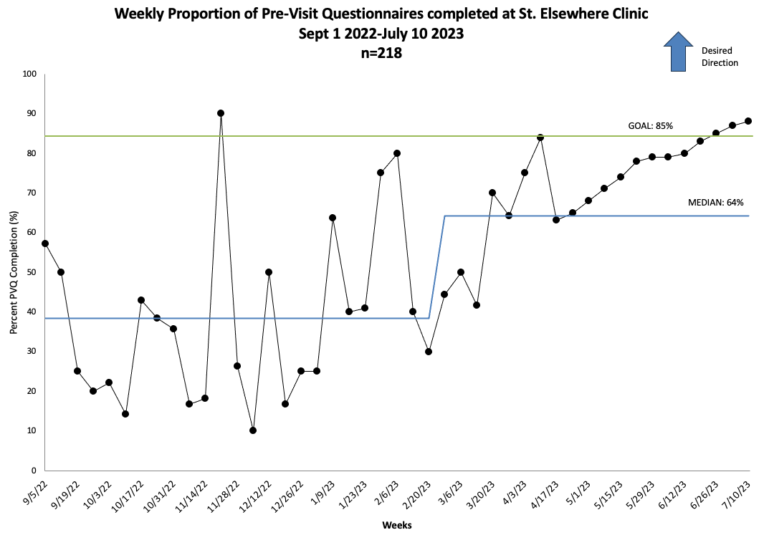
Run Chart
PDSA 1
PDSA 2
Notes:
Slide Script:
Let’s evaluate the run chart, this time linking the key run chart elements to a data-driven improvement story.
Type of Chart? Run Chart
Title? Read the run chart title
3. Desired Direction Upward
4. Y Axis Percent of Previsit Questionnaire Completion
5. X Axis Data over time, being measured monthly. Also note the data suggests onboarding more clinics over time.
6. Goal Number of patients targeted ~ 250.
7. Median Begins at or near zero (related to network launch). Note it shifts upward (assuming enrollment / system performance improving) and no later shifts downward (degrading enrollment).
8. “Dots” Each dot on the run chart, represents a group of patients, with data aggregated monthly.
9. Annotations This run chart has 2 PDSA cycles; one in October 2022 and one in March 2023.
Why is plotting data in real time helpful to this team? Why not wait and analyze the data all at the end, in a before and after approach?
Plotting real-time data is critical to understanding how enrollment in this new technology tool and innovation is influencing care. It allows your team, in real time, to diagnose challenges, and identify opportunities for improvement. Depending on numbers, the team may want to plot the dot weekly, or in this case they chose monthly to follow their progress.
We will elevate our understanding of the run chart, in Lesson 2 where we will move from the key elements of a run chart to interpretation and application of run chart rules which have formal statistical principles that improve our ability to interpret the data.
TIME: 2.5 minutes

Slide 9
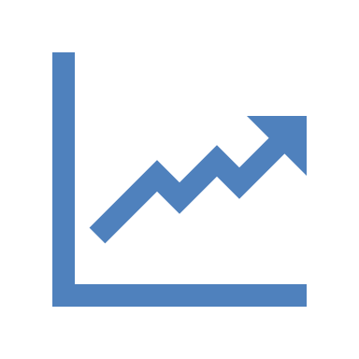
Run Chart Terminology Matching Review
A. Horizontal axis that typically denotes time.
B. Line set by the team denoting what they are aiming for.
C. Used to make sense of the data; often denote PDSA cycles and/or major changes to the system.
D. Summary statistics that represent the center point or typical value of a dataset.
E. Vertical axis that typically Is the rate, proportion or numeric value of the outcome of interest.
F. Used in run charts as the measure of central tendency; less influenced by outliers.
Median
X Axis
Y Axis
Goal
Annotations
Measure of Central Tendency
Notes:
Optional poll
SLIDE SCRIPT:
Median = F.
Mean = G.
X Axis = A.
Y Axis = E.
Goal = B.
Annotations = C.
Measure of Central Tendency = D.
INSTRUCTOR NOTES: Use the Poll feature or even chat for people to vote.
TIME: 90 seconds

Slide 10

Part 2: Deeper Dive into Run Charts
Understanding common cause versus special cause variation
Reviewing the run chart rules
Applying the run chart rules to understand your data more deeply
Notes:
SLIDE SCRIPT:
There is also a Part 2 to this lesson if you would like to take a deeper dive into run charts including:
Understanding common cause versus special cause variation. The main purpose of the run chart is to identify whether a process is improving or getting worse. A run chart allows for a temporal (analytic) view of data versus a static (enumerative) view. Essentially you are looking for signals. Run chart signals of improvement or degradation are not just a “guess” but are detected by statistical tests looking for nonrandom patterns in the data sequence.
We will also review the run chart rules. Run charts are based upon a set of statistics but the good news is YOU don’t have to do the math. There are 3 probability-based rules to determine if the data patterns you are seeing are “random” noise or if the patterns are unlikely to be caused by random variation or chance. This is often called a “signal”. Once the run chart rules are fulfilled, you can say with 95% certainty that there has been a change in your system of care, that is likely not due to chance. This is roughly equivalent to a p-value of p<0.05.
This next lesson in run chart will give you the skills required to apply run chart rules to understand your data more deeply.
Time: 1.5 Minutes

Slide 11

The Power of Plotting and Sharing Data Over Time
“Plotting measurements over time turns out, in my view, to be one of the most powerful devices we have for systemic learning. […]
If you follow only one piece of advice from this lecture when you get home, pick a measurement you care about and begin to plot it regularly over time.
You won’t be sorry!”
Don Berwick
Institute for Healthcare Improvement
1995 IHI Forum plenary speech
"Run to Space"
Notes:
Optional Slide
SLIDE SCRIPT: read slide
INSTRUCTOR NOTES: You are part of a movement, creating a culture of data-driven learning. Standard run charts and data sharing are two powerful tools to fuel revolutionary learning.
TIME: 20 seconds

Slide 12

Use your run chart in your team huddles
to debrief PDSAs and plan next steps!
Notes:
SLIDE SCRIPT:
As we begin to summarize – the run chart is a powerful visual representation of your data over time. Even with a basic understanding you can and should get started learning from data today!
We hope you will model the desired behaviors of using a run chart with your team during every meeting or huddle. This will help the team “own” the data and interpret the impact of the PDSAs they are testing on the outcome of interest.
The run chart is a critical tool both to tell your improvement story (i.e. sharing with other members of the care team). It allows your team to TEST their theory of improvement illustrating how PDSA cycles impact the measure of interest, explore causal pathways and linkages.
Makes the team’s theory of change logical and visible
Helps each team member to see their role and work as a critical link in the cycle or improvement
Reinforces high impact best practices and focus on sustainment.
INSTRUCTOR NOTES: Every team member needs to be able to envision themselves doing this work. If time allows share a tangible example from a successful team that may inspire / motivate / and inform.
TIME: 1 minute

Slide 13
Summary
Run Chart = Visual representation of your measure over time
Run charts have a standard anatomy, form and function.
Using a run chart reinforces PDSA thinking and keeps the team FOCUSED on continuous improvement.
Run charts allow you to discern if PDSAs were associated with a change in the outcome and often can inform the next PDSA cycles.
Notes:
SLIDE SCRIPT:
This lesson has provided an overview of run charts, and their key components, with an “at a glance” view of how to begin to interpret them. A run chart is a simple improvement tool that visually displays your data over time.
They have a standard anatomy, form and function.
Run charts allow you to discern if PDSAs were associated with a change in the outcome and often can inform the next PDSA cycles.
Using a run chart reinforces PDSA thinking and keeps the team FOCUSED on continuous improvement.
Part 2 of this series will focus on the run chart rules to help you analyze run charts more effectively. You will learn that the humble run chart, is based upon statistical rules and will add some rigor to your analysis, without further need for mathematical processing.
INSTRUCTOR NOTES: The most important “next step” is to get the teams into ACTION! Part 2 of the lesson will include an exercise where the teams review run charts, apply the run chart rules, and begin to interpret simple data.
TIME: 30 seconds

Slide 14

Resources
Excel Template to Develop a Basic Run Chart
Run Chart Checklist & Coaching Tips
Short Foundational Paper:
Perla RJ, Provost LP, Murray SK. The run chart: a simple analytical tool for learning from variation in healthcare processes. BMJ Quality & Safety. 2011 Jan;20(1):46-51. DOI: 10.1136/bmjqs.2009.037895.
Notes:
SLIDE SCRIPT:
Here are some resources for you to explore, that may be found in the supplemental lesson materials.
The best way to understand run charts, is to play with them. You can sketch a run chart with a pencil, paper and ruler to wrap your head around what you want to measure, and how you will plot the dot over time. The toolkit has an EXCEL tool, to help you develop a basic run chart.
Once you create your run chart, use the run chart checklist to refine it. There are simple coaching tips for each part of the run chart “anatomy.”
And to prepare for our next lesson, I hope you will take the time to read 1 short but very informative paper.
TIME: 20 seconds

Slide 15
Next Steps
ACTIVITY | MATERIALS
Review Run Chart Basics: Part 1 Lesson | Run Chart Basics: Part 1 micro-lesson powerpoint
Develop a Run Chart for a Local Measure | Run chart EXCEL template
Share Your Run Chart Mock-up and use the Run Chart Checklist & Coaching Tips to assess quality | Run Chart Checklist & Coaching Tips
Review and use the run chart, annotate it and learn from it at your team meeting/huddle to inform your next PDSA.
TEAM FORMATION
Notes:
SLIDE SCRIPT:
INSTRUCTOR NOTES: Moving learning into action is critical. You must link this theory burst to a team assignment, homework, or next steps.
Customize next steps based on team needs. Next steps might include:
Reviewing / critiquing simple run charts.
Creating a simple run chart for their local ”plot the dot” campaign (i.e. enrollment).
Prioritizing what data teams may want/ need to collect locally (i.e. process measures) to drive improvement.
TIME: 60 seconds

