Slide 1



Run Chart Basics: Part 2
Applying Run Chart Rules to
Analyze Data Over Time
Alice Kennedy, MPH
Research Project Director
The Dartmouth Institute
Last modified 12/5/2023
Notes:
SLIDE SCRIPT:
Hello, my name is Alice Kennedy, I’m a Research Project Director with The Dartmouth Institute for Health Policy and Clinical Practice at Giesel School of Medicine at Dartmouth. I’m here to share an installment of the IBD Qorus Quality Improvement Curriculum, brought to you through a partnership of The Crohn’s & Colitis Foundation and The Dartmouth Institute. The purpose of this lesson is to help you and your team gain a better understanding and appreciation of an important quality improvement tool, called the run chart. You will garner important tips for how to analyze and interpret run charts using 4 simple rules.
TIME: 30 seconds

Slide 2
Learning Objectives
Describe
Understand
Understand the 4 run chart rules and their probability-based statistical underpinnings.
Analyze
Analyze a run chart using the rules to identify runs, trends, shifts and potential astronomical data.
Describe 2 types of variation, common cause and special cause variation.
Notes:
SLIDE SCRIPT:
We have 3 learning objectives for today that include:
Presenter simply reads the learning objectives.
TIME: 30 seconds

Slide 3
The Cornerstone of Our Methodology:
The IHI Model for Improvement
AIM
What are we trying to accomplish?
MEASURE
How will we know that a change is an improvement?
CHANGES
What change can we make that will result in improvement?
Act
Plan
Study
Do
Notes:
SLIDE SCRIPT:
It is always helpful to anchor our work in the overarching framework of the Model for Improvement.
Run charts are a critical tool to understand variation in your system, to measure the impact of your project overall, and to understand how small tests of change influence your SMART Aim.
TIME: 30 seconds

Slide 4
Why Use Run Charts?
Run charts are constructed to make it easy for your team to reveal variation in system performance and evaluate it.
Run charts are interpreted using 4 rules that are based upon statistical principles.
The good news is that you do not have to do math or need any special software to create and interpret run charts.
Notes:
SLIDE SCRIPT:
Why use run charts to guide improvement and innovation teams?
Then read slide.
INSTRUCTOR NOTES: The goal here is to demystify run charts and help show how the background “statistics” make this preferable to a line graph or other modality.
TIME 30 seconds

Slide 5
Run Charts Lesson 1
Key elements, structure and common terminology.
Run Chart Lesson 2
Interpret and analyze run charts applying the probability-based rules.
Bottom Line
Statistics behind the run chart are based on an “estimated” error of p<0.05.
95% confidence that the changes/variation in the data are real signals and not just noise!
Notes:
SLIDE SCRIPT: Let’s reflect on our learning journey. . . .
Read the slide. And then set-up the next slide . . .
Run charts help us to identify variation in a system and to discriminate between “types” of variation.
INSTRUCTOR NOTES: Be sure to emphasize the bottom-line point. Run charts have some rigor! And, as data sets grow to 20+ data points over time (REF: The Healthcare Data Guide) - the run chart can morph into statistical process control charts, which provide an even more sophisticated tier of analysis respective to common cause and special cause variation. Also NOTE: Research data, is often analyzed with statistics that create a p-value; however, this form of analysis is typically not appropriate for QI data.
TIME: 45 seconds

Slide 6
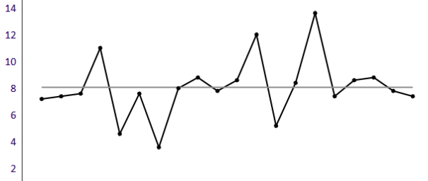
Two Types of Variation
Common Cause Variation (CCV)
  Inherent in all systems
  Natural variation or “noise”
  Changes in data are simply “random”
Special Cause Variation (SCV)
  Non-random variation
  Signals a change in the system
  Seek to “attribute” the variation to a cause
  SCV may be
    Unplanned (e.g., COVID pandemic)
    Planned (e.g., QI initiative or implementation of an innovation)
Notes:
SLIDE SCRIPT:
When interpreting run charts, it is important to understand the kinds of variation you see to accurately interpret them.
Common cause variation is inherent in all systems, and is variation that happens naturally, also known as noise. The changes you see in the data are simply random.
Special cause variation signals a change in the system, and shows non-random variation. You can seek to attribute the variation to a cause; either unplanned or planned.
Common mistakes when interpreting variation:
Mistake noise for signal (false positive, or Type-I error)
Mistake signal for noise (false negative, Type-II error)
Bottom Line: run charts are excellent for ease of use, plotting data over time, revealing variation, and noting temporal relationships between your data and changes you are testing.
In upcoming lessons you will learn about statistical process control charts which are better at distinguishing between common cause and special cause variation (if/when the # of data points = 20 or more).
INSTRUCTOR NOTES: Read slide to distinguish common cause vs. special cause variation
TIME: 1 Minute

Slide 7
Run Chart Rules
Shifts
Trends
Runs
Astronomical Points
Notes:
There are 4 run chart rules that help you interpret the data you are plotting:
Shifts, Trends Runs, Astronomical Points.
Let’s take a closer look.

Slide 8
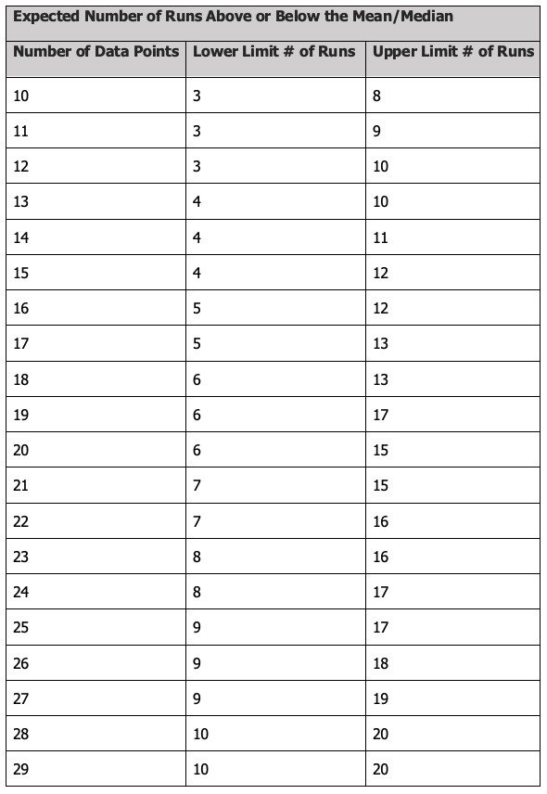
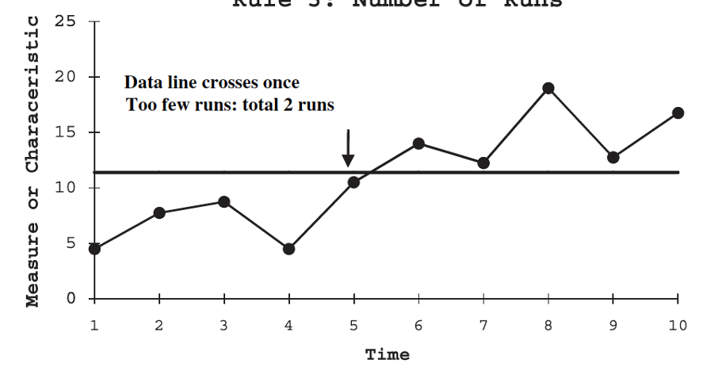
Run Chart Rule 1: Number of Runs
Perla J. Provost LP, Murray SK. The run chart: a simple analytical tool for learning from variation in healthcare projects. BMJ Qual Saf. 2011: 20:46-51.
Run Definition
Series of consecutive points on the same side of the median line. If the data are “random” they should cross the median line regularly.
How to Count Runs?
Count the number of times the data crosses the median and add 1. Ignore points that lie exactly on the median.
What Does it Mean?
Having more or fewer runs than expected indicates that there is non-random variation in the process (i.e., special cause variation).
Count the number of times the line connecting the data points crosses the median and add 1
Notes:
SLIDE SCRIPT:
There are four run chart rules that we use to guide our interpretation of the data that we plot. There are varying definitions of shifts and trends which are usually small (plus one or two points in either direction). We will focus on applying the rules described by Perla and Provost.
First, we will focus on the number of “runs” on a given run chart. What is a run?
A run is a series of consecutive points on the same side of the median line. If the data are “random” they should cross the median line regularly.
So, how do we Count Runs?
We count the number of times the data crosses the median and add 1. We ignore points that lie exactly on the median.
So, how do we interpret this? Having more or fewer runs than expected indicates that there is non-random variation in the process (i.e., special cause variation).
Now let’s Count the number of times the line connecting the data points crosses the median and add 1.
QUESTION TO AUDIENCE: How many runs are in this example? (2)
ANSWER: There is only 1 cross of the median. We count that cross of the median and add 1 for a total of 2 runs.
ANIMATE in the TABLE.
Next – we look at this chart [Animate]– and assess how many runs should there be.
First, we count the total number of data points plotted which in this example there are 10 points.
You can see in the top row, that with 10 data points, we should expect a lower limit of 3 runs and an upper limit of 8 runs.
What does a lower or higher than expected number of runs mean? It may be a “hint” or signal that special cause variation is already in play.
You will want to interpret the # of runs in context with the next 2 rules, trends and shifts.
INSTRUCTOR NOTES: Different manuals, studies, and resources cite slightly different interpretation rules. Do not let the learners get “hung up” on the actual number . . . Keeping in mind the overarching concept of trends and shifts, is the most important learning objective. Runs are often less useful.
TIME: 2 minutes

Slide 9
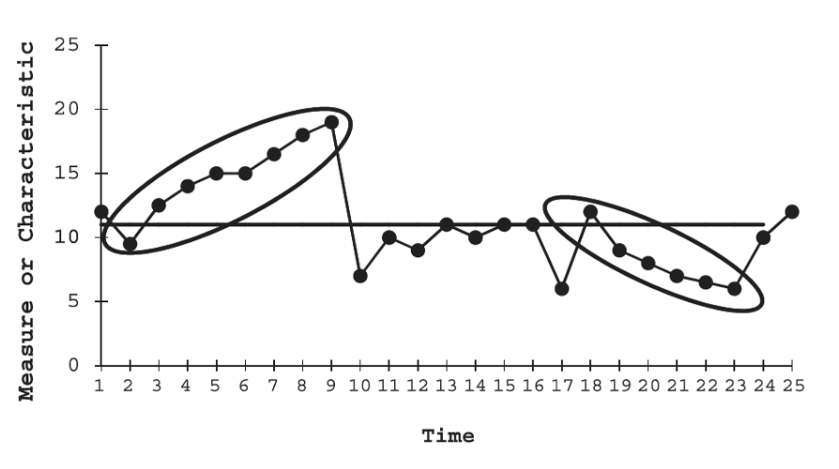
Run Chart Rule 2: Trends
Perla J. Provost LP, Murray SK. The run chart: a simple analytical tool for learning from variation in healthcare projects. BMJ Qual Saf. 2011: 20:46-51.
PDSA 1: New Check-In Script
PDSA 2: Self-Check-in Kiosk
Trend Definition
Six or more consecutive data points that go in the same direction (increasing or decreasing).
How Do I Count a Trend?
Count the number of consecutive data points going in the same direction.
What Does it Mean?
A trend is an indicator of special cause variation in the system. To qualify as a trend, it must meet the statistical threshold of 6.
6 consecutive points going in the same direction
Notes:
SLIDE SCRIPT:
What is a trend? (read the slide).
How Do I Count a Trend? (read the slide).
What Does a Trend Mean? (read the slide).
Reflecting on changes that are happening in your system, and/or changes you have imposed on your process, it might be helpful in understanding what is not a statistically important trend.
ANIMATE SLIDE: See how adding your annotated PDSA cycles help with interpretation of the data? Run charts without annotations only tell half of the data story.
TIME: 2 minutes

Slide 10
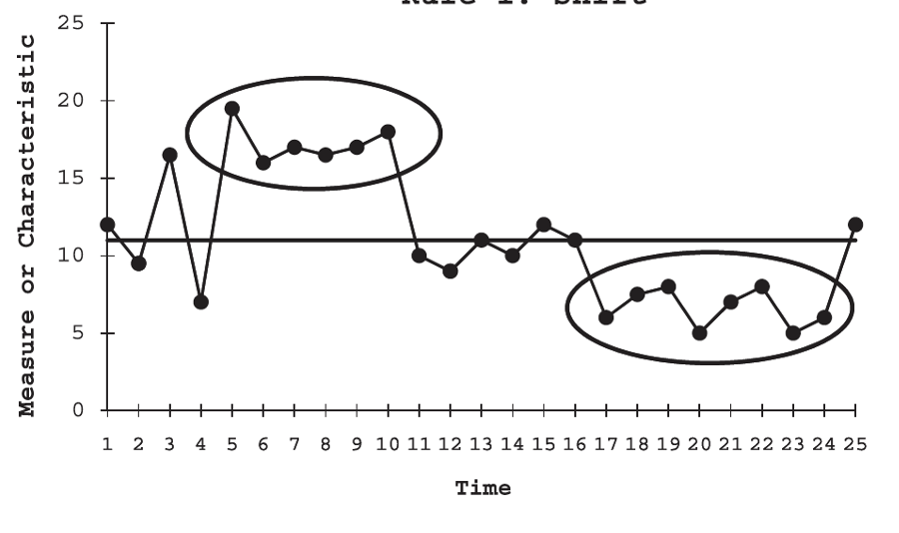
Run Chart Rule 3: Shifts
Perla J. Provost LP, Murray SK. The run chart: a simple analytical tool for learning from variation in healthcare projects. BMJ Qual Saf. 2011: 20:46-51.
Shift Definitions
Six to eight consecutive points and all of the points must fall above or below the median.*
*Values that fall on the median do not add to or break a shift.
How Do We Count Shifts?
Count the number of consecutive points above or below the median.
What Does a Shift Mean?
A shift indicates that special cause variation is impacting your system. Your system now is performing at a “new state” – and may require you to shift your median line.
6-8 consecutive points above or below the median
Notes:
SLIDE SCRIPT:
What is a Shift? (read the slide definition)
How Do we Count Shifts? (read the slide).
What Does a Shift Mean? (read the slide).
A shift is even more powerful than the prior rules. Once you identify a SHIFT, you may elect to move your median line to communicate that the system is now performing differently. You can extend that median line out 6 to 8 points as that is the earliest potential time to detect the next shift in the system. Once again you will want to look at the PDSA cycles that preceded the shift to better understand your system.
TIME: 2 minutes

Slide 11
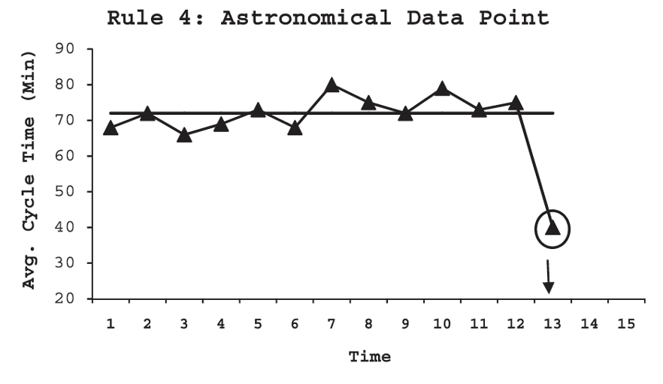
Run Chart Rule 4: Astronomical Data Point
Perla J. Provost LP, Murray SK. The run chart: a simple analytical tool for learning from variation in healthcare projects. BMJ Qual Saf. 2011: 20:46-51.
Astronomical Data Point Definition
A data point that is obviously different from the rest of the points.
How?
There is no statistical definition for “astronomical”. It is a judgement call and all studying the chart would agree the point is unusual.
What Does it Mean?
While Rules 1, 2 and 3 are probability based, Rule 4 is subjective and recognizes the importance of the visual display of the data in a run chart.
Single outliers
Notes:
SLIDE SCRIPT:
What is the definition for astronomical data points? (read the definition).
How do you detect an astronomical data point? (read the definition)
What does an astronomical data point mean? (read the definition)
If time allows . . . You can dig deeper here:
When facing an astronomical data point, we often ask a series of questions such as:
Is this number even possible or might it represent an error in the data?
If it is possible, ask the team to reflect on their system knowledge and provide insight into why so high or so low?
Double check the N’s (how many data points are aggregated into the dot)? Sometimes astronomical values can occur with very small numbers of data.
Your team will need to develop some “theory” around the data point and continue to evaluate system performance, based upon the data points that follow.
TIME: 2 minutes

Slide 12
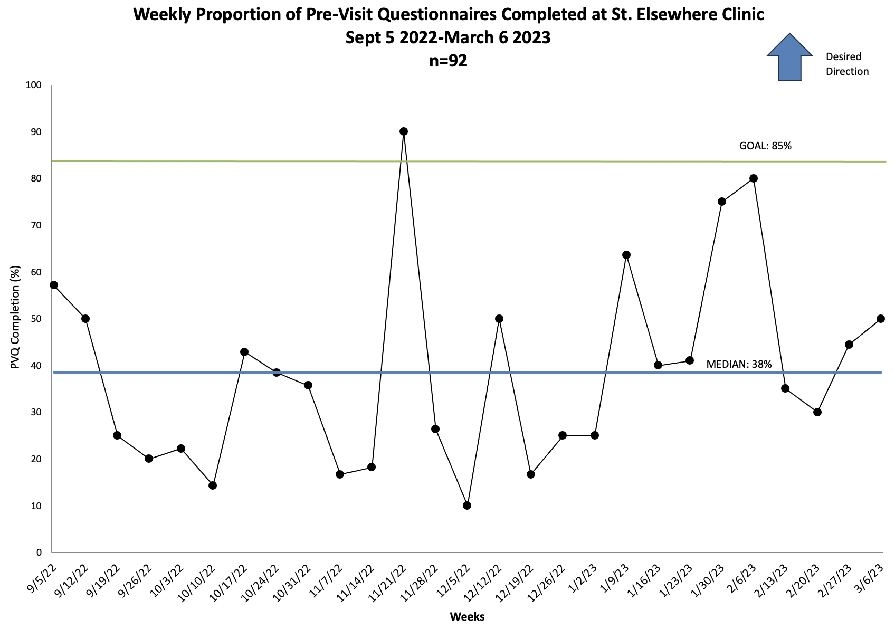
Notes:
SLIDE SCRIPT:
In a prior lesson, we shared this example as a whole snapshot of data over time. When you are using data in real time, studying the data works a bit differently. You and the team actively “plot the dots” weekly, biweekly or monthly. In this way, the data story builds over time and your teams understanding of their system and its performance deepens.
This is a run chart, tracking the number of pre-visit questionnaires completed weekly in a Health Clinic at St. Elsewhere Hospital.
This chart includes data collected from September 1 2022 to March 5 2023. The total number of questionnaires represented in the dots is 92.
This group formed a team, reviewed their data, set a SMART aim, and established a goal of 85% PVQ completion per month.
Is there any special cause variation here? Let’s run a test for the two of the run chart rules, runs and astronomical points. To calculate the number of runs, lets first count the number of runs, or times the data line crosses the median (COUNT). The data crosses the median 10 times, then we need to add 1, for a total of 11 runs on this chart. (ANIMATE) Let’s look at our expected number of runs table: for a chart with 27 data points, between 9 and 19 runs are expected and we had a total number of 11 runs which falls in the expected range, meaning we do not have any special cause variation due to runs in this chart.
Moving on to looking for any astronomical data points, remember that there is no statistical definition for “astronomical”. It is a judgement call and all studying the chart would agree the point is unusual. Do you see any here? (ANIMATE)
This point in late November warrants a further look at what might have been happening at that time – is it an error? If not, what can be learned from this tremendous although temporary increase in completion?
TIME: 90 seconds

Slide 13
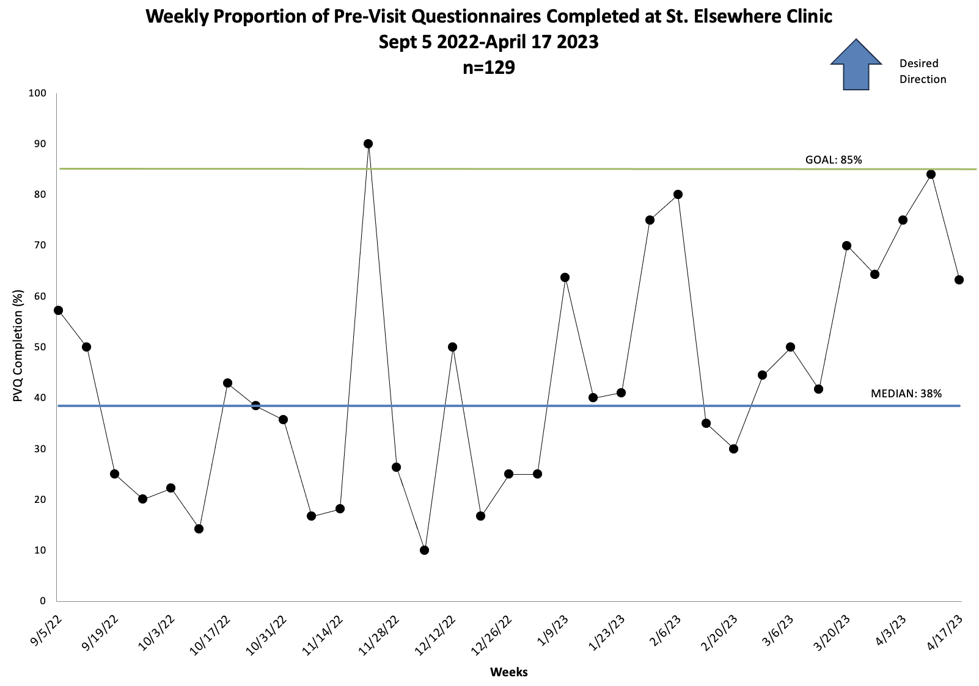
6-8 consecutive points above or below the median
Notes:
SLIDE SCRIPT:
Now let’s fast forward a next few weeks and see what's happened with our data from September 2022 to April 2023.
Q: What are we observing here?
A: There are an increasing number of data points above the initial median. Let’s start to interpret them with some of our run chart rules. Remember a TREND is 6 consecutive points going in the same direction and a SHIFT is 6-8 consecutive points above or below the median. (ANIMATE RULE) (You can ask the audience to look, and see if they jump in). What’s happening in January 2023? (Note it does not meet trend or shift criteria). What’s happening in late February 2023? (note it meets shift criteria and ANIMATE).
Q: What do you predict will happen next?
A: No right or wrong answer here; however, based on past performance we may predict that completion might continue to go up—in the desired direction.
However, now that the shift has happened – we will want to recalculate our median to reflect this important change in our system! So we will recalculate starting with the week that the shift started – here, it is the week of February 27th.
TIME: 60 seconds

Slide 14
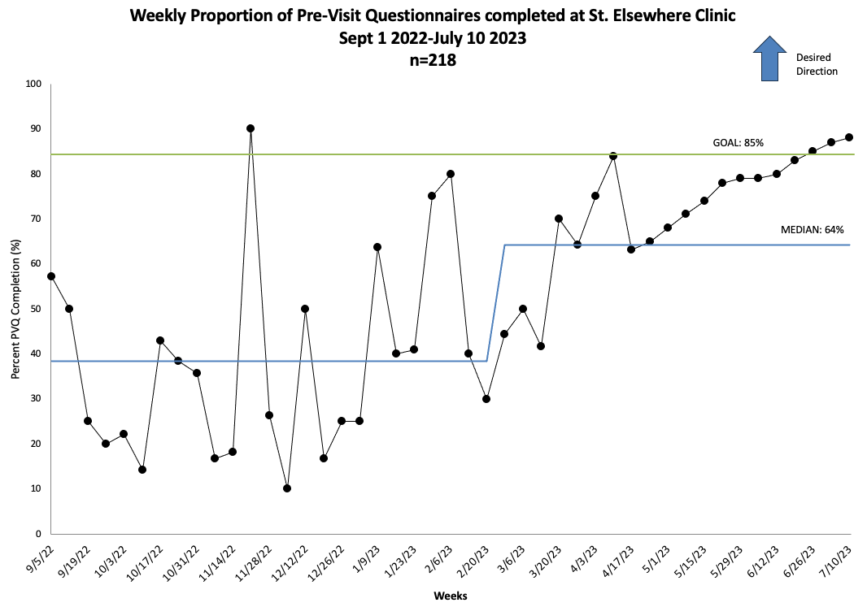
6 consecutive points going in the same direction
Notes:
Slide Script:
Here you can see that we have recalculated our median to reflect the special cause shift in our system – the new median is 64% completion rate and our data has now been collected through July 2023.
And even with our new, higher median, do you observe yet another special cause variation in PVQ completion – (ANIMATE RULE) starting in April we see 6 or more (actually12 here!) points going in the same direction – this is a major trend in the desired direction. (ANIMATE CIRCLE)
TIME: 60 seconds

Slide 15

Display your run chart prominently in team spaces. Create the habit of using run chart data to anchor every team huddle or meeting.
Notes:
SLIDE SCRIPT:
Read the slide. Plotting your own data and feeding it back to the team is a powerful motivator of performance.
This method, sometimes called a “plot the dot” campaign, is associated with improvements in quality of care.
INSTRUCTOR NOTES: Your goal is to model the behaviors desired to create the conditions for success. Building run chart review into every standard agenda is a good way to create the rhythm and discipline of improvement.
TIME: 30 seconds

Slide 16
In Summary
There are TWO types of variation: Common Cause and Special Cause
To analyze a run chart, compare the data to the median and apply the run chart rules.
Data over time tells a story of temporal associations to better understand if your PDSA cycles are impacting the system you are improving.
Notes:
SLIDE SCRIPT:
There are TWO types of variation: Common Cause and Special Cause. In our improvement work we are looking to distinguish between common cause variation or noise versus special cause variation. ...…. GENE ADDED MATERIAL HERE .... Common Cause Variation takes place when the “system of causes” are working in the way they usually work and produces the current level of variation in the process ( a lot of variation or a little variation) produced by the things that are happening as usual and over time. However, Special Cause Variation takes place when something “new” enters the system. This “new thing” entering the system is associated with a change in the pattern of variation. The ”new thing” could be designed by a process improvement team, or a service innovation, or it could come from someplace else such as a change in the inputs or the local context – e.g., a labor strike, a natural disaster causing a power outage, an epidemic, etc.
To analyze a run chart, compare the data to the median and apply the run chart rules.
Data over time tells a story of temporal associations to better understand if your PDSA cycles are impacting the system you are improving.
TIME: 30 seconds

Slide 17

Resources
Excel Template to Develop a Basic Run Chart
Run Chart Checklist & Coaching Tips
Run Chart Rules Cheat Sheet
Articles
Perla RJ, Provost LP, Murray SK. The run chart: a simple analytical tool for learning from variation in healthcare processes. BMJ Quality & Safety. 2011 Jan;20(1):46-51.
Ivers N, et al. Audit and feedback: Effects on professional practice and healthcare outcomes. Cochrane Database of Systematic Reviews 2012, Issue 6. Art. No.: CD000259.
Anhøj J, OlesonAV. Run Charts Revisited: A Simulation Study of Run Chart Rules for Detection of Non-Random Variation in Health Care Processes. Plos One 9(11): e113825.
Notes:
SLIDE SCRIPT:
Here are some further resources that can be found in the supplemental materials of the lesson.
The best way to understand run charts, is to play with them. You can sketch a run chart with a pencil, paper and ruler to wrap your head around what you want to measure, and, how you will plot the dot over time. The supplemental tools contains an EXCEL tool, to help you develop a basic run chart.
Once you create your run chart, use the run chart best practices checklist to refine it. There are simple coaching tips for each part of the run chart “anatomy.”
And to prepare for our next lesson, I hope you will take the time to read 1 short but very informative paper.
TIME: 20 seconds

Slide 18
Next Steps
ACTIVITY | MATERIALS
Review Run Chart Lesson Part 2 | Run Chart Basics Part 2 micro-lesson powerpoint
Develop a run chart for your QI project. | Run chart EXCEL template
Use the Run Chart Best Practices Checklist & Tips to assess quality of your run chart with your team. | Run Chart Checklist & Tips Form
Review and use the run chart, annotate it and learn from it at your huddles to inform your next PDSA. | Run Chart Rule Cheat Sheet
TEAM FORMATION
Notes:
SLIDE SCRIPT: In a continuous quality improvement collaborative like IBD Qorus, you don’t have to be in an Action Period of an Improvement Initiative to be collecting and learning from your data. Feel free to share this lesson with key members of your team; start or continue to collect data for your QI reports; and start to plot it over time in a run chart, set aside time to review the Run Chart and Run Chart Rules with your team to to interpret what your data is telling you!
INSTRUCTOR NOTES:
TIME: 60 seconds

