Slide 1



Crafting a SMART Aim
A Critical Foundation For Improvement
Alice Kennedy, MPH
Research Project Director
The Dartmouth Institute
Last modified 12/5/2023
Notes:
SLIDE SCRIPT:
Hello, my name is Alice Kennedy, I’m a Research Project Director with The Dartmouth Institute for Health Policy and Clinical Practice at Giesel School of Medicine at Dartmouth. I’m here to provide you with an installment of the IBD Qorus Quality Improvement Curriculum, brought to you through a partnership of The Crohn’s & Colitis Foundation and The Dartmouth Institute. This lesson is called Crafting a SMART Aim, and the purpose of this lesson is for teams to develop the knowledge and skills to develop a crisp and compelling SMART aim for their quality improvement project.
TIME: 30 seconds

Slide 2
Learning Objectives
Define
Define a SMART Aim and link it to the first 2 key questions in the Model for Improvement.
Review
Review the 5 key components of a SMART Aim.
Critique
Critique SMART aim statements as a strategy to improve your own SMART aim for your QI project.
Notes:
SLIDE SCRIPT: read slide
INSTRUCTOR NOTE: Developing a SMART aim is critical to the success of your quality improvement project. It may seem simple at first glance; however, to do it well takes time and practice!
TIME: 30 seconds

Slide 3
What is a SMART Aim?
Clear and explicit statement that guides the improvement project.
States what your team will accomplish over time using a measurable goal.
SMART Aim = Specific, Measurable, Attainable, Relevant, and Timebound.
Notes:
SLIDE SCRIPT:
Let’s begin with defining a SMART Aim.
It is a clear and explicit statement of intent to guide your project.
A SMART aim declares what your team will do, or accomplish, over what time period, and provides a concrete measurable numeric goal.
S-M-A-R-T is an acronym with each letter representing a key component of an aim statement. S= Specific, M=Measurable, A = Attainable, R=Relevant, and T=Timebound.
INSTRUCTOR NOTE: A good SMART Aim is crystal clear! It must be unambiguous and measurable with concrete goals to assess progress.
TIME: 60 seconds

Slide 4

Why Use a SMART Aim?
Provides direction for your project
Engages and aligns stakeholders
Aids in identifying measures
Illustrates your goal in 30 seconds or less
Avoids scope creep
Notes:
SLIDE SCRIPT:
You may ask, “Why use a SMART AIM?”
A SMART aim provides direction for the project –what, in whom, by when and actively engages and aligns all stakeholders. It reveals current state (“from X”) and future state (“to Y”). It is critical that the SMART aim be time bound – as this creates the urgency that will be required to accomplish your goal.
Your SMART Aim aids in identifying a means of measuring success.
The statement also illustrates your project goal in 30 seconds or less similar to an “elevator” pitch of your project to others.
SMART Aim statements guide your team from the start and helps avoid scope creep throughout the project.
TIME: 30 seconds

Slide 5
The Cornerstone of Our Methodology:
The IHI Model for Improvement
AIM
What are we trying to accomplish?
MEASURE
How will we know that a change is an improvement?
CHANGES
What change can we make that will result in improvement?
Act
Plan
Study
Do
Notes:
SLIDE SCRIPT:
How do you start to craft a SMART Aim? Begin with the model for improvement! Ask yourself and your team 2 key questions.
What are we trying to accomplish?
How will we know that a change is an improvement?
INSTRUCTOR NOTE: In a workshop style session you may pause here. Share a SMART Aim worksheet, and whenever possible have participants work in teams. You can prompt them further by asking these key clarifying questions.
What is the result we want to achieve?
Who will benefit from this improvement?
Whose interests are served? Will this benefit both patients? And Providers?
Where will the change occur?
When will the project start and stop?
What is in scope – and what is out?
TIME: 30 seconds

Slide 6
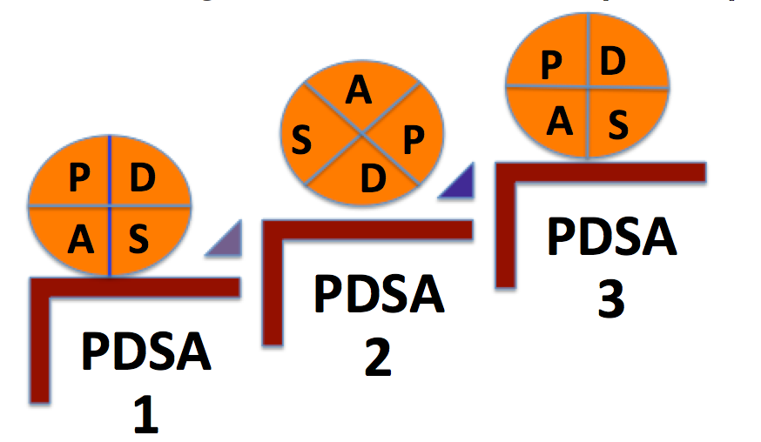


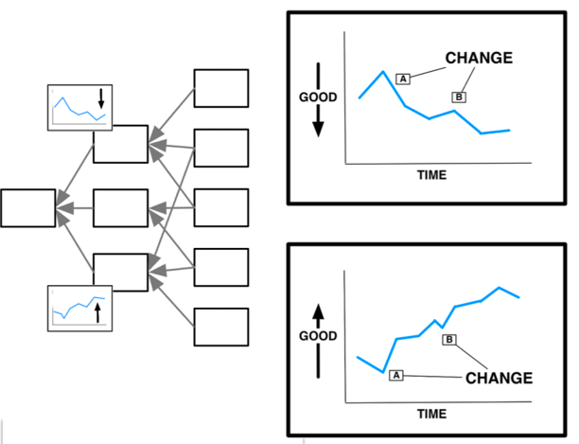
Your SMART Aim is the Foundation of Your QI Work
PDSAs
Measures
Drivers
Aim
Notes:
SLIDE SCRIPT:
Your SMART aim statement grounds your work, keeping your project priorities focused on things that will further the Aim. Notice the logic here . . . See how the aim links to your primary and secondary drivers, which informs change ideas and PDSA cycles (what changes can we make to drive improvement) and are all closely aligned with your measures.
Your aims, drivers, change ideas, PDSA Cycles, and Measures all Link Back to Your Aim!
INSTRUCTOR NOTE: Good to keep emphasizing, aims, drivers and measures! They must align and fit together logically.
TIME: 60 seconds

Slide 7

FIVE Key Components of a SMART Aim
Notes:
SLIDE SCRIPT:
A successful aim statement needs to be SMART, and what is in that?
First it should specific – or set a clear goal.
It should be measurable, having concrete criteria for measuring progress and defining success numerically.
Next, it should be attainable or achievable
It should also be relevant, including objectives that you and your team are motivated about working towards.
Finally, it should be timebound: with and established a timeframe (usually 6-12 months).
Instructor Notes: Time period to achieve will depend on the complexity of the aim, the system context and complexity, and how high you set the bar to “achieve.”
TIME: 90 seconds

Slide 8
A Simple Recipe for a SMART Aim
What
  We will (increase / decrease) what [insert practice or outcome] from X (baseline rate) to Y
Who
  Insert patient population or setting
When
  Insert Date
Notes:
SLIDE SCRIPT:
This sounds simple but could be more complex than first thought.
A common challenge in writing the SMART is getting the measurement piece right. Be specific about this, remembering that some is not a number, and soon is not a time.
Ask yourself and your team about the what, who and when while setting your SMART Aim.
Let’s look at an example to help think about this.
TIME: 30 seconds

Slide 9

SMART Aim Example
“We aim to increase the % of Treat-to-Target surveys completed by IBD Qorus patients at NYU Langone IBD Center from 0% to 75% by June 1, 2021.”
NYU Langone IBD Center
IBD Qorus Learning Collaborative
New York, New York
Notes:
SLIDE SCRIPT:
Here is an example of an aim statement from NYU Langone IBD Center, one of the IBD Qorus sites. Let’s read it and pick out the anatomy of an aim statement.
What are they trying to accomplish? (read aim)
TIME: 60 seconds

Slide 10
Does NYU Langone’s Aim Statement Pass the SMART Aim Test?
“We aim to increase the % of Treat-to-Target surveys completed by IBD Qorus patients at NYU Langone IBD Center from 0% to 75% by June 1, 2021.”
Notes:
SLIDE SCRIPT:
Let’s dig deeper to understand if this Aim is really a SMART aim by breaking down the acronym.
Is it specific: does it set a clear goal?
The term ‘TTT completion’ could benefit from an operational definition? Is completion the # of surveys completed, or or targets set?
Is it measurable: Does it have concrete criteria for measuring progress and success?
Critique: From 0-75% is a clear measure, and it will be important to understand both the numerator and denominator for this percentage – once you clarify ‘TTT completion’
Next is Attainable: Can it be achieved?
Critique: The magnitude of change should be carefully considered – and this team can answer this question best, in their own unique context.
Is it Relevant: Does it include objectives that the team is willing and able to work towards.
Critique: Again this is a barometer only the team can assess. Are they passionate about this challenge? And is this improvement in their power and control?
Finally – is it time-bound: Does it have an established a timeframe?
Critique: In this example, a 75% increase in 6 months is ambitious and laudable! You and your team should think carefully here about the interventions you will test, the magnitude of effect you might expect, and the resources you have to drive the intervention.
Instructor Notes: Your goal is to get the audience to identify areas to improve the SMART Aim. Give the group time to identify areas for improvement. In a live setting you could “throw a Hershey Kiss” to reward comments, improvements! In a Zoom session you could launch a dancing meme or get folks to give a thumbs up – if the suggestion is really an improvement! Make this fun and interactive.
If time allows move on to a second example.
TIME: 1.5 minutes

Slide 11

SMART Aim Example
“We aim to improve ED utilization for our IBD patients by decreasing ED use from 30% per month to 15% per month by April 30, 2019.”
The Oregon Clinic-GI East
IBD Qorus Learning Collaborative
Portland, Oregon
Notes:
OPTIONAL SLIDE
SLIDE SCRIPT:
Here is an example of an aim statement from the Oregon Clinic, one of the IBD Qorus sites. Let’s read it and pick out the anatomy of an aim statement.
What are they trying to accomplish?
TIME: 60 seconds

Slide 12
Does the Oregon Clinic’s Aim Statement Pass the SMART Aim Test?
“We aim to improve ED utilization for our IBD patients by decreasing ED use from 30% per month to 15% per month by April 30, 2019.”
Notes:
OPTIONAL SLIDE
SLIDE SCRIPT:
Let’s dig deeper to understand if this Aim is really a SMART aim by breaking down the acronym.
Specific: Sets a clear goal.
Critique: ED utilization needs an operational definition? Is it ED visits? Or the total package of the visit, testing, diagnostics etc.
Measurable: Has concrete criteria for measuring progress and defines success numerically.
Critique: 30% needs an operational definition; 30% of what? Always think about numerators and denominators for your measures.
Achievable: Can it actually be accomplished?
Critique: The magnitude of change should be carefully considered. Centers who are performing poorly (i.e. gross over utilization) could expect a larger impact / magnitude of effect. Centers who are already performing well, may need to aim for a smaller magnitude effect. For “never events” stop-the-line improvements (like wrong site surgery) we should aim for zero system defects.
Relevant: Includes objectives that the team is willing and able to work towards.
Critique: Is the team passionate about this challenge? Are they motivated to improve it? Is improvement in their power and control?
Time-bound: Establishes a timeframe (usually 6-12 months).
Critique: A 50% reduction, in 6 months is ambitious and laudable! Think carefully here about the interventions you will test, and the magnitude of effect you might expect, and the resources / capacity you have to drive the intervention.
Instructor Notes: Your goal is to get the audience to identify areas to improve the SMART Aim. Give the group time to identify areas for improvement. In a live setting you could “throw a Hershey Kiss” to reward comments, improvements! In a Zoom session you could launch a dancing meme or get folks to give a thumbs up – if the suggestion is really an improvement! Make this fun and interactive.
If time allows move on to a second example.
TIME: 1.5 minutes

Slide 13

SMART Aim Example
“We will increase IBD Qorus enrollment from 433 to 480 patients (a 10% increase) by 3/31/2020.”
Notes:
OPTIONAL SLIDE
SLIDE SCRIPT:
Here is another example of an aim statement, this time from a Qorus site on the other side of the country, Saratoga Schenectady Gastroenterology Associates. Let’s critique this Aim Statement using the SMART Aim check-up approach we just demonstrated.
Specific: Sets a clear goal.
Critique: Partially! Qorus enrollment needs an operational definition that all agree on. Does performing the pre-visit scantron enrollment? Or / do they give permission to share their data? What is your team’s explicit goal?
Measurable: Has concrete criteria for measuring progress and defines success numerically.
Critique: Clear! Concise! And Data already exists in the Qorus dashboard. NOTE: you will need to align your definition with the data definition for greatest easy of use.
Achievable: Can it actually be accomplished?
Critique: That depends on how many patients are in the practice who are not yet enrolled. Would be good to know these numbers and understand them before committing to 10%.
The magnitude of change should be carefully considered. Centers who have low enrollment could expect a larger impact / magnitude of effect. Centers who have very high enrollment, may either go for 100% / (a stretch goals!) or aim for more modest gains depending on their local context and conditions. performing well, may need to aim for a smaller magnitude effect.
Relevant: Includes objectives that the team is willing and able to work towards.
Critique: Is the team passionate about this challenge? Are they motivated to improve it? Is improvement in their power and control? Is the entire team engaged?
Time-bound: Establishes a timeframe (usually 6-12 months).
Critique: A 10 % increase seems possible. Think carefully here about the interventions you will test, and the magnitude of effect you might expect, and the resources / capacity you have to drive the intervention.
Instructor Notes: Good to emphasize here that SMART aims typically require multiple iterations and revisions. It is rare to “nail it” on your first draft. Keep polishing!
TIME: 60 seconds

Slide 14
Does Saratoga’s Aim Statement Pass the SMART Aim Test?
“We will increase IBD Qorus enrollment from 433 to 480 patients (a 10% increase) by 3/31/2020.”
Notes:
OPTIONAL SLIDE
SLIDE SCRIPT:
Let’s critique this Aim Statement using the SMART Aim check-up approach we just demonstrated.
Specific: Sets a clear goal.
Critique: Partially! Qorus enrollment needs an operational definition that all agree on. Does performing the pre-visit scantron enrollment? Or / do they give permission to share their data? What is your team’s explicit goal?
Measurable: Has concrete criteria for measuring progress and defines success numerically.
Critique: Clear! Concise! And Data already exists in the Qorus dashboard. NOTE: you will need to align your definition with the data definition for greatest easy of use.
Achievable: Can it actually be accomplished?
Critique: That depends on how many patients are in the practice who are not yet enrolled. Would be good to know these numbers and understand them before committing to 10%.
The magnitude of change should be carefully considered. Centers who have low enrollment could expect a larger impact / magnitude of effect. Centers who have very high enrollment, may either go for 100% / (a stretch goals!) or aim for more modest gains depending on their local context and conditions. performing well, may need to aim for a smaller magnitude effect.
Relevant: Includes objectives that the team is willing and able to work towards.
Critique: Is the team passionate about this challenge? Are they motivated to improve it? Is improvement in their power and control? Is the entire team engaged?
Time-bound: Establishes a timeframe (usually 6-12 months).
Critique: A 10 % increase seems possible. Think carefully here about the interventions you will test, and the magnitude of effect you might expect, and the resources / capacity you have to drive the intervention.
Instructor Notes: Good to emphasize here that SMART aims typically require multiple iterations and revisions. It is rare to “nail it” on your first draft. Keep polishing!
TIME: 1.5 minutes

Slide 15

Share Your SMART Aim – Make a Public Commitment and Keep it Visible!
Notes:
SLIDE SCRIPT:
A SMART Aim is a team effort from start to finish. Writing the SMART aim together helps the team discern, align and commit to the desired outcomes.
Once your QI team has written the SMART Aim, commit to it publicly. Post the SMART Aim statement on your bulletin board. Talk about it at team huddles. Share the AIM statement to engage your entire care team and staff to help drive the outcome—TOGETHER!
INSTRUCTOR NOTES: If time allows, see if someone can share a story of a SMART Aim went wrong? Or an innovative way they engaged their QI team, or larger practice in owning the SMART Aim.
TIME: 60 seconds

Slide 16

Craft Your SMART Aim
We will (increase / decrease) what [insert practice or outcome] from X (baseline rate) to Y (desired rate) in [insert population] by when [insert date].
Notes:
SLIDE SCRIPT: (optional slide--see instructor’s note)
Let’s get started! Gather with your teammates. Let me introduce the step-by-step worksheet. (Walk through the worksheet)
TIPS: your team may want to cure cancer or IBD. Instead, start with a “small” early win. Select a measure that your team will be motivated to improve. What’s in it for them (improved time, efficiency, satisfaction, decreased frustration)? want to improve. Pick an area that aligns with the aims of your project (improvement initiative, change package, etc.). Even better if your project aligns with existing strategic initiatives.
Keep the focus simple, clear, unambiguous. Less is better.
AIMS must have a singular focus – what will you improve?
And in what population/ setting will this improvement take place?
What will be your measurable outcome (the metric) which must be STATED IN NUMERIC FORM!
By when? AIMS must be time-bound to create a sense of urgency / and / accountability for your team.
Instructor Notes: In a live session (IF time allows) you can structure meaningful exercises like:
Have teams share their SMART Aim with another team and critique each other’s work.
Alternatively, you could practice sharing your SMART Aim with a senior leader, think “pitch”. The person role playing the senior leader might ask key questions to make it SMARTER.
Taking a good SMART Aim and improving upon it, showing it get crisper and smarter is a great learning strategy.
TIME: 3-8 minutes

Slide 17
Summary
SMART Aim key components
Specific
Measurable
Attainable
Relevant
Timebound
Critical Foundation For Every Project
Share your Aim Statement with your team
Notes:
SLIDE SCRIPT:
In summary investing in a SMART Aim and revisiting it often is a critical step in achieving improvement using disciplined quality improvement. A SMART Aim must include the 5 key components: Specific, Measurable, Attainable, Relevant and Timebound. Your aim statement will include what you are trying to accomplish, in whom, by when and is a critical foundation for every project!
TIME: 30 seconds

Slide 18

Resources
Katakam, L. and Suresh, G., 2017. Identifying a quality improvement project. Journal of Perinatology, 37(10), pp.1161-1165.
Setting Your SMART Aim (6:24)
https://qi.kentcht.nhs.uk/smart-aims-and-an-aims-statement/
Notes:
SLIDE SCRIPT:
Here are some resources for you to explore, that may be found in the supplemental lesson materials.
TIME: 30 seconds

Slide 19
Next Steps
ACTIVITY | MATERIALS
Review SMART Aim lesson and share with key members of your team | SMART Aim micro-lesson
View Instructional Video on SMART Aims | https://qi.kentcht.nhs.uk/smart-aims-and-an-aims-statement/
Review SMART Aim Examples | SMART Aim Examples
Craft a SMART Aim and Perform a Check-up On Your SMART Aim | SMART Aim Worksheet
Share & Compare | Email your SMART Aim to: alice.m.kennedy@dartmouth.edu
TEAM FORMATION
Notes:
SLIDE SCRIPT:
If the Collaborative is currently in an Action Period of an Improvement Initiative, you may be asked to take some next steps at this time, such as [Read Slide]
Check with IBD Qorus Leadership to see what next steps are right for you!
INSTRUCTOR NOTE: Update who on the team the aim statements should be sent to.
TIME: 60 seconds

