Slide 1



Introduction to Statistical Process Control
Alice Kennedy, MPH
Research Project Director
The Dartmouth Institute
Last modified 12/5/2023
Notes:
SLIDE SCRIPT:
Hello, my name is Alice Kennedy, I’m a Research Project Director with The Dartmouth Institute for Health Policy and Clinical Practice at Giesel School of Medicine at Dartmouth. I’m here to provide you with an installment of the IBD Qorus Quality Improvement Curriculum, brought to you through a partnership of The Crohn’s & Colitis Foundation and The Dartmouth Institute. This lesson is about understanding data using Statistical Process Control, or SPC. This will be one of the most technical lessons of our QI learning journey but we hope at the end of this lesson you feel comfortable interpreting data displays in this format.
TIME: 30 seconds

Slide 2
Learning Objectives
Describe
Describe a Statistical Process Control (SPC) Chart and how it links to your SMART Aim.
Review
Review the key components of a SPC Chart.
Analyze
Practice analyzing SPC Charts using the “Big 3” approach: (1) central tendency; (2) precision; and (3) variation.
Notes:
SLIDE SCRIPT: [Read the three objectives above]
INSTRUCTOR NOTES: None.
TIME: 30 seconds

Slide 3
The Cornerstone of Our Methodology: The IHI Model for Improvement
AIM
What are we trying to accomplish?
MEASURE
How will we know that a change is an improvement?
CHANGES
What change can we make that will result in improvement?
Act
Plan
Study
Do
Notes:
SLIDE SCRIPT: It is always helpful to anchor our work in the overarching framework of the Model for Improvement. Statistical Process Control is a critical tool to understand variation in your system, to measure the impact of your project overall, and to understand how tests of change influence progress towards achieving your SMART Aim. SPC is often used for monitoring and assessment of longer-term efforts and can also be used to assess sustainability and for benchmarking.
INSTRUCTOR NOTES: This framing slide is an established part of the pedagogy of this series that learners will have seen before as part of the framing of each of the prior learning modules. Don’t need to go into great detail here explaining the model for improvement, just frame this module in the setting of the framework.
TIME: 30 seconds

Slide 4
What is a Statistical Process Control Chart?
A measurement approach to inform improvement.
Tracks data over time and allows comparisons between groups.
Often used for long-term monitoring, assessing sustainability, and benchmarking.
Compared to Run Charts, SPC Charts have increased sensitivity, rigor, and predictive capability.
Notes:
SLIDE SCRIPT: Statistical Process Control has many applications in improvement:
- it is a measurement approach to inform improvement
- it tracks data over time and allows comparisons between groups
- it is often used for long-term monitoring, assessing sustainability, and benchmarking
In this module we will build upon what you have previously learned about Run Charts to introduce Statistical Process Control.
TIME: 60 seconds

Slide 5
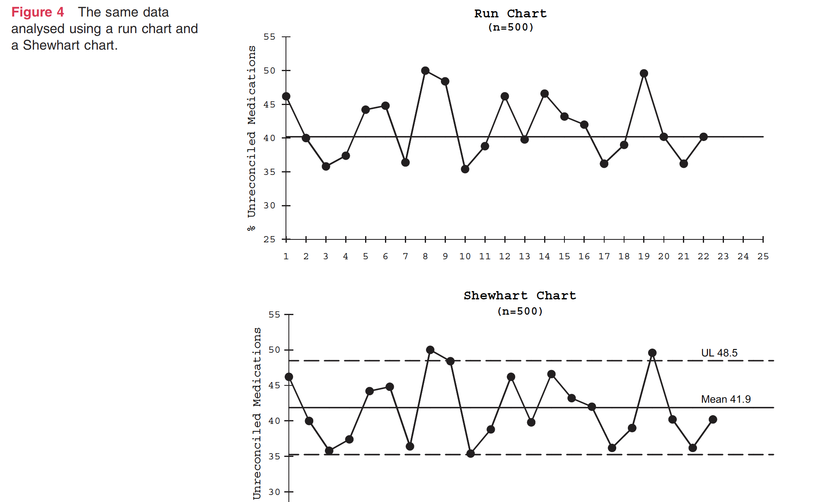
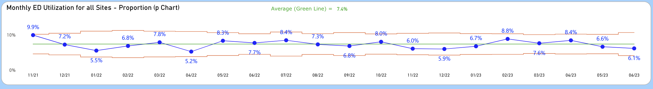
Run Chart (time plot + median)
MEDIAN
SPC Chart
(time plot + mean + control limits)
MEAN
Notes:
SLIDE SCRIPT: You have previously learned about Run Charts, which are a simple and effective approach for measuring and assessing variation in improvement work. Run Charts are time plots with a median line added. Remember that the median is the middle value in a distribution and is shown as the center line in a Run Chart.
[ANIMATE] In comparison, SPC Charts are time plots with a mean line and control limits added. Remember that the mean is the average of all values. In this picture, the mean line is green and the control limits are red. Like Run Charts, SPC Charts can detect Shifts and Trends, but unlike Run Charts they can also detect significant point variations compared to the mean value, shown as points outside of the control limits.
INSTRUCTOR NOTES: Focus on framing the descriptive differences between Run Charts and SPC Charts and making the initial leap from the former to the latter.
TIME: 60 seconds

Slide 6
Why use Statistical Process Control Charts?
Longitudinal monitoring and benchmarking
Better sensitivity to detect non-random changes (special cause signals)
Ability to detect differences in magnitude as well as shifts and trends
Predict stability (statistical control) and near-term future performance
Ability to determine if improvements are sustained
Excerpt from IBD Qorus QI Reporting System, used with permission (2021)
Notes:
SLIDE SCRIPT: In many cases, SPC Charts are used in combination with or after initial use of Run Charts to guide improvement work. There are instances where SPC may be preferred because it allows for:
Longitudinal monitoring and benchmarking
Better sensitivity to detect non-random changes or special cause signals
Ability to detect differences in magnitude as well as shifts and trends
Predict stability (statistical control) and near-term future performance
Ability to determine if improvements are sustained
In summary, when compared to Run Charts, SPC Charts have increased sensitivity, rigor, and predictive capability.
INSTRUCTOR NOTES: The goal here is to introduce rationale for when SPC might be considered.
TIME: 60 seconds

Slide 7
Deriving SPC Theory from Distributions
Proportion of data by SD (σ) in a normal distribution
99.7%
95.5%
68.3%
In SPC, “Sigma” (σ) = Standard Deviation
Sigma are the average distance of data from mean
Normal distributions are not required for SPC.
Slide Courtesy of:
Matthew Niedner, MD Director of quality & Safety, PICU
Assistant Professor of Pediatrics CS Mott Children’s Hospital University of Michigan
-3SD
-2SD
-1SD
MEAN
+1SD
+2SD
+3SD
Notes:
SLIDE SCRIPT: SPC theory can be understood by using the concept of data distribution, which is like a picture showing how data points relate to their average. Here you see a bell-shaped curve called the 'normal distribution,' commonly used in statistics. The average is at the center of the curve, and we call it the 'mean.’ Deviations from the mean can be used to assess variation – in a normal distribution these are called standard deviations, [ANIMATE] in SPC they are called sigma. The concept of “six sigma” in Lean Six Sigma is derived in part from the idea of trying to keep the variation in the data points within the +3 and -3 Sigma range.
INSTRUCTOR NOTES: Critical part here is to make the connection between the normal distribution concept and SPC, especially the concepts of mean, Standard Deviation, and sigma.
TIME: 60 seconds

Slide 8
Understanding Control Charts
UPPER CONTROL LIMIT (UCL)
-3SD
-2SD
-1SD
MEAN
+1SD
+2SD
+3SD
+3σ
+2σ
+1σ
MEAN
-1σ
-2σ
-3σ
LOWER CONTROL LIMIT (LCL)
← TIME →
Slide Courtesy of:
Matthew Niedner, MD Director of quality & Safety, PICU
Assistant Professor of Pediatrics CS Mott Children’s Hospital University of Michigan
Notes:
SLIDE SCRIPT: Continuing the comparison of a normal distribution to an SPC Chart, we’ll keep our “bell curve” (normal distribution) on its side. [ANIMATE] Each data point was observed at a different time and each falls within a specific “sigma” lane. The display on the right is a statistical process control chart which shows data distribution as a series of data points moving from left to right over time, each of which is a certain distance away from the mean placing it within a certain sigma zone (+ or - 1, 2, or 3).
INSTRUCTOR NOTES: Important part here is “turning the distribution on its side” to illustrate how SPC depicts a data distribution.
TIME: 60 seconds

Slide 9
Types of Variation in SPC
Common Cause “noise”
Special Cause “signal” (two commonly used rules)
UPPER CONTROL LIMIT
+3σ
+2σ
+1σ
MEAN
-1σ
-2σ
-3σ
LOWER CONTROL LIMIT
Any Point(s) Beyond Control Limits (3σ)
“Large Effect Size”
SHIFT
8 Consecutive Points on Same Side of Mean Line
“Small but sustained signal”
Slide Courtesy of:
Matthew Niedner, MD Director of quality & Safety, PICU
Assistant Professor of Pediatrics CS Mott Children’s Hospital University of Michigan
← TIME →
Notes:
SLIDE SCRIPT: The upper and lower control limits of an SPC Chart are set at +3 and -3 sigma. [ANIMATE] On the left the points all fall within the control limits, indicating common cause, or random, variation. [ANIMATE] On the right there is one point above the upper control limit, indicating nonrandom variation because the value is significantly higher than the mean.
The shift and trend detection rules you learned for run charts can also be used in SPC. [ANIMATE] Here a downward shift is shown of 8 or more consecutive points below the mean. We have adopted IHI rules, which include 3 sigma control limits, 8-point shifts, 6-point trends, and any points outside the upper or lower control limits.
INSTRUCTOR NOTES: Here we illustrate how SPC depicts a data distribution and how this can be used to assess common and special cause variation (detect special cause signals).
TIME: 90 seconds

Slide 10
SPCC Interpretation: The “Big 3” Analysis
2) Range (Precision) = Highest-Lowest Point (67 – 43 = 24)
1) Central Tendency: Mean (average) = 53
3) Downward Shift
Notes:
SLIDE SCRIPT: SPC analysis can range from simple to complex- we're going to review the "Big 3", which is a simple yet powerful way to understand your data.
[ANIMATE] The first step of the Big 3 analysis is the measure of central tendency which is the mean at 52.8 This is the average performance level of this data set.
[ANIMATE] The second step of the Big 3 is the range, or precision, which is calculated by subtracting the lowest value from the highest value – a range of 24 in this example. A wider range indicates lower precision and a tighter range indicates better precision.
The third step of the Big 3 is to assess for special cause signals - shift, trends, or points outside of the 3 sigma control limits. [ANIMATE] Here we see one point above the upper control limit and a downward shift circled in red. The presence of one or more special cause signals indicates nonrandom variation compared to the mean. These signals inform teams to investigate what has happened as they are likely not by chance.
INSTRUCTOR NOTES: Critical part here is to introduce the “Big 3” assessment approach.
TIME: 30 seconds

Slide 11
Don’t Forget to Annotate Your SPC Chart
New residents started
PDSA #1 started here
Notes:
SLIDE SCRIPT: Once your team understands the context that led to special cause variation, it is recommended to annotate the SPC Chart to show this to your audience.
INSTRUCTOR NOTES: This slide can be covered quickly, main point is to show how a Big 3 analysis can be visually summarized, and the importance of adding annotations. It is animated so you can emphasize each part separately.
TIME: 20 seconds

Slide 12
Application – Responding to Variation
Algorithm for Addressing Variation
Identify the Cause:
If Positive: “Maximize, optimize, replicate, or standardize.”
If Negative: “Minimize or eliminate”
Special Cause Variation
(Unpredictable)
Reduce Variation (Increase Precision):
Make the process even more reliable.
Sub-Optimal Average Performance:
Redesign process to get a better result.
Common Cause Variation
(Predictable)
Miltner, RS, Quality Improvement Models: PDSA, HQS, 2016
Notes:
SLIDE SCRIPT: When teams see special cause variation, they should investigate and take action based on whether it is in the desired direction or not.
If common cause variation is observed, assess the mean to see how close it is to the goal and assess the range to see if the degree of variation observed is acceptable. If these conditions are met, then no action is required. If the mean is too high or too low, or if the range is too wide, action can be taken to improve the mean and/or precision.
It should be noted that these two states are connected; as improvement efforts are attempted, special cause signals may be observed indicating improved performance as seen in the top row which if sustained eventually establish a new baseline pattern that, if sustained, falls into a new common cause variation pattern as seen in the bottom row.
INSTRUCTOR NOTES: Measurement is only useful if it informs improvement. The important part here is to show why identifying the variation pattern is important to link the variation type to the improvement interventions.
TIME: 30-60 seconds

Slide 13
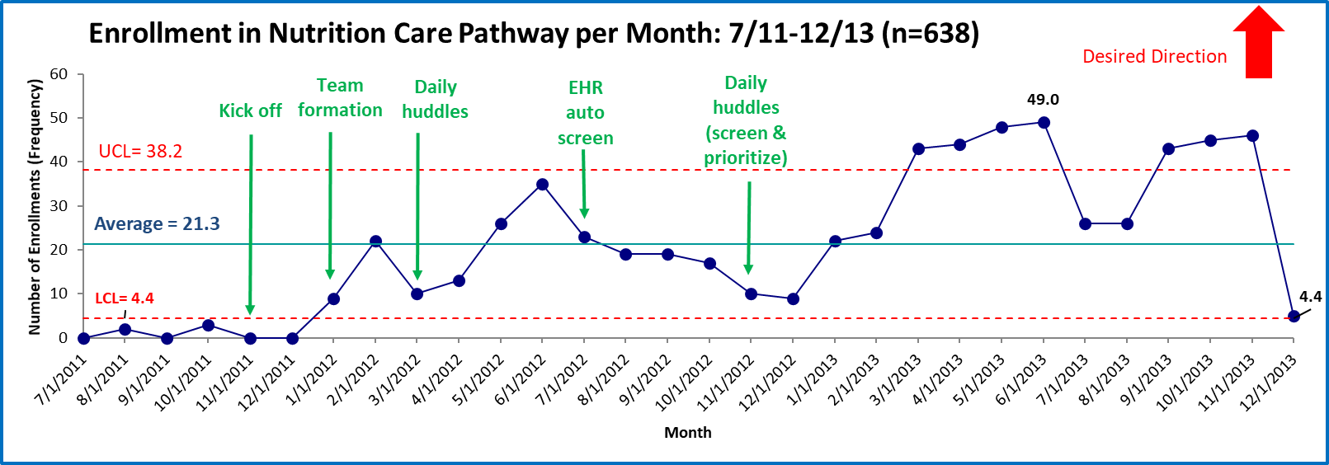
Big 3 Exercise: Interpretation
“Big 3” Summary
Mean (Average) = 21.3
Range (Precision) = 49 – 4.4 = 44.6
Notes:
Answers slide: Now you try one! This is a SPC Chart tracking participant enrollment for an improvement initiative. Assess the Big 3 and then advise the improvement team on next steps based on your findings.
First let’s find the mean – can anyone volunteer to identify the mean? (pause to let audience respond). [ANIMATE] The mean here is 21.3.
Next, who can identify the range? (pause to let audience respond). [ANIMATE]. The range is the difference between the highest and lowest points – 49 minus 4.4, or, 44.6.
Next, we’ll look for different variation types.

Slide 14
Big 3 Exercise: Interpretation
Special Cause Signals
Shifts (8 points)
Trends (6 points)
Points outside of the UCL or LCL
Notes:
Slide Script: Remembering our special cause rules from Run Charts [ANIMATE], let’s look for any shifts, trends, or points outside the control limits. Can anyone volunteer to identify a shift? (pause to let audience respond). [ANIMATE] Here we have a shift starting in February and continuing until November, when it is broken by a drop in enrollments. Now let’s look for any trends, do you see them here? (pause to let audience respond). [ANIMATE] The first trend is downward going from June to December. [ANIMATE] The second starts immediately after, going upward from December to June 2013.
Finally, let’s look for points outside the control limits – can anyone identify those? (pause to let audience respond).
Instructor notes: When looking for points outside the control limits, note that there are several options! July, August, September, October, November, and December 2011 are all outside the Lower Control Limit (LCL), and March, April, May, June, September, October and November 2013 are all outside the Upper Control Limit (UCL). These are all individual Special Cause signals that warrant further investigation.

Slide 15
Big 3 Exercise: Interpretation
“Big 3” Summary
Mean (Average) =21.3
Range (Precision) = 49-4.4= 44.6
Variation Type = Special Cause
What to do: Investigate, sustain, optimize the increases
Special Cause Signals
Shifts (8 points) = 1
Trends (6 points) = 2
Points outside of the UCL or LCL = 13
Notes:
Slide Script: Based on what we identified, what can we learn about our system?
Instructor Notes: Encourage audience to discuss what might be happening.
Examples include (add your own as well):
What PDSAs worked? (Daily huddles may have been helpful; EHR auto screen did not appear to increase enrollment)
What happened during November and December 2012? (Could this decrease be attributed to holidays? Did the improvement team keep working?)
What would we like to know more about? (We need annotations for February – November 2013 to understand what is driving these increases in enrollment!)

Slide 16
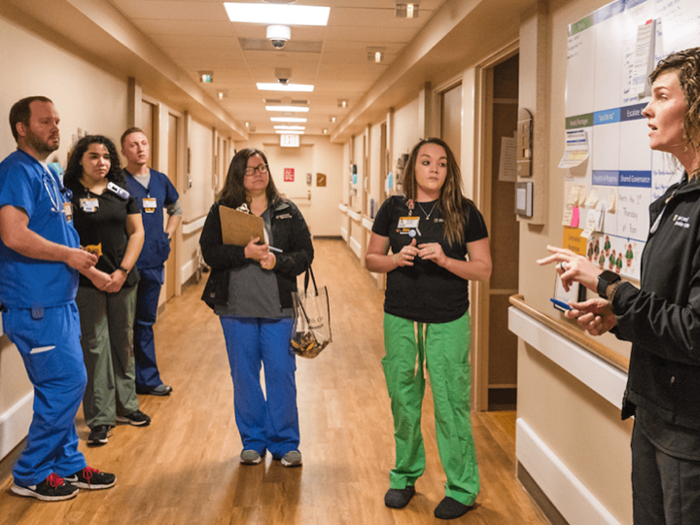
Use SPC Charts to Anchor Your Team Huddles & Meetings
Notes:
SLIDE SCRIPT: SPC Charts are a powerful visual representation of your data over time and can be used by improvement teams to inform improvement work during every meeting or huddle. Using SPC Charts can help teams interpret the impact of the PDSAs being tested, illustrating how PDSA cycles affect the measure of interest.
INSTRUCTOR NOTES: Focus on how SPC can be used by improvement teams in basic terms.
TIME: 15 seconds

Slide 17
Summary
Statistical Process Control is a measurement approach used to study variation to inform improvement.
It is often used in combination with or after initial use of Run Charts.
Identifies measurable improvement, can also be predictive and assess sustainability.
Often used in larger scale improvement or longitudinal monitoring situations or when better statistical rigor and sensitivity are needed.
Notes:
SLIDE SCRIPT:
INSTRUCTOR NOTES: Summary of the session high points
TIME: 15 seconds

Slide 18

Resources
Articles:
Benneyan JC, Lloyd RC, Plsek PE. Statistical process control as a tool for research and healthcare improvement. BMJ Quality & Safety 2003;12:458-464.
Videos:
Institute for Healthcare Improvement Video 1
Institute for Healthcare Improvement Video 2
Statistical software that creates SPC Charts for you (free trial/subscription required):
QI Macros
SPC XL
Minitab
Notes:
SLIDE SCRIPT:
Here are some resources for you to explore, that may be found in the supplemental lesson materials including two helpful instructional videos from the Institute for Healthcare Improvement, and web-based applications to help you in creating your own statistical process control charts.
TIME: 30 seconds

Slide 19
Next Steps
ACTIVITY | MATERIALS
Review SPC Lesson and share with key members of your team | SPC micro-lesson powerpoint
Review the SPC Charts in your monthly IBD Qorus data report | Monthly Measures Report
Share your SPC Chart | Use an SPC Chart in your Data Driven Improvement Story – don’t forget to annotate!
TEAM FORMATION
Notes:
SLIDE SCRIPT: In a continuous quality improvement collaborative like IBD Qorus, you don’t have to be in an Action Period of an Improvement Initiative to be collecting and learning from your data. Feel free to share this lesson with key members of your team; start or continue to collect data for your QI reports; and when you receive your monthly report, set aside time to review the SPC Charts with your team to look for areas in which you can start to improve!
INSTRUCTOR NOTES: None
TIME: 15 seconds

